Slide 1
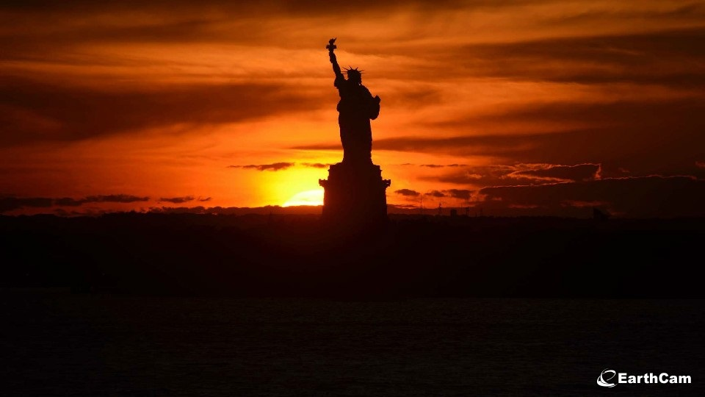
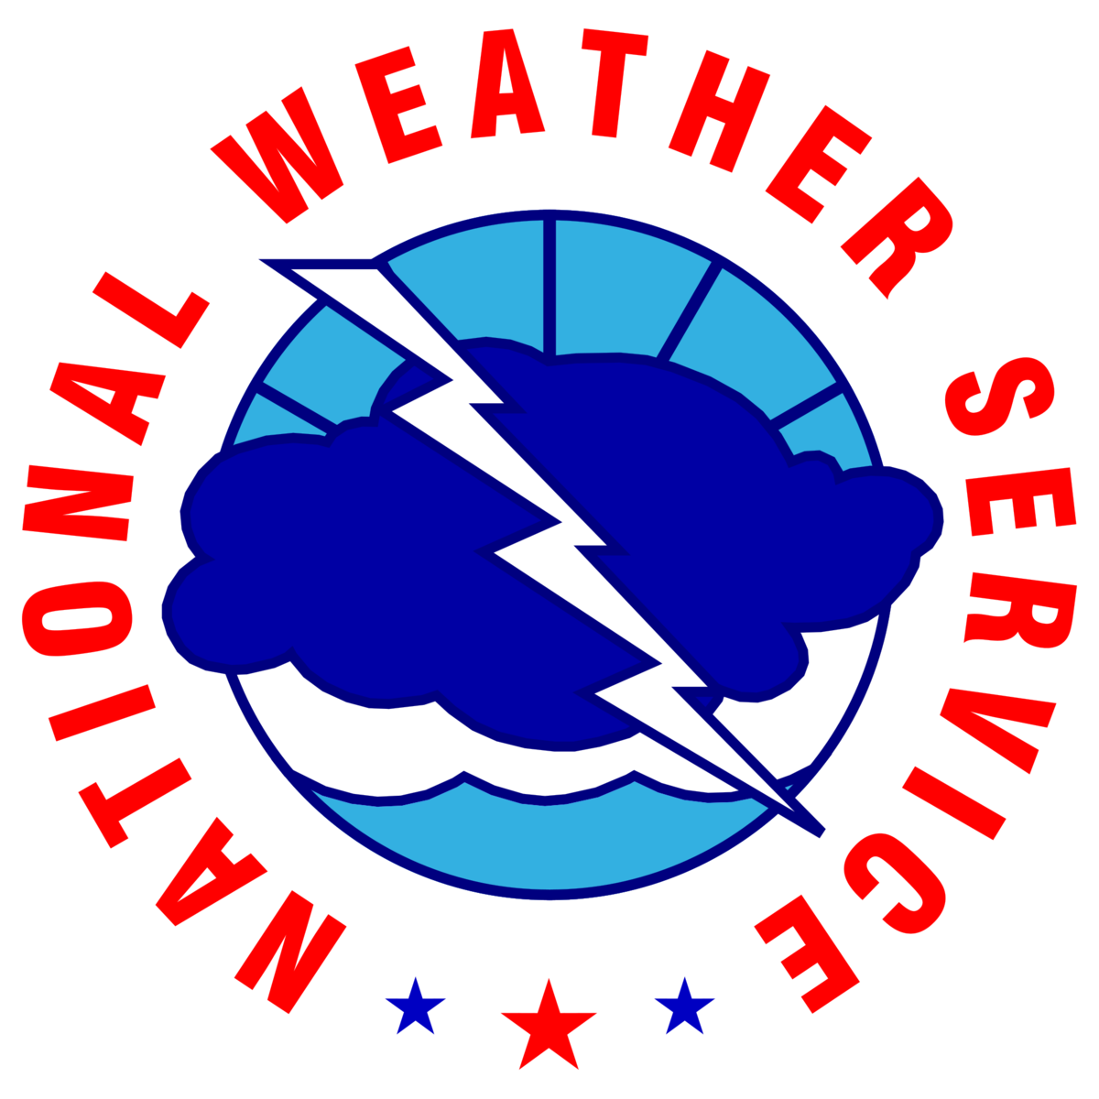
Utilizing an Improved Analysis from the NYC Micronet to Monitor, Forecast and Communicate Extreme Temperatures Across New York City
September 13th, 2022
Dave Radell, NOAA/NWS WFO New York, NY (OKX)
Nick Bassill, UAlbany Center of Excellence/NYSM
Dimitri Ambroise, NOAA/EPP NERTO/CCNY

Slide 2
Project Objectives
Hofstra Univ. Observation Locations
Monitor, Forecast, Communicate.
1. Can NYC Micronet data/analysis assist in further defining where NWS Excessive Heat Products are issued?
2. Are available numerical weather forecasts capable of simulating the observed spatial and temporal variability of extreme temperatures across New York City?
3. Are alternative forecast heat elements, like Wet Bulb Globe Temperature (WBGT), more effective in communicating the excessive heat threat?

Slide 3
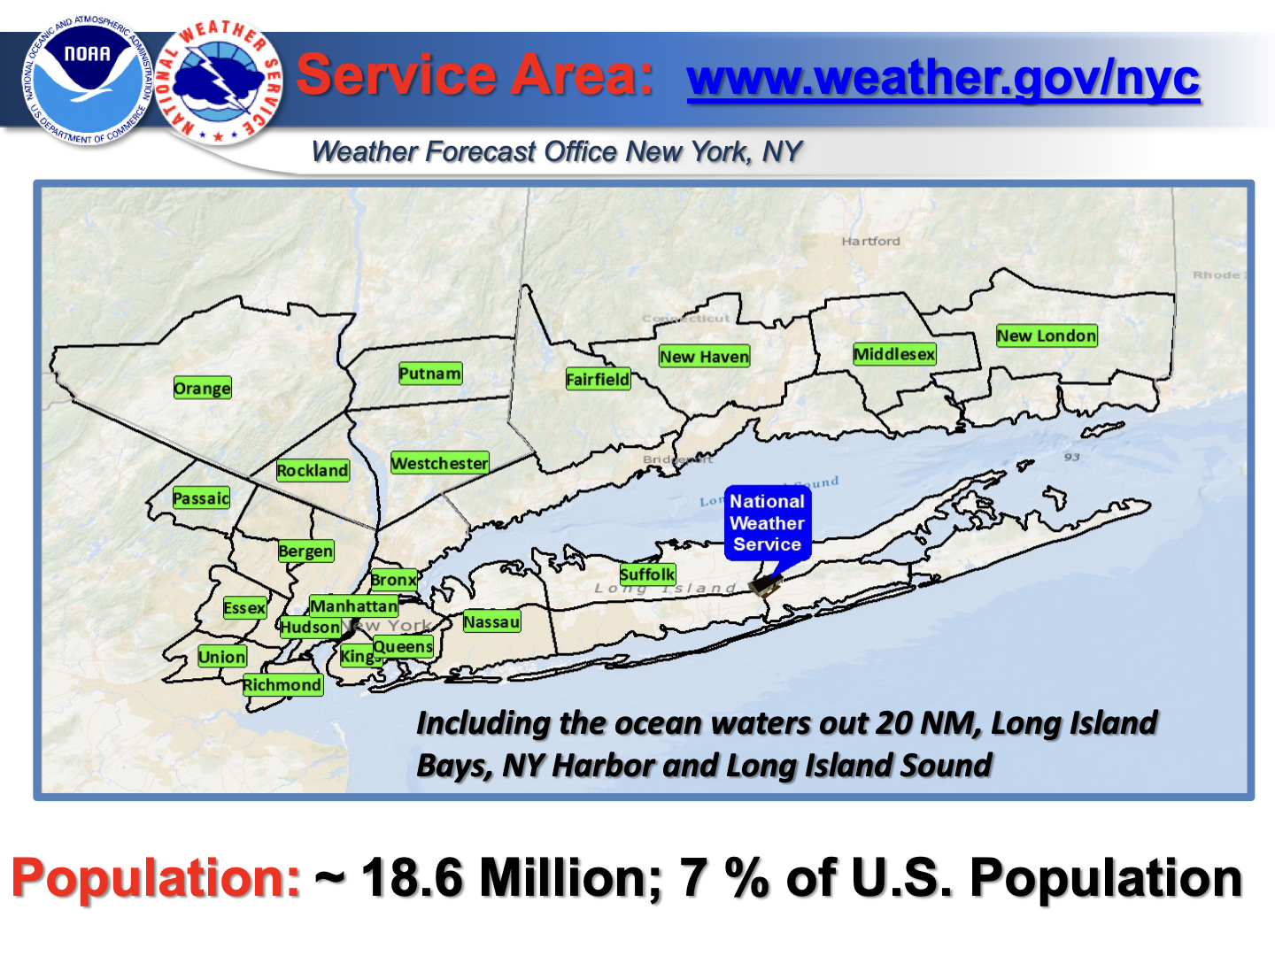
40
X

Slide 4
Weather Related Fatalities, 1990-2021
Source: US National Hazard Statistics

Slide 5
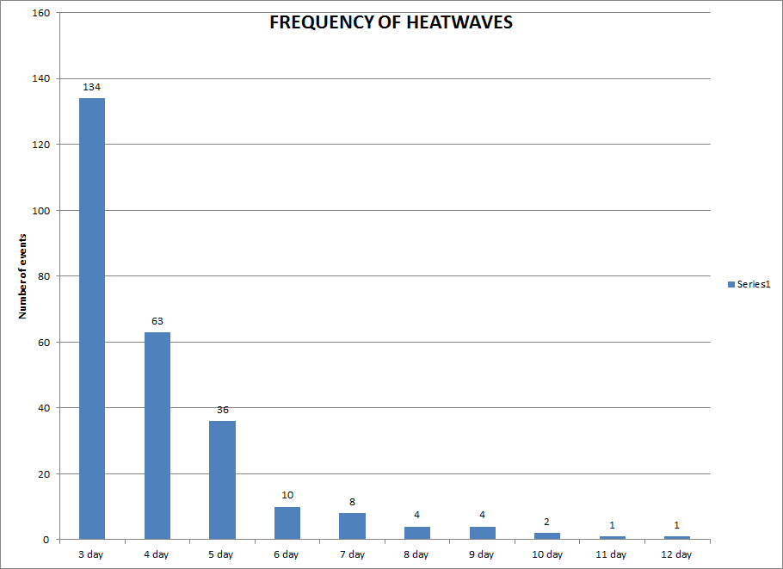
NYC Heatwave Frequency, 1876 - 2011
(1 per year)
(1 every 2 years)
(1 every 4 years)
(1 every 12 years)
Heat wave defined as 3 days where high temperature >= 90⁰.
2022: NYC/JFK 6 days, ending 7.24

Slide 6
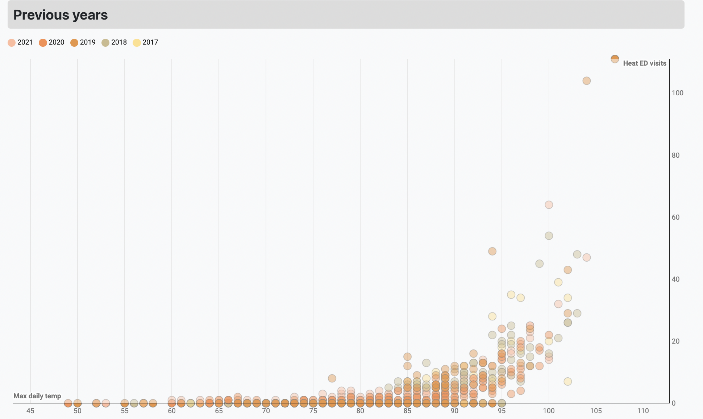
NYC ER Visits for Heat Related Illness (2017-2021)
Courtesy NYCEM
MaxT or Max HI, whichever is greater.
Notes:
Courtesy NYC Office of EM. Note the “outliers” on the ER visits, mostly early season events.

Slide 7
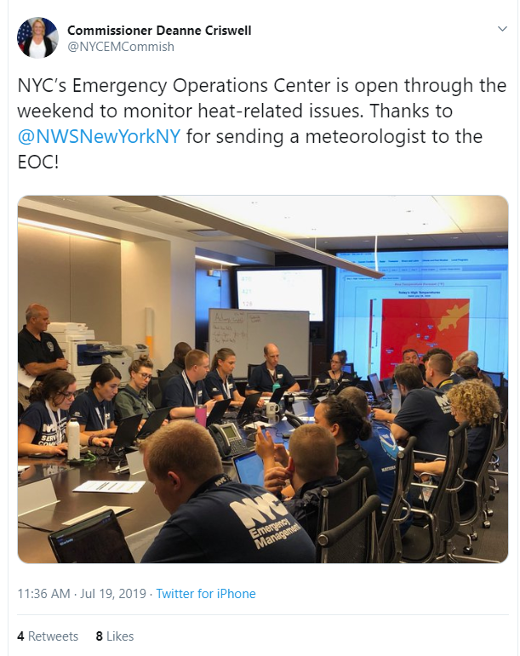
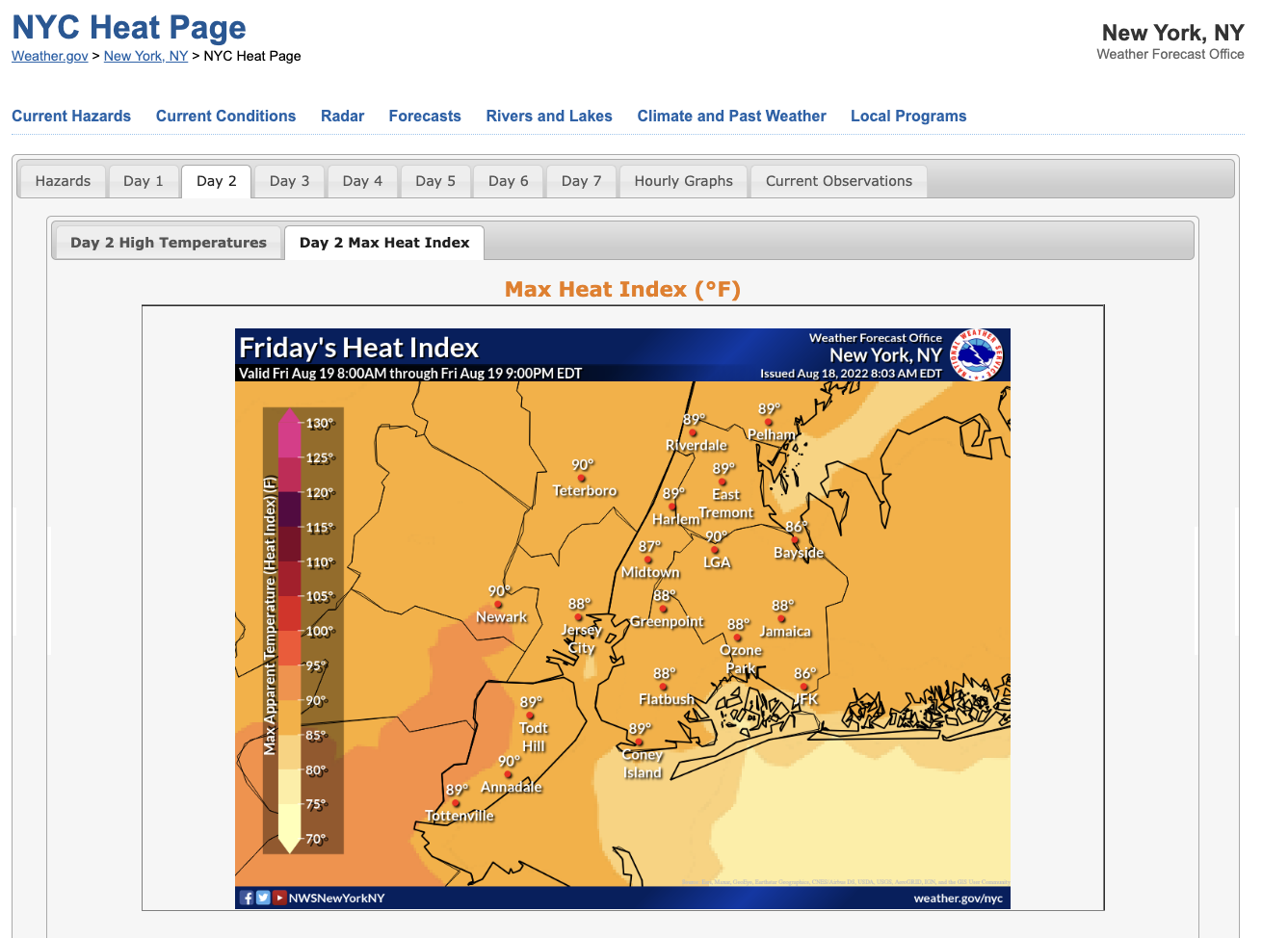
WFO OKX Heat IDSS to NYC
WFO OKX has traditionally provided enhanced heat Impact-Based Decision Support Services (IDSS) to NYCEM. For the triathlon, biking cut to 12.4 miles (from 24.8) and running 2.5mi (from 6.2 miles).
Notes:
*Heat Index of at least 100° F but less than 105° F for any period of time.
*Maximum Heat Index of 95º F or greater for any length of time, occurring on 2 consecutive days.
*Heat Index of at least 105º F for at least 2 consecutive hours.

Slide 8
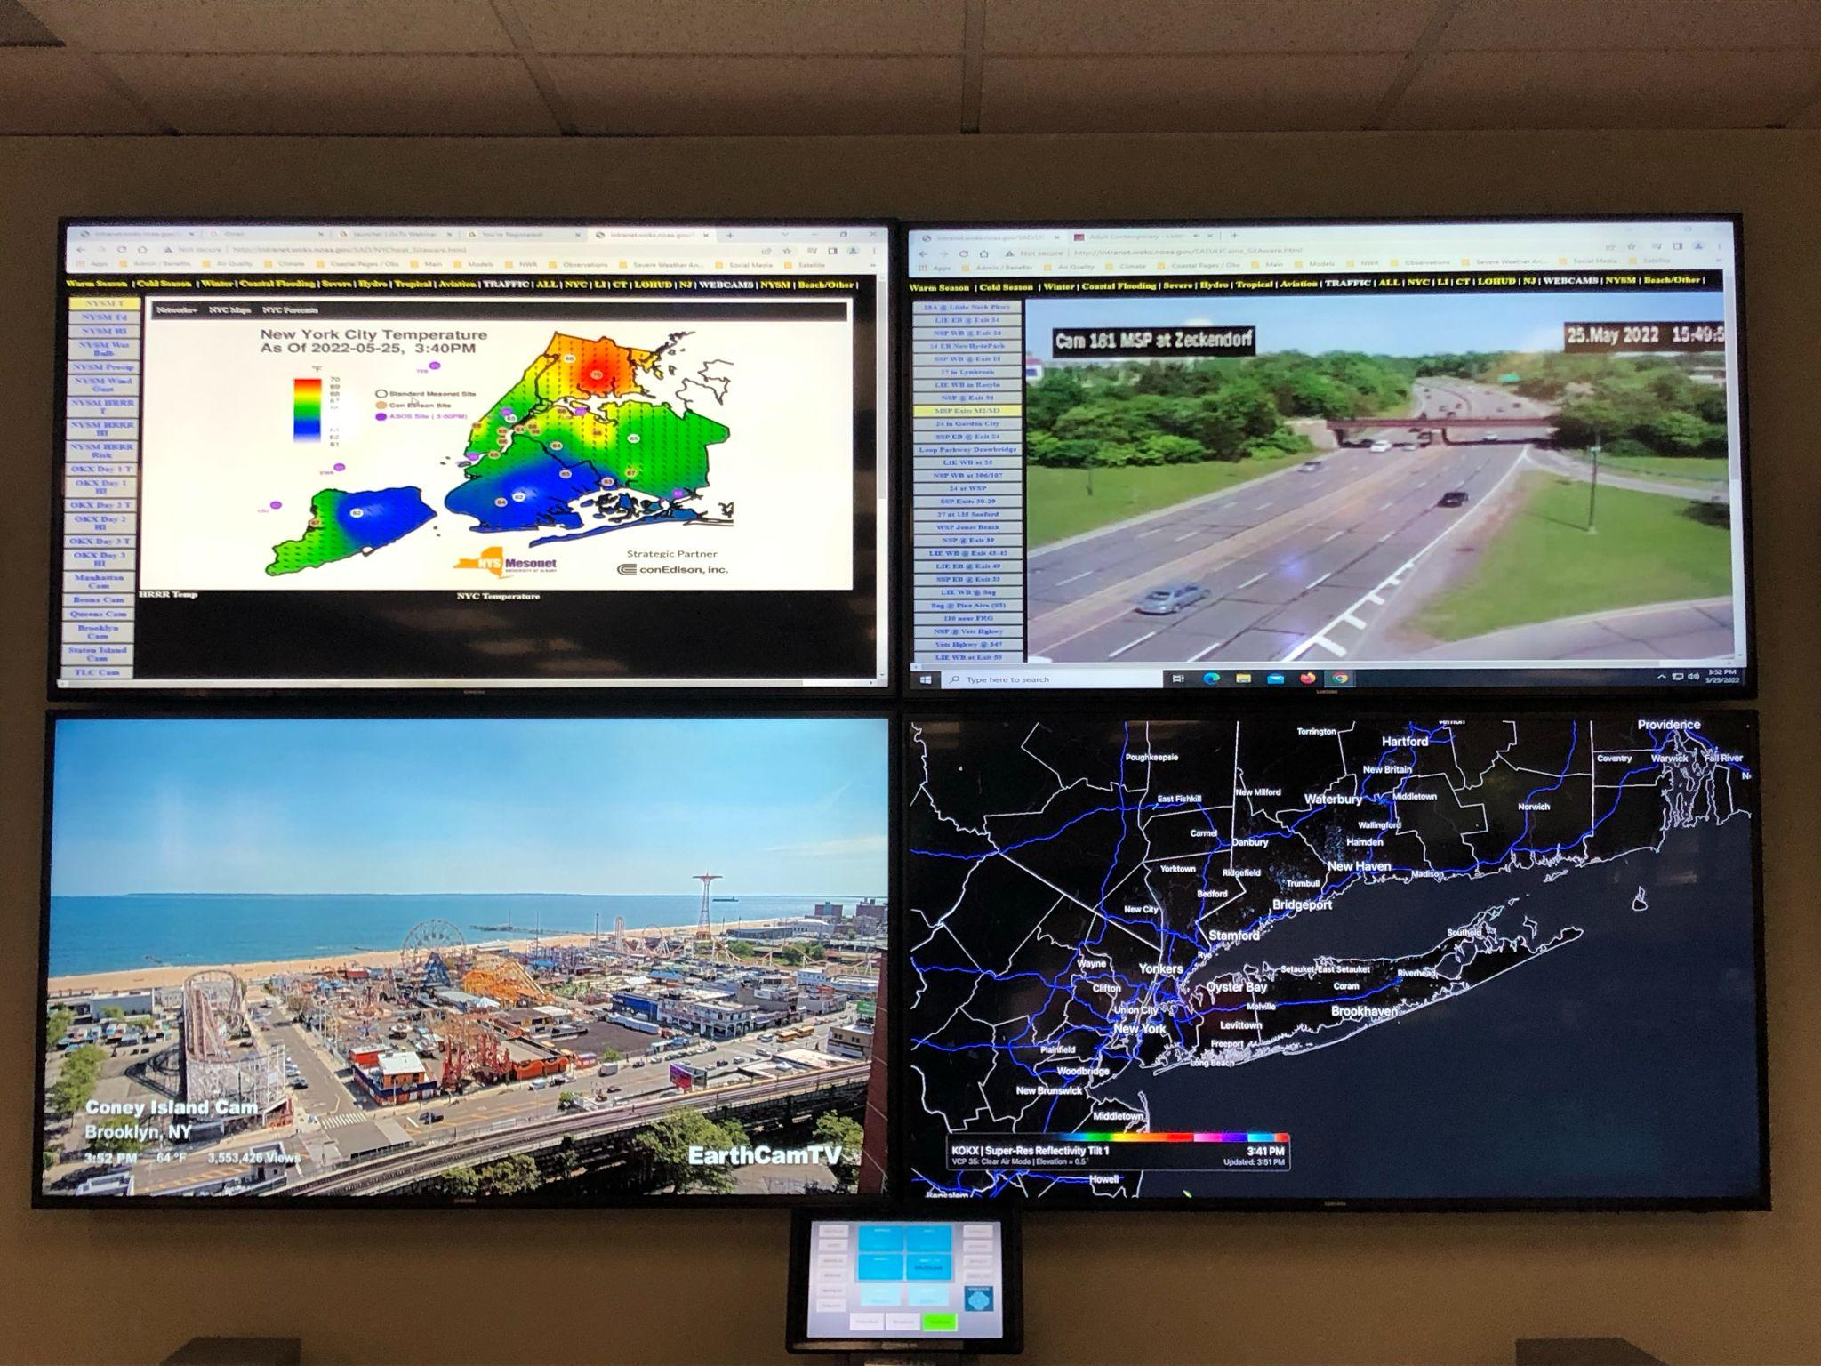
WFO New York Heat Situational Awareness
Hofstra Univ. Observation Locations

Slide 9
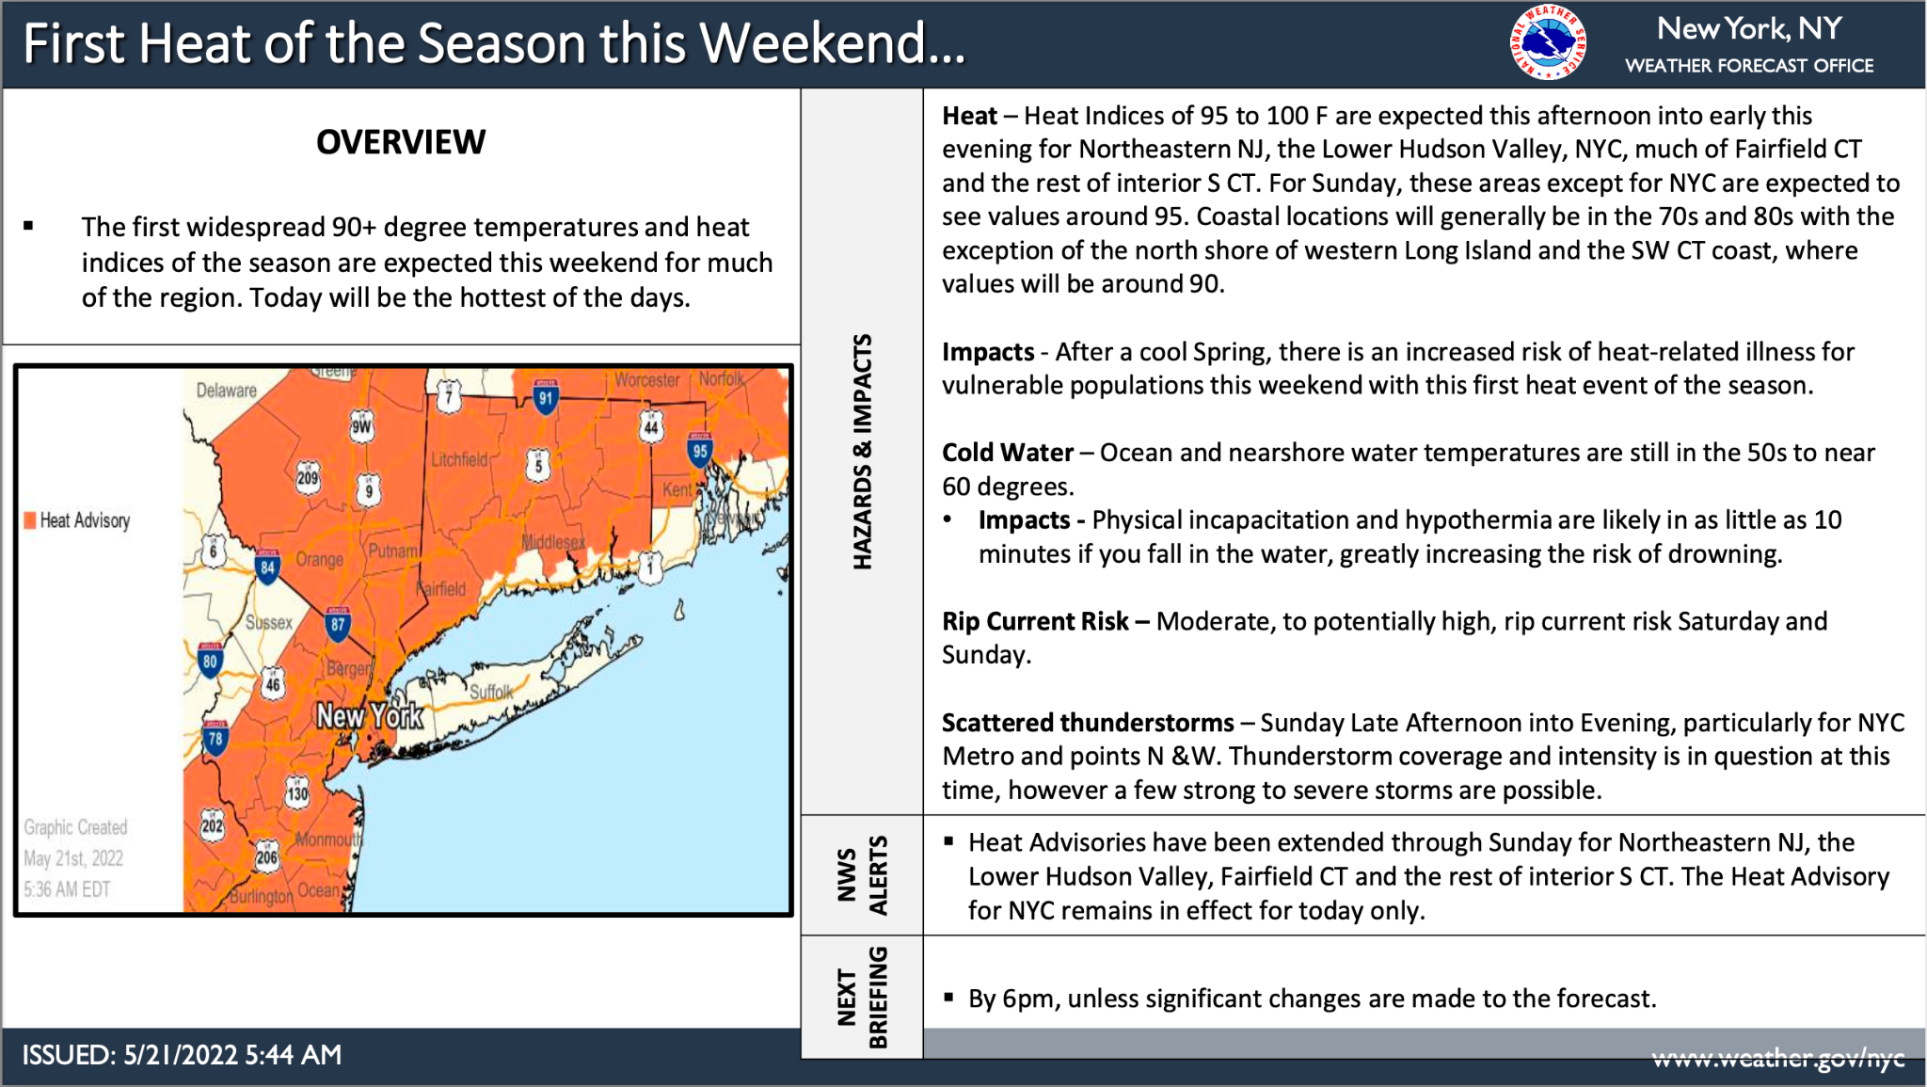
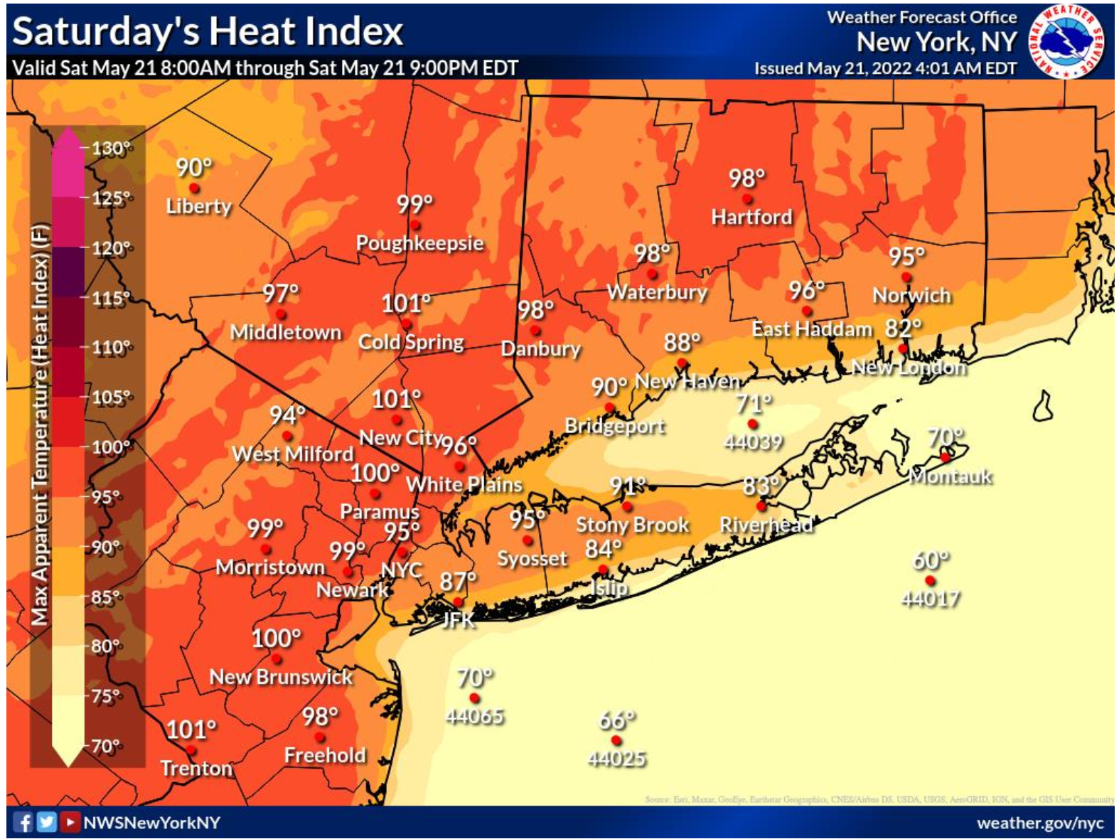
Early Season 2022 Event: May 21st-22nd
(1 per year)
(1 every 2 years)
(1 every 4 years)
(1 every 12 years)
*Heat Index of at least 100° F but less than 105° F for any period of time.
*Maximum Heat Index of 95º F or greater for any length of time, occurring on 2 consecutive days.

Slide 10
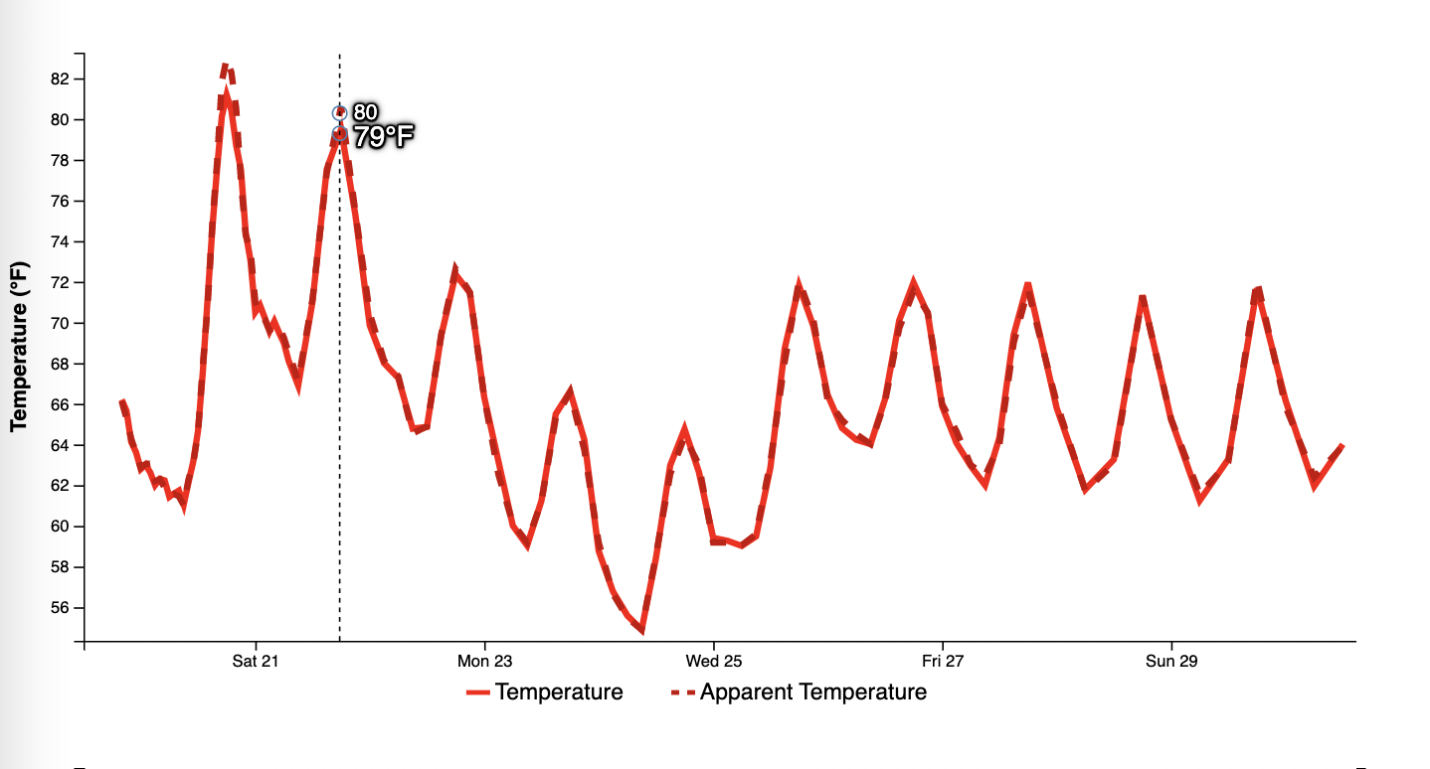
Early Season 2022 Event: May 21st-22nd-National Blend of Models
(1 per year)
KJFK
(1 every 2 years)
(1 every 4 years)
(1 every 12 years)

Slide 11
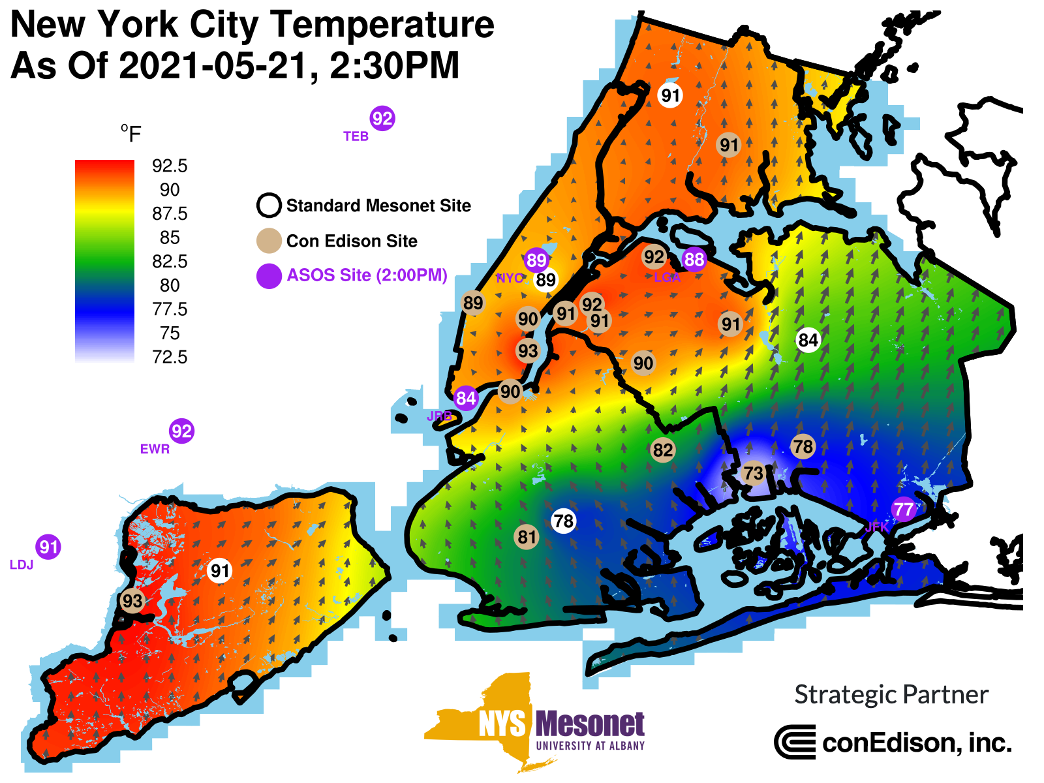
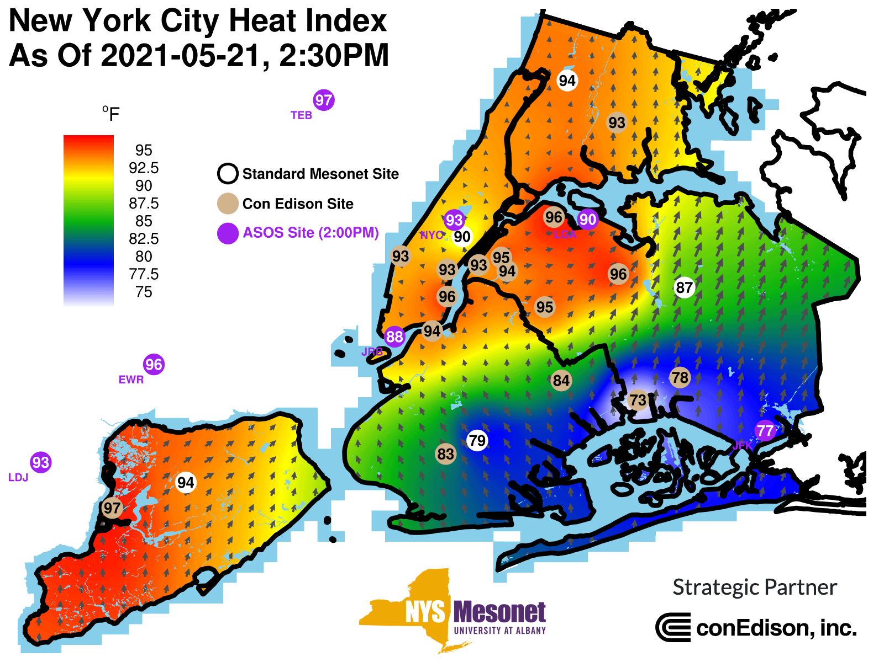
Early Season 2022 Event: May 22nd
(1 per year)
(1 every 2 years)
(1 every 4 years)
(1 every 12 years)

Slide 12
Expanding our Heat IDSS
NWS New York, NY was asked to provide WBGT information for 2019 and 2022 NYC Triathlon. Plus used in other athletic events…
Notes:
*Heat Index of at least 100° F but less than 105° F for any period of time.
*Maximum Heat Index of 95º F or greater for any length of time, occurring on 2 consecutive days.

Slide 13
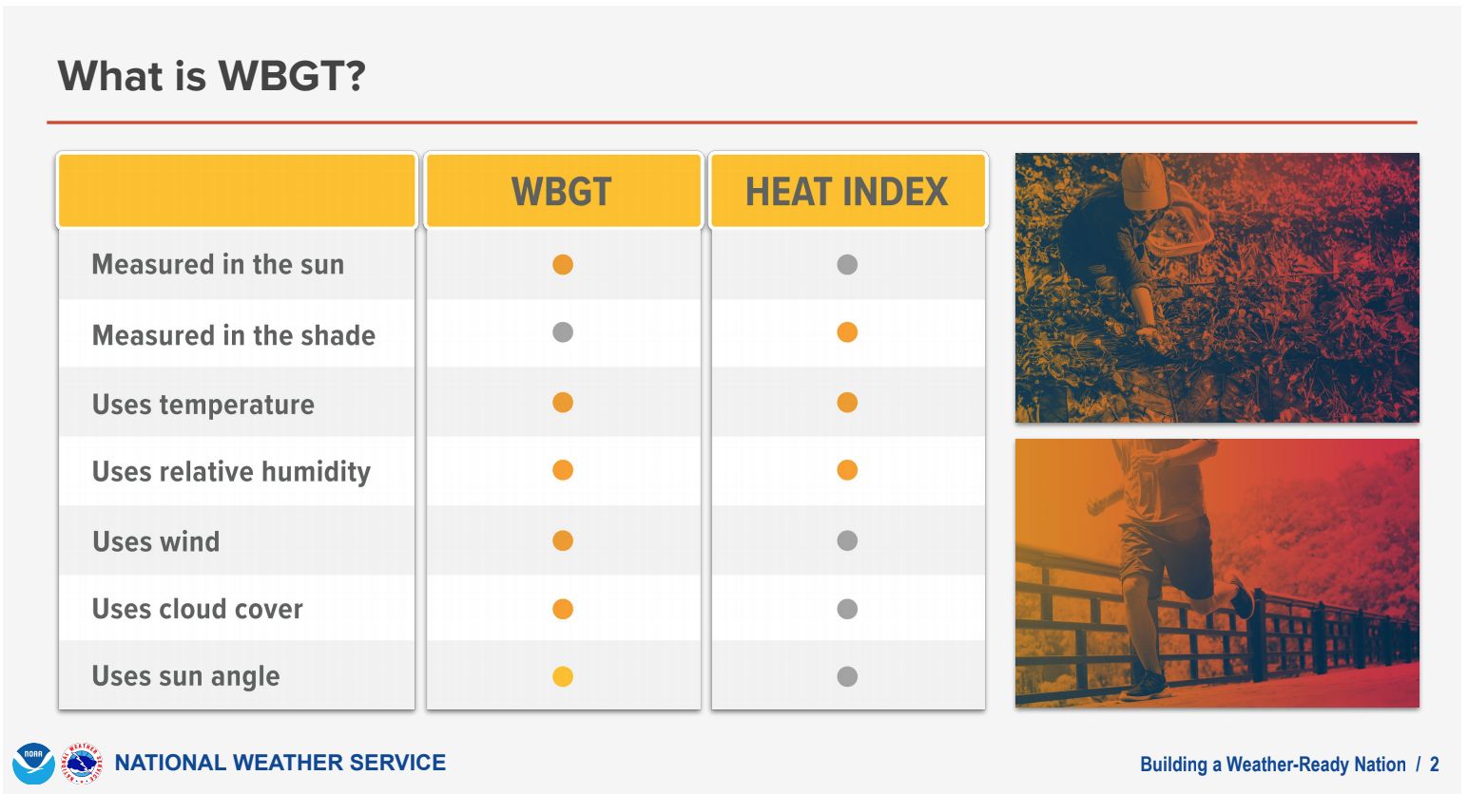
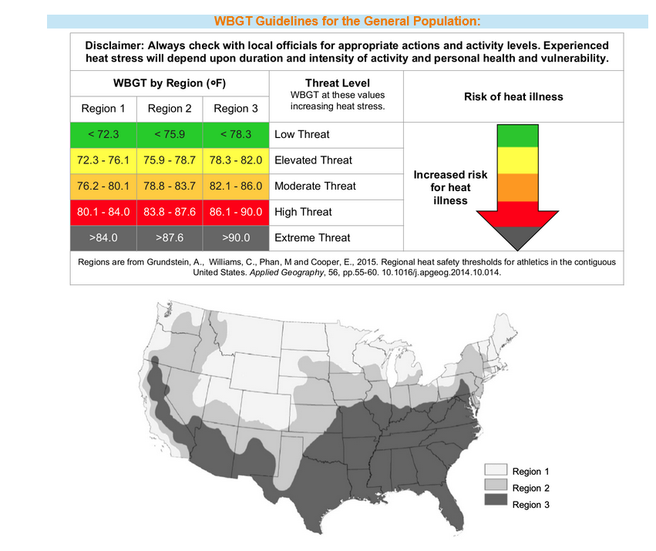
Heat Index Versus WBGT
Is WBGT better “science”? Or better for IDSS???
Notes:
What’s OLD is NEW again! Been around for awhile, literature going back decades.

Slide 14
Forecasts: Experimental NDFD
Hofstra Univ. Observation Locations
Computed at WFO and centrally at NWS/MDL:
T_{w}: Computed from NDFD T, Td, Wind, sky. Solar irradiance from (Hunter and Minyard, 1999).
T_{g}: Hourly solar flux (zenith angle at every grid point) and sfc pressure are computed. NDFD T, Td, Wind, sky also used. 10m fcst winds reduced to 2m.
T_{d}: NDFD Temp
Notes:
Neither Tw or Tg represents perfectly the heat stress on a clothed human….note in this linear weighting technique that Tw carries the most weight. So most error on the inputs would be attributed here.

Slide 15
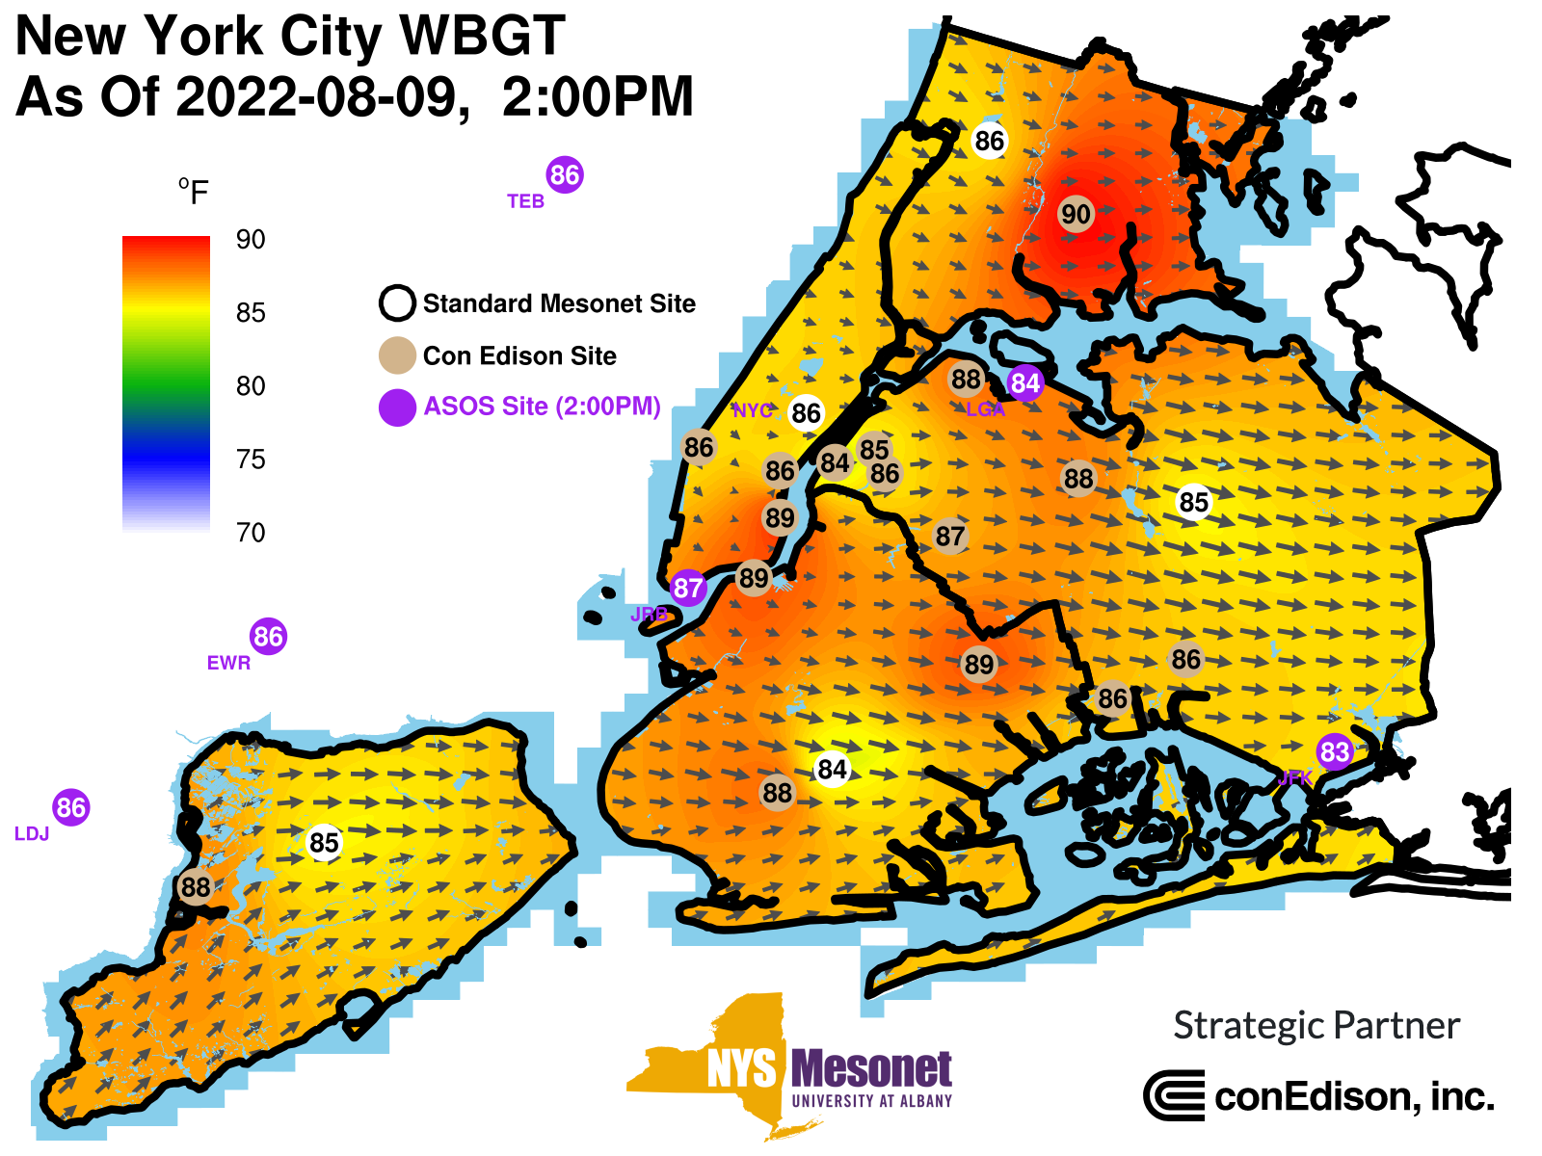
Observations: NYC Micronet
Hofstra Univ. Observation Locations
In summer of 2022, OKX NOAA/EPP/MSI NERTO Student Dimitri Ambroise helped test the code to compute WBGT at the NYSM mesonet/micronet sites.
Methodology:
Similar to NWS.
Winds are reduced to 2m.
Sensitivity to solar zenith angle.
https://operations.nysmesonet.org/~nbassill/NOAA/

Slide 16
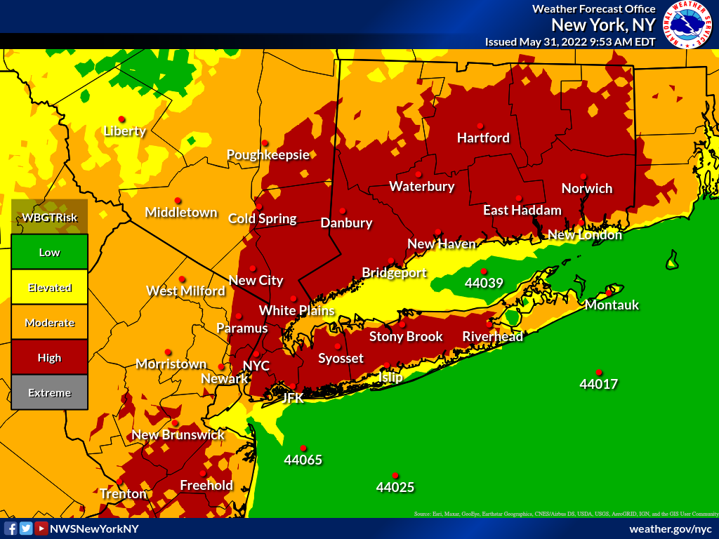
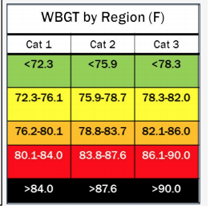
Forecasts: Experimental NDFD and WFO Production
Hofstra Univ. Observation Locations
NYC is split!
Grundstein, Andrew & Williams, Castle & Phan, Minh & Cooper, Earl. (2015). Regional heat safety thresholds for athletics in the contiguous United States. Applied Geography. 56. 55-60. 10.1016/j.apgeog.2014.10.014.

Slide 17
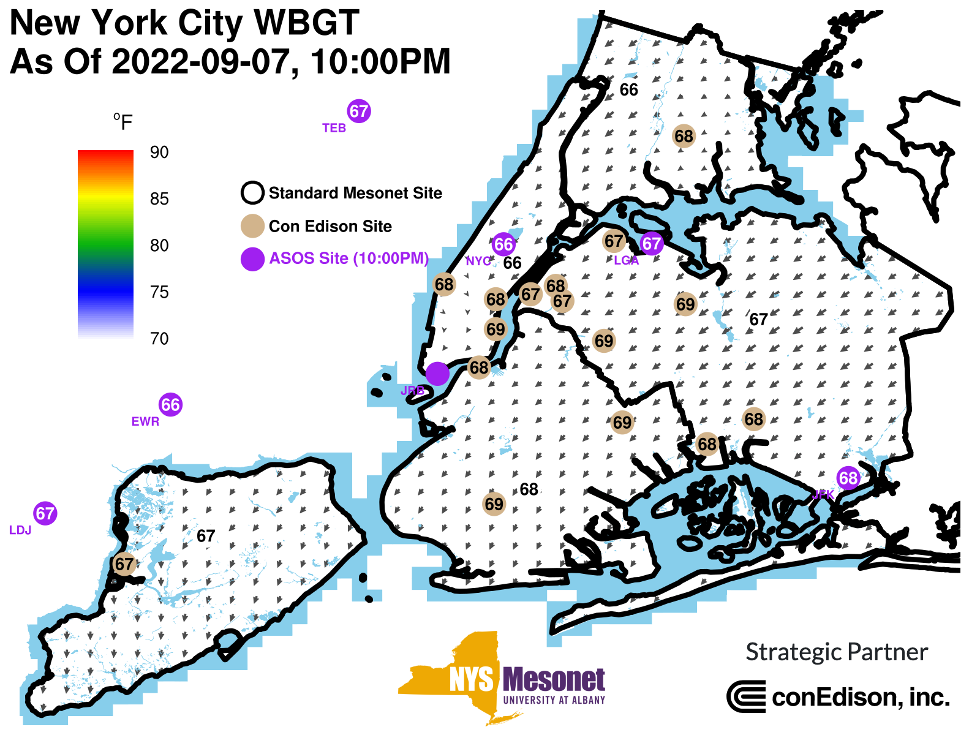
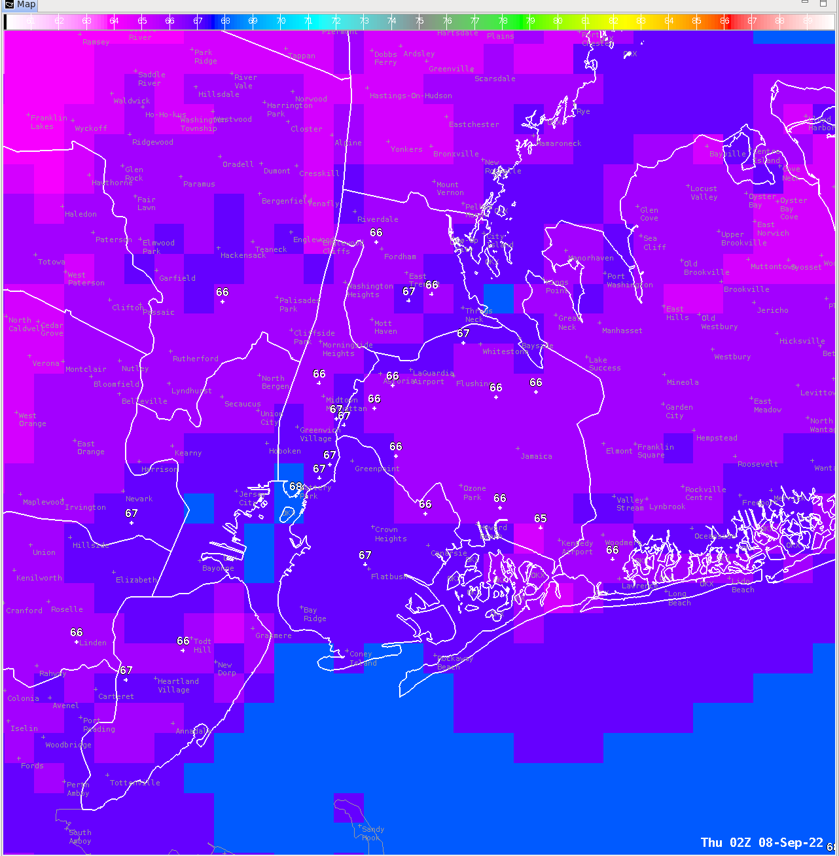
How Good Are the Forecasts?
and
Hofstra Univ. Observation Locations
NYC is split!
10pm NDFD WBGT Forecast

Slide 18
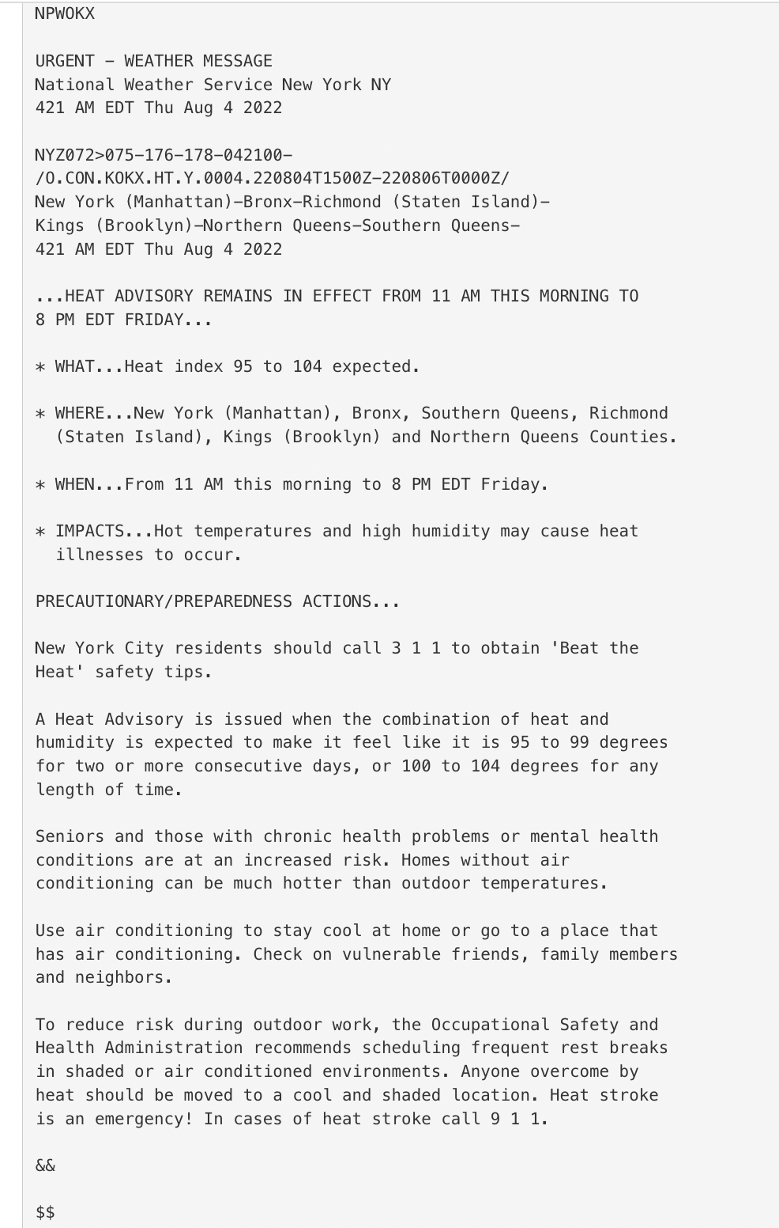
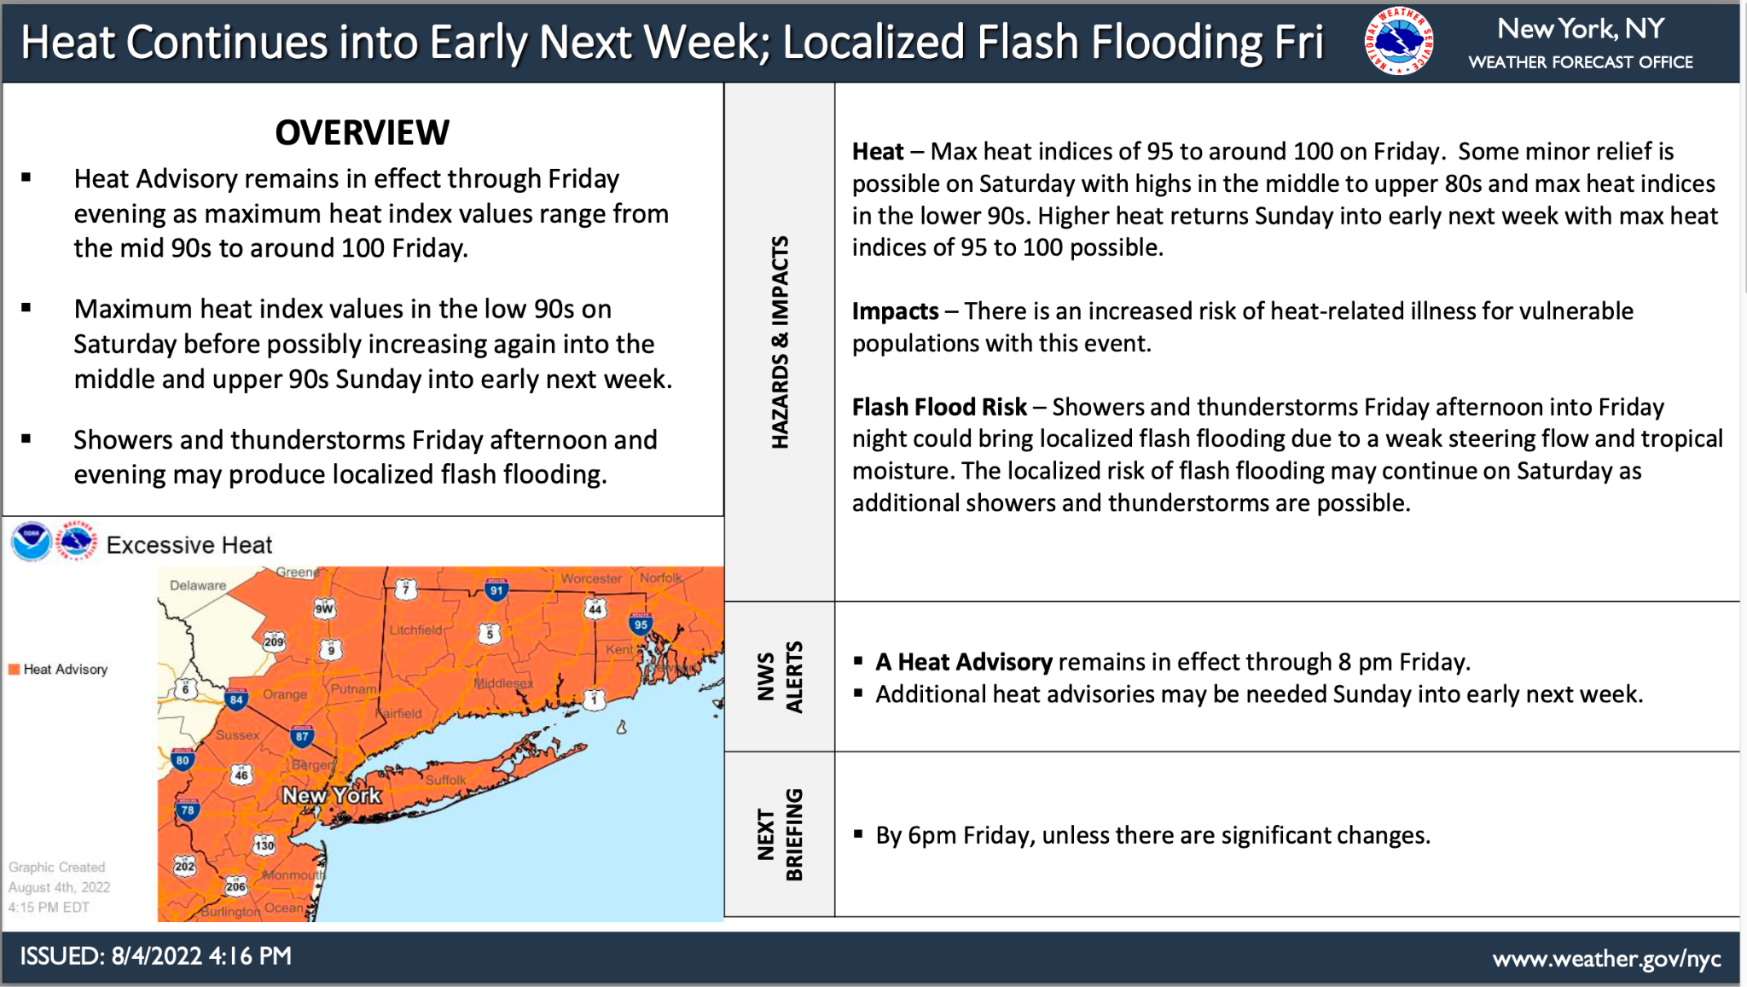
How Good Are the Forecasts?
and
Hofstra Univ. Observation Locations
Early August 2022 Heat Event
NYC is split!

Slide 19
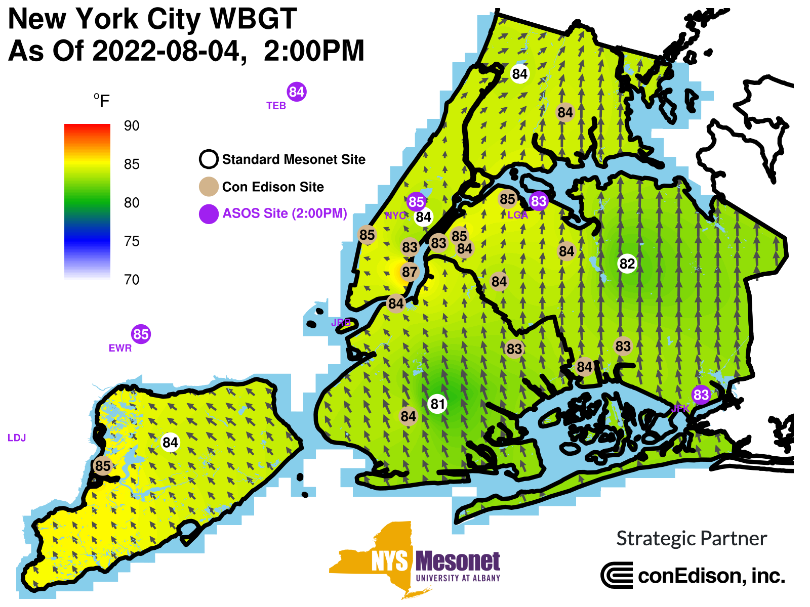
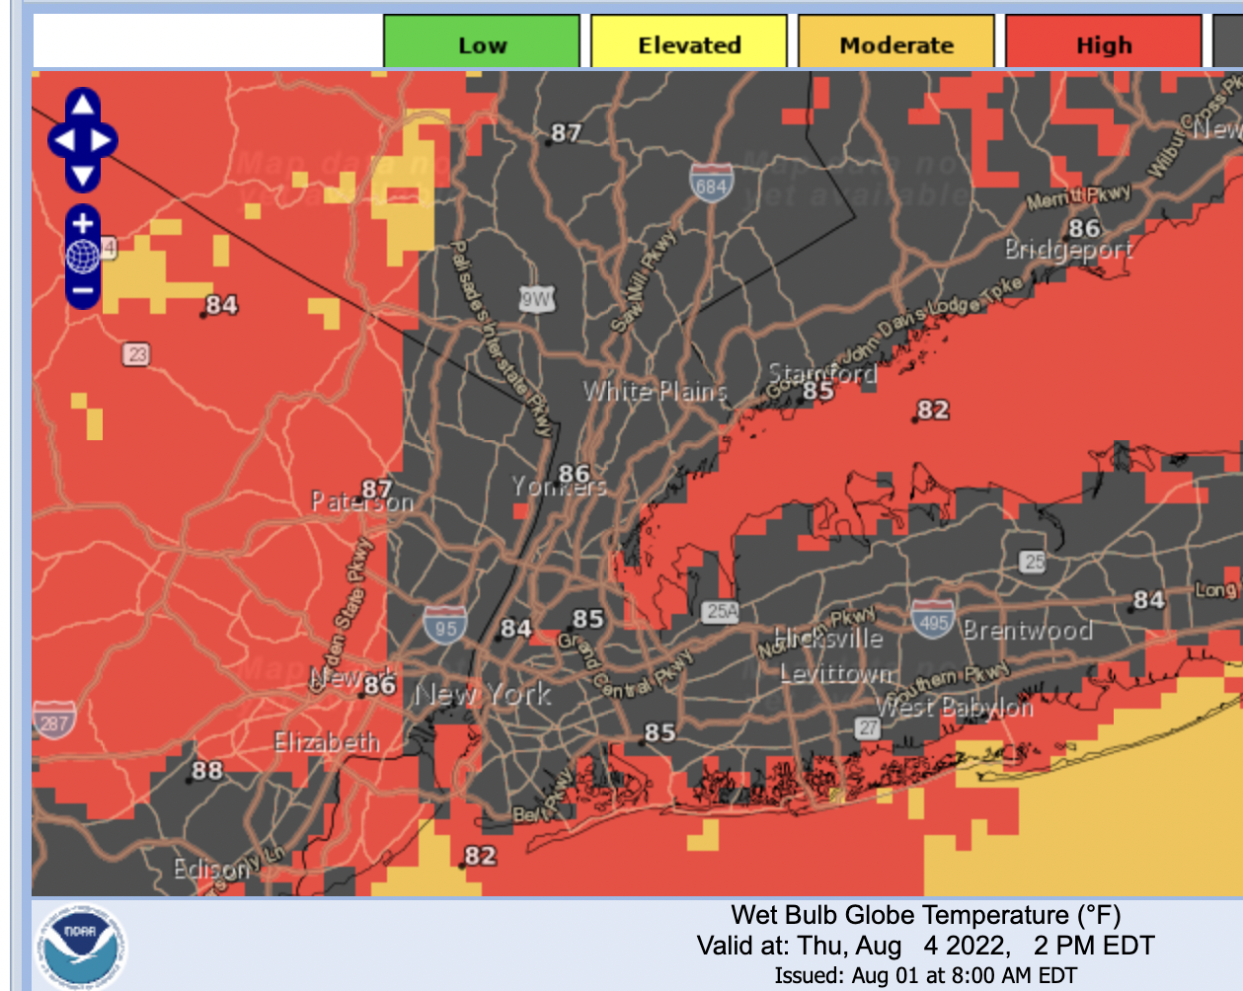
OKX WBGT - 4 August, 18Z Heat Advisory
KNYC | 85 | 84 | -1
KJFK | 83 | 85 | +2
KLGA | 83 | 84 | +1
BX Meso | 84 | 87 | +3
Observation (closest)
Forecast
Fcst Difference
Notes:
Forecasts fairly close. Perhaps a few degrees high bias in the forecast. One category difference–forecast off by about a degree..

Slide 20
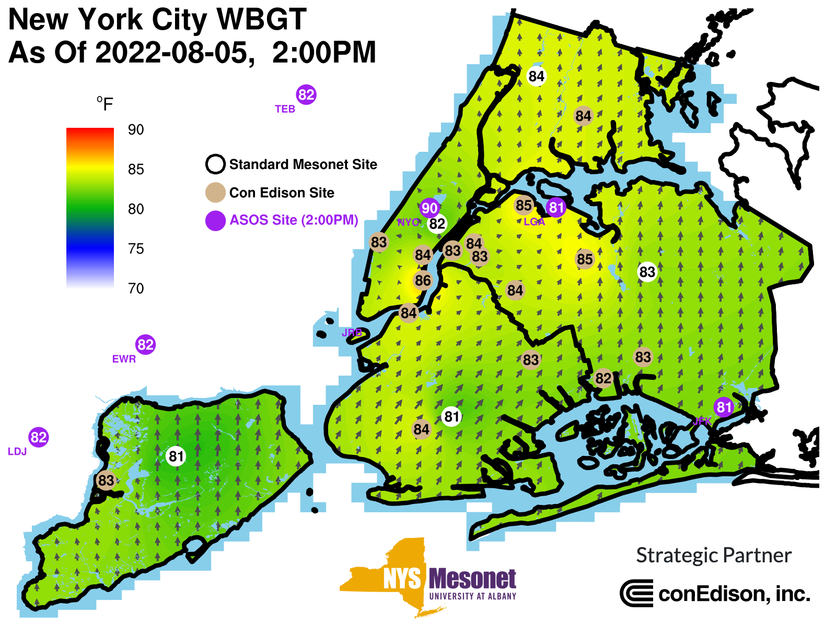
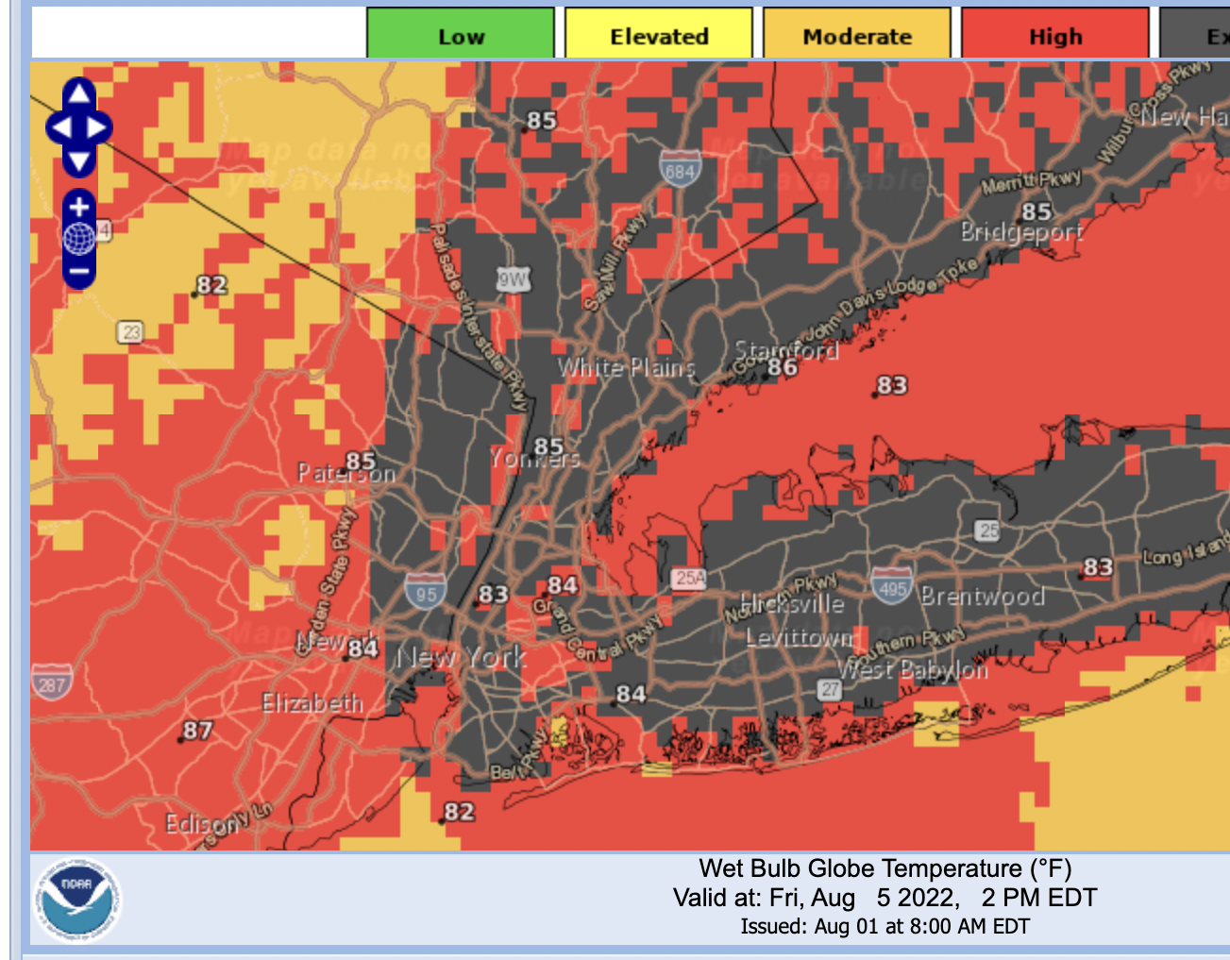
OKX WBGT - 5 August, 18Z Heat Advisory
KNYC | 90 | 83 | -6
KJFK | 81 | 84 | +3
KLGA | 81 | 84 | +3
BX Meso | 84 | 85 | +1
Observation (closest)
Forecast
Difference

Slide 21
OKX WBGT - 9 August, 18Z Heat Advisory
CPK | 86 | 86 | 0
QUEE | 85 | 87 | +2
BKLYN | 84 | 84 | 0
SI | 85 | 87 | +2
BX | 86 | 86 | 0
Observation (closest)
Forecast
Difference
Notes:
(On average, OKX WBGT quite close to the observations and captures spatial variability well. Exceptions are northern Bronx (1-2 deg too low), Staten Island (a degree or two too low). Note the 5 degree variability across Brooklyn…

Slide 22
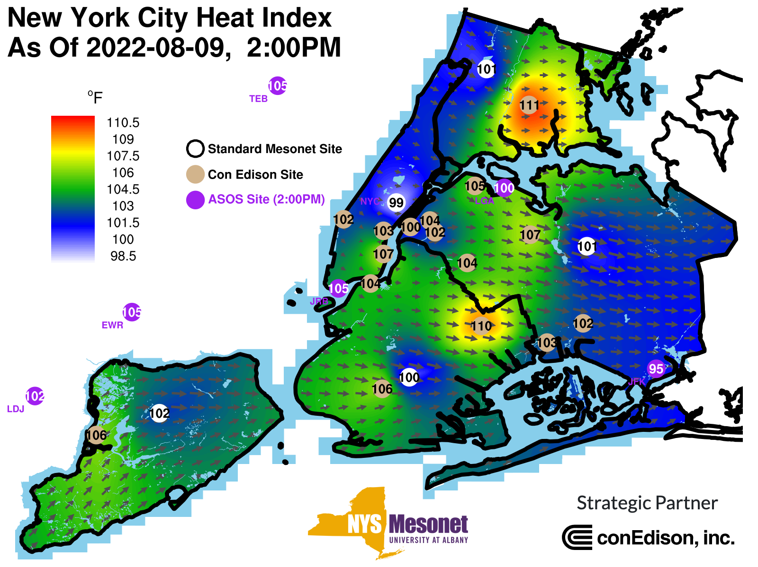
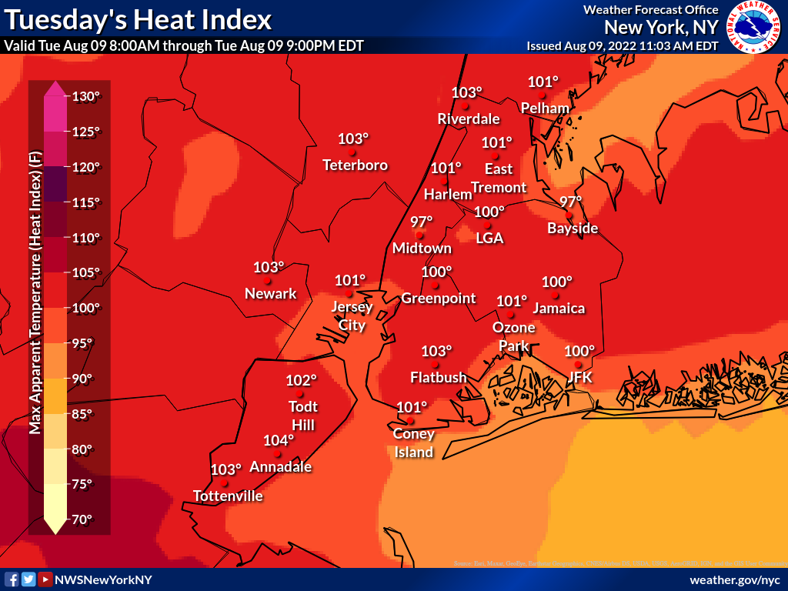
OKX WBGT - 9 August, 18Z Heat Advisory
CPK | 99 | 97 | -2
QUEE | 100 | 100 | 0
BKLYN | 100 | 101 | +1
SI | 102 | 104 | +2
BX | 101 | 103 | +2
Observation (closest)
Forecast
Difference

Slide 23
OKX WBGT - 9 August, 18Z Heat Advisory

Slide 24
Summary and Thoughts
1. Like Heat Index, WBGT spatial variability can be large across the Boroughs. NYC Micronet shows this well–but we may be able to refine our WWA issuance given these obs.
2. New WBGT forecast differences on par with Heat Index differences (a few degrees). Manhattan has a slight a cool bias (ASOS); slight warm bias elsewhere based on initial testing.
3. Small sample, but 15% of the time the WBGT category was off by one.
4. Do you message the category, value, or both for WBGT?

Slide 25
Summary
Thank You!
david.radell@noaa.gov or
OKX Heat Team Lead: joseph.pollina@noaa.gov

