Slide 1
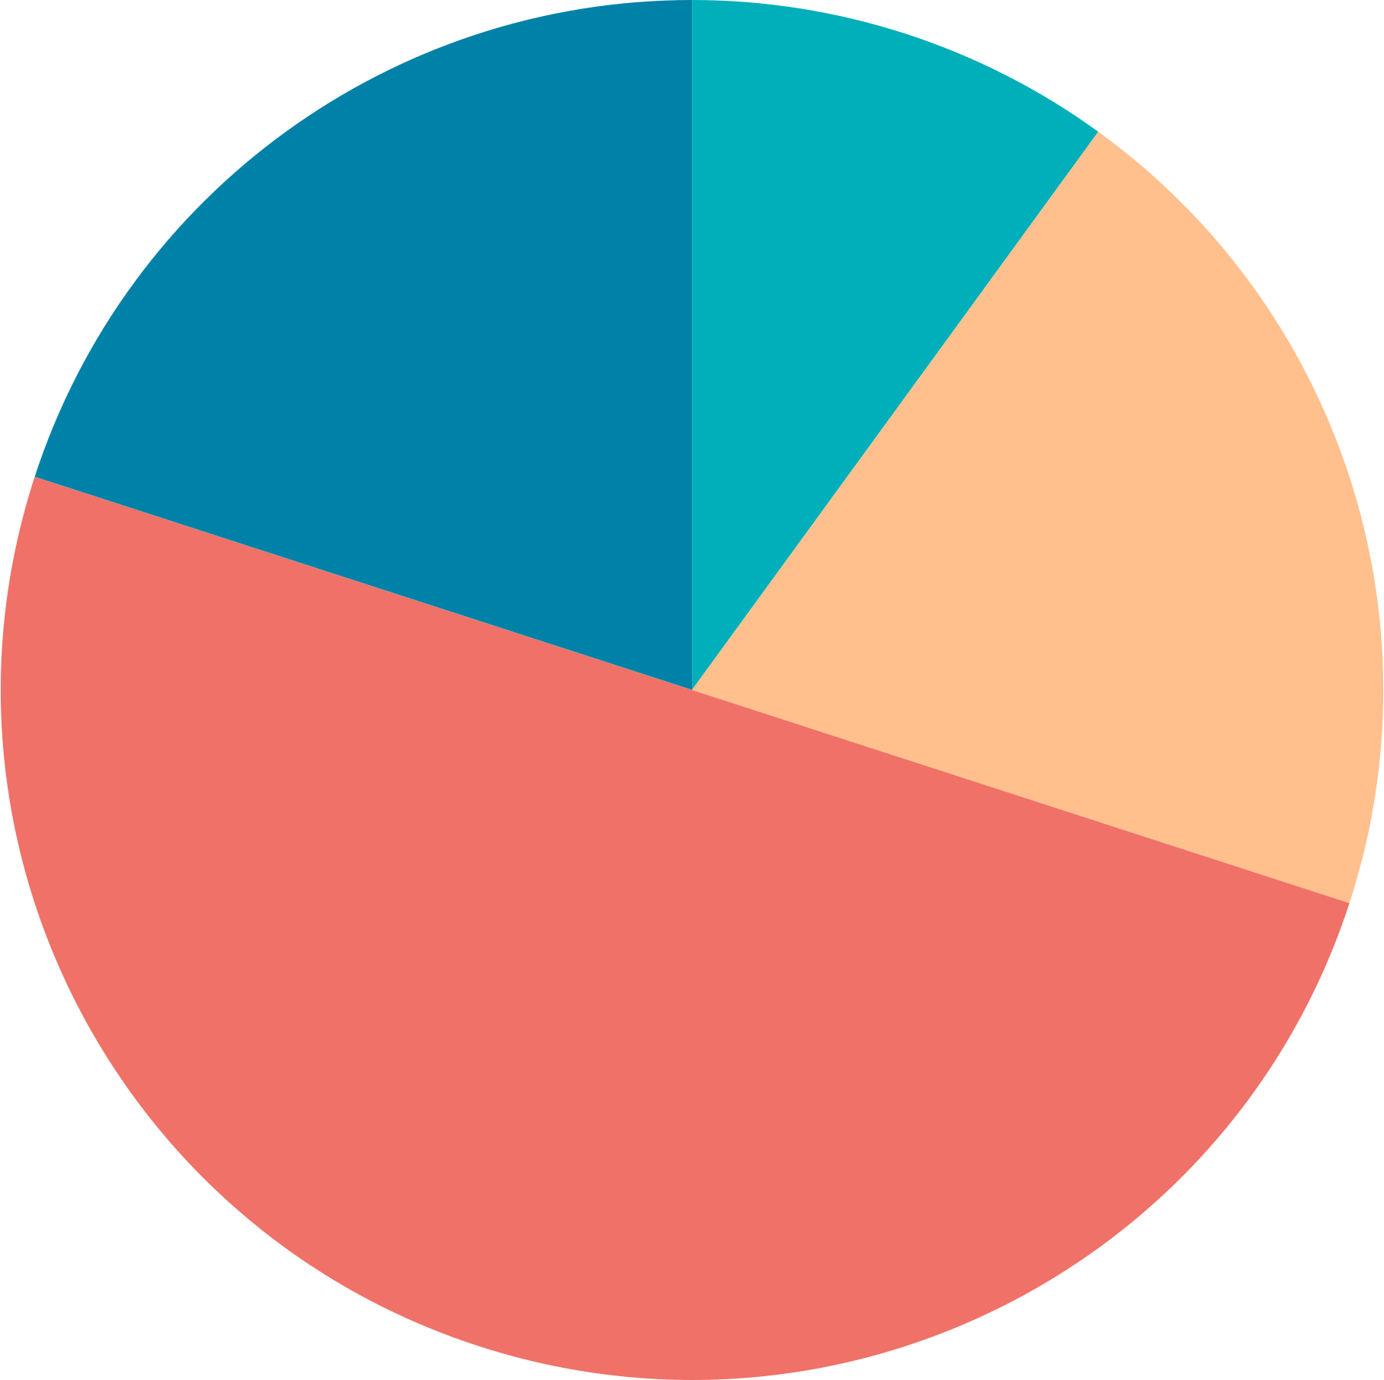
Using Data Dashboards to Communicate Extreme Temperature Risk An Assessment of Visual Display and Design
Sav Olivas and Jeannette Sutton
College of Emergency Preparedness, Homeland Security and Cybersecurity, University at Albany Albany, NY
Funded by NOAA Observations
NA21OAR4590360​

Slide 2
Decision-making can be facilitated by consolidating information into a data dashboard
A front is coming into the Atlantic seaboard from the Rocky Mountains, and it is forecasted to bring heavy snow into the Tri-State Region. You’re an emergency manager, and it is your job to report on current weather conditions to your colleagues.
How many websites do you have to visit to collect the information you need? How quickly can you parse through them?
How quickly could you do it, if it was all in one place?

Slide 3
Decision-making can be facilitated by consolidating information into a data dashboard
90 ̊F
93 ̊F
72 ̊F
Visual display of essential information
Different sets of data on a single screen
Information can be monitored efficiently

Slide 4
Effective design of a dashboard is crucial
When a site is organized well, users know where and what to click on to find what they’re looking for
Navigation – the way the site is structured
Usability – how easily users can interact with a site, or accomplish what they intend to do
Clarity in design guides efficient navigation

Slide 5
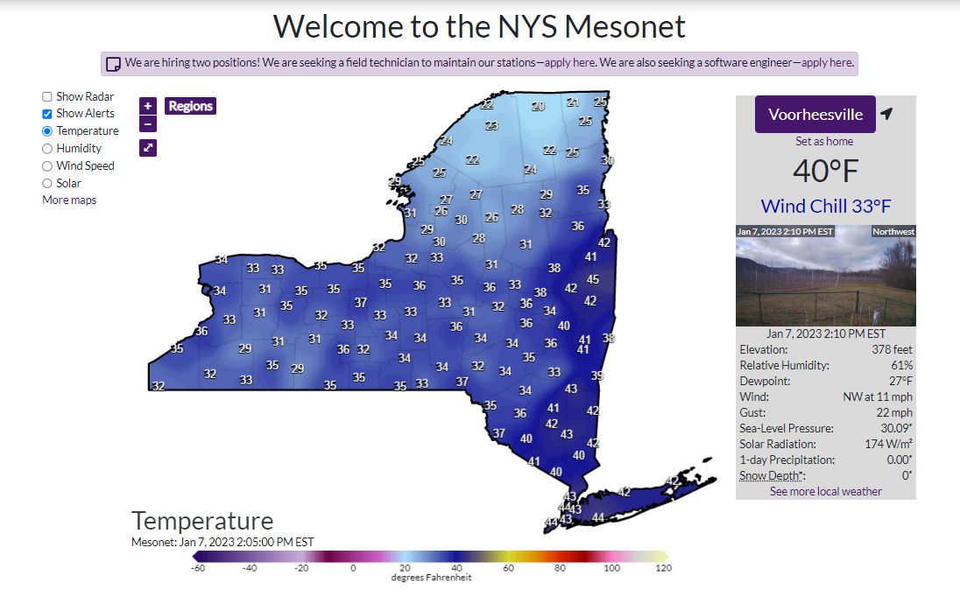
Mesoscale networks | MesoNet
Operational Dashboard: Monitors and manages performance of business operations
MesoNet websites act similarly
Display real-time observations for a variety of purposes

Slide 6
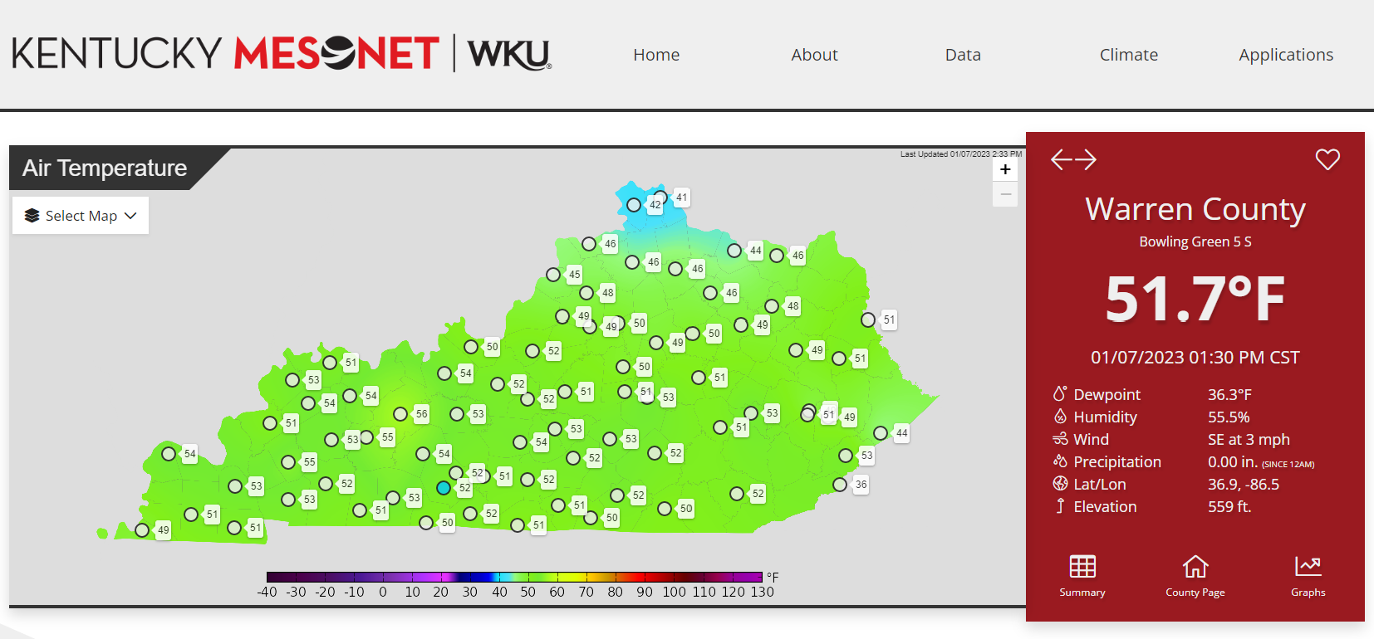
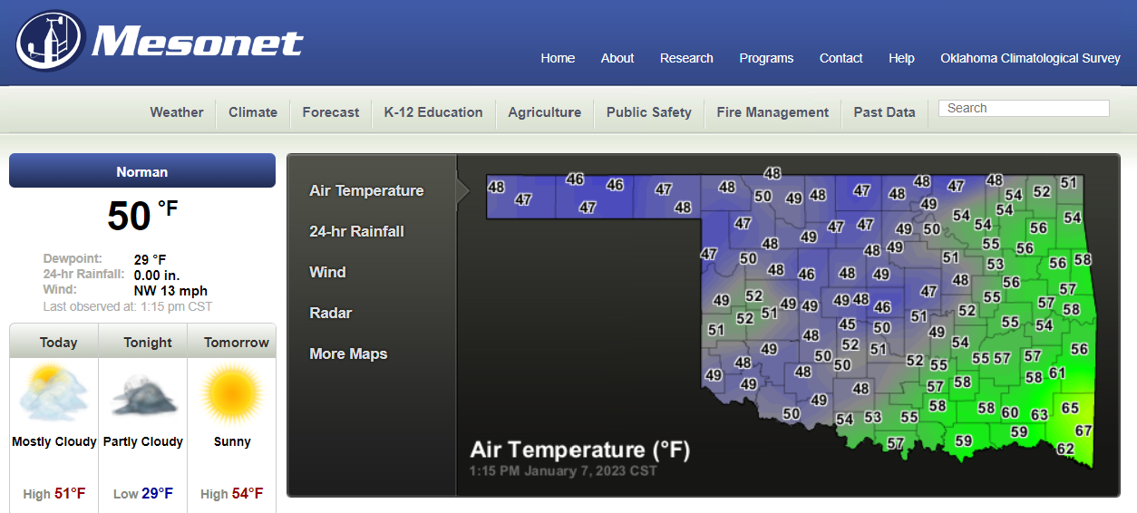
purpose we aimed to identify (1) the extent to which Mesonet visual dashboards include station observation information (2) the usability of these sites to observe and obtain the given data.

Slide 7
data analysis
Content
The words that are used, the types of information contained
Style
Color, font, other
Structure
Where things are placed on the page
Interactivity– How the user interacts and navigates the site (mouse icon)

Slide 8
content
style
structure
interactivity
Current temperature, precipitation, windspeed were included most often.
100%
50%
0%
Temperature
Moisture
Precipitation
Wind Speed
Pressure
Current
Max
Min
Dewpoint
Humidity

Slide 9
Data was most frequently presented geographically – but at different scales
content
style
structure
interactivity
Mesonet Stations
89%
of MesoNet websites used maps
Individual stations contain their own information
Clicking on a station pulls up that information, while keeping a wide state-view
We’ll see more how this is accomplished in interactivity…
Map Name
Key

Slide 10
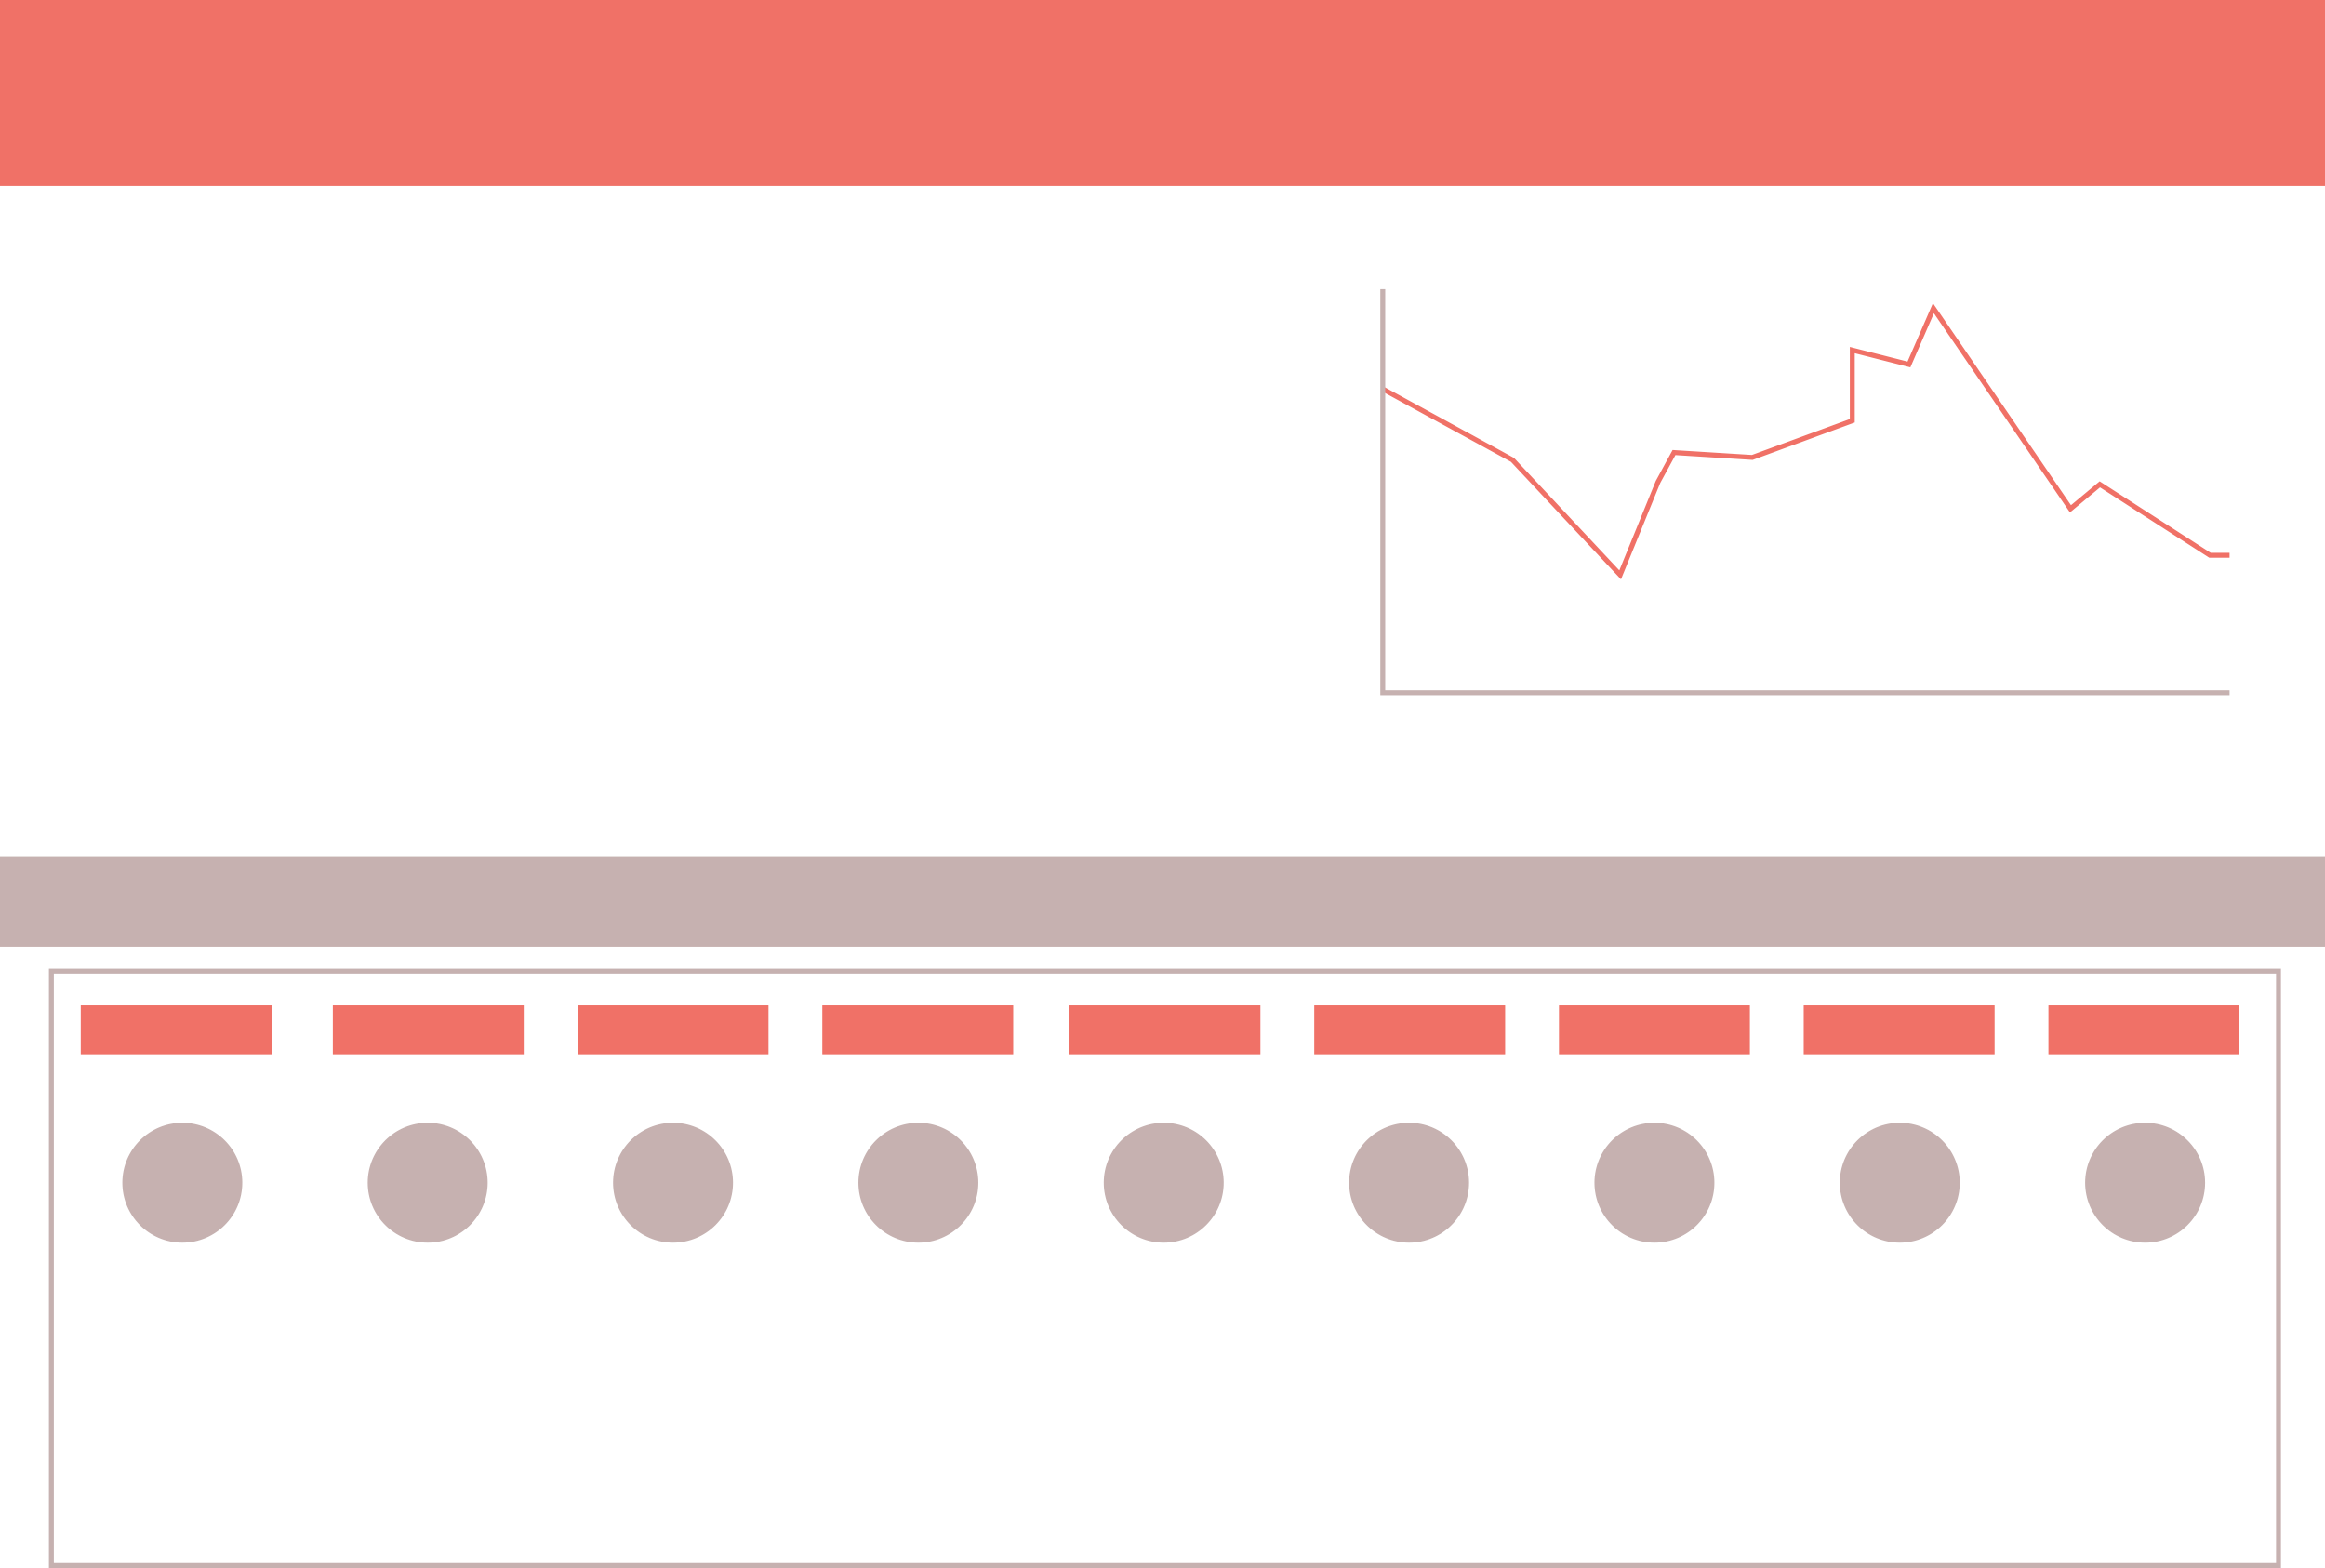
As a result, some layouts may be more limited in how much they can show all at once
content
style
structure
interactivity
Station Name
11%
XXXX : XX
XXXX : XX
XXXX : XX
XXXX : XX
XXXX : XX
XXXX : XX
XX ̊F
did not use maps
Graphs and charts show point information from one singular station
Websites that have no map only cover the scope of one station on a map site

Slide 11
content
style
structure
interactivity
Dashboard structure frequently focused the reader’s eyes on the center of the screen
12.6%
14.7%
11.9%
9.6%
15.8%
10%
6.5%
11.8%
7.1%
Of all content, over all Mesonet sites, how often each total grid was taken up by content (in %)

Slide 12
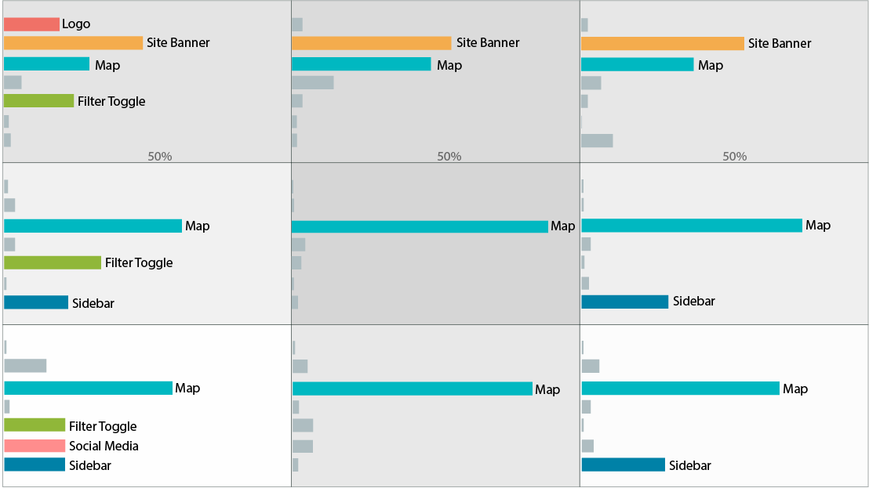
content
style
structure
interactivity
Dashboard data was consistently structured with the map in the center and site banners on top
Of all content, over all Mesonet sites, how much each feature takes up each grid (in %).

Slide 13
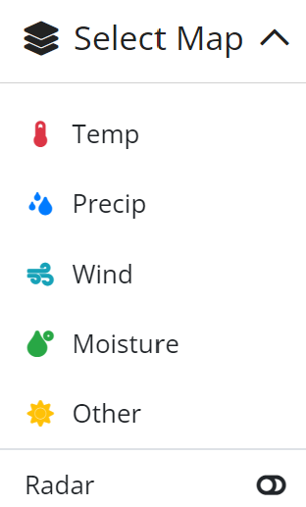
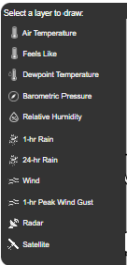
content
style
structure
interactivity
Filtering allows users to access different datasets without leaving the MesoNet homescreen.​
Filter Toggle
Temperature
Humidity
Obvious Visual Cue
… Not so Obvious Cue
Temperature
Temperature
Dewpoint
Precipitation
Toggle is clearly labeled
Filter is obvious: dark rectangle that contrasts
Not immediately clear it is a filter toggle
Too subtle: out of the way, but at a cost

Slide 14
content
style
structure
interactivity
Faceting allows users to access additional information without leaving the dashboard home page.​
Temperature
Map Name
Station Name
Station Name
XX ̊F
XX ̊F
Date | Time
Dewpoint …………….. XX
Humidity ……………… XX
Wind …………………… XX
Precipitation ………… XX
Date | Time
Dewpoint …………….. XX
Humidity ……………… XX
Wind …………………… XX
Precipitation ………… XX

Slide 15
… So which kind of dashboard is better?
We need to know what users are looking for, first
Our next steps for this research include usability testing
The results will lead to new design that will be tested with emergency managers​

Slide 16
Parting design tips…
content
style
structure
interactivity
Prioritize the end-user, when choosing what you include on your site
Use high contrast to draw the eye to important information
Make deliberate choices about where you place things
Label interactable items clearly or make visual feedback obvious
hover here
hover here

Slide 17
Thank you for your attention! ​
Questions? Comments?
solivas@albany.edu
jsutton@albany.edu

