Slide 1
Diagnosing the Relationship between Flash Flooding and NYSM Soil Moisture
Andrew Lunavictoria University at Albany, State University of New York, Albany, NY
Collaborators: Nick Bassill
Director of Research Development, Center of Excellence, New York State Mesonet
Notes:
Thank nick

Slide 2
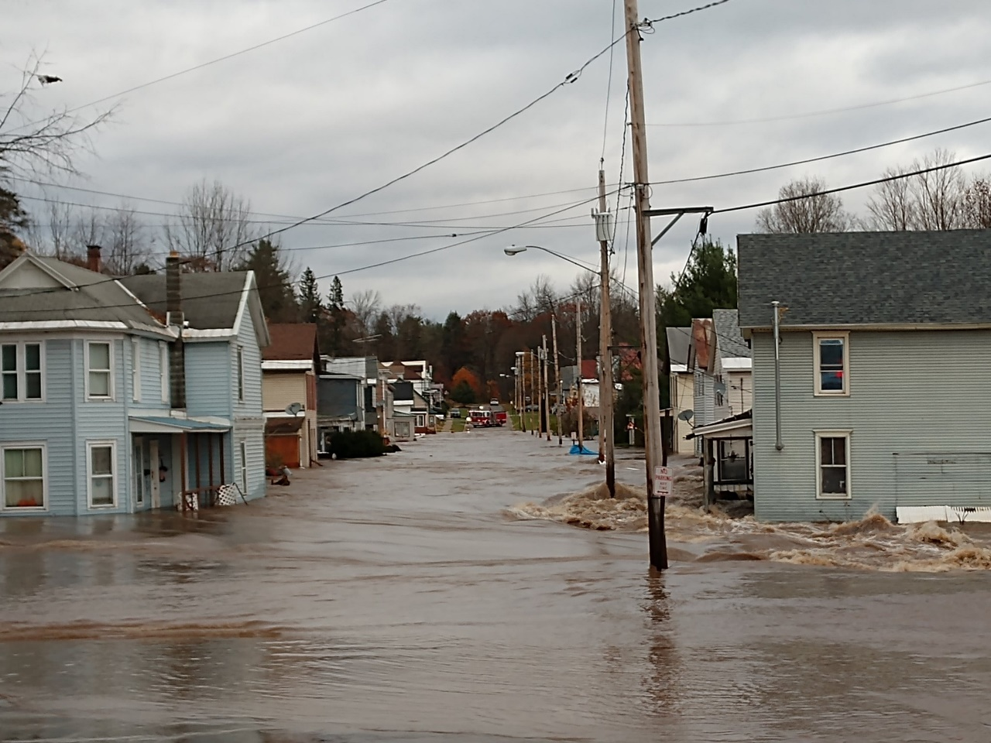
What is a flash flood?
Flash flooding is when there is a rapid rise of water within a few minutes to multiple hours that causes a threat to life or property.
Causes:
heavy precipitation
dam failure
ice jam
NWS-ALY

Slide 3
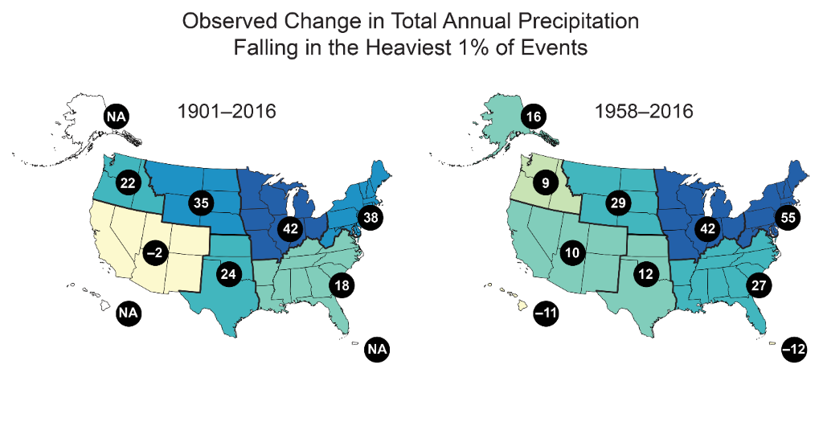
Motivation
National Climate Association 2018

Slide 4
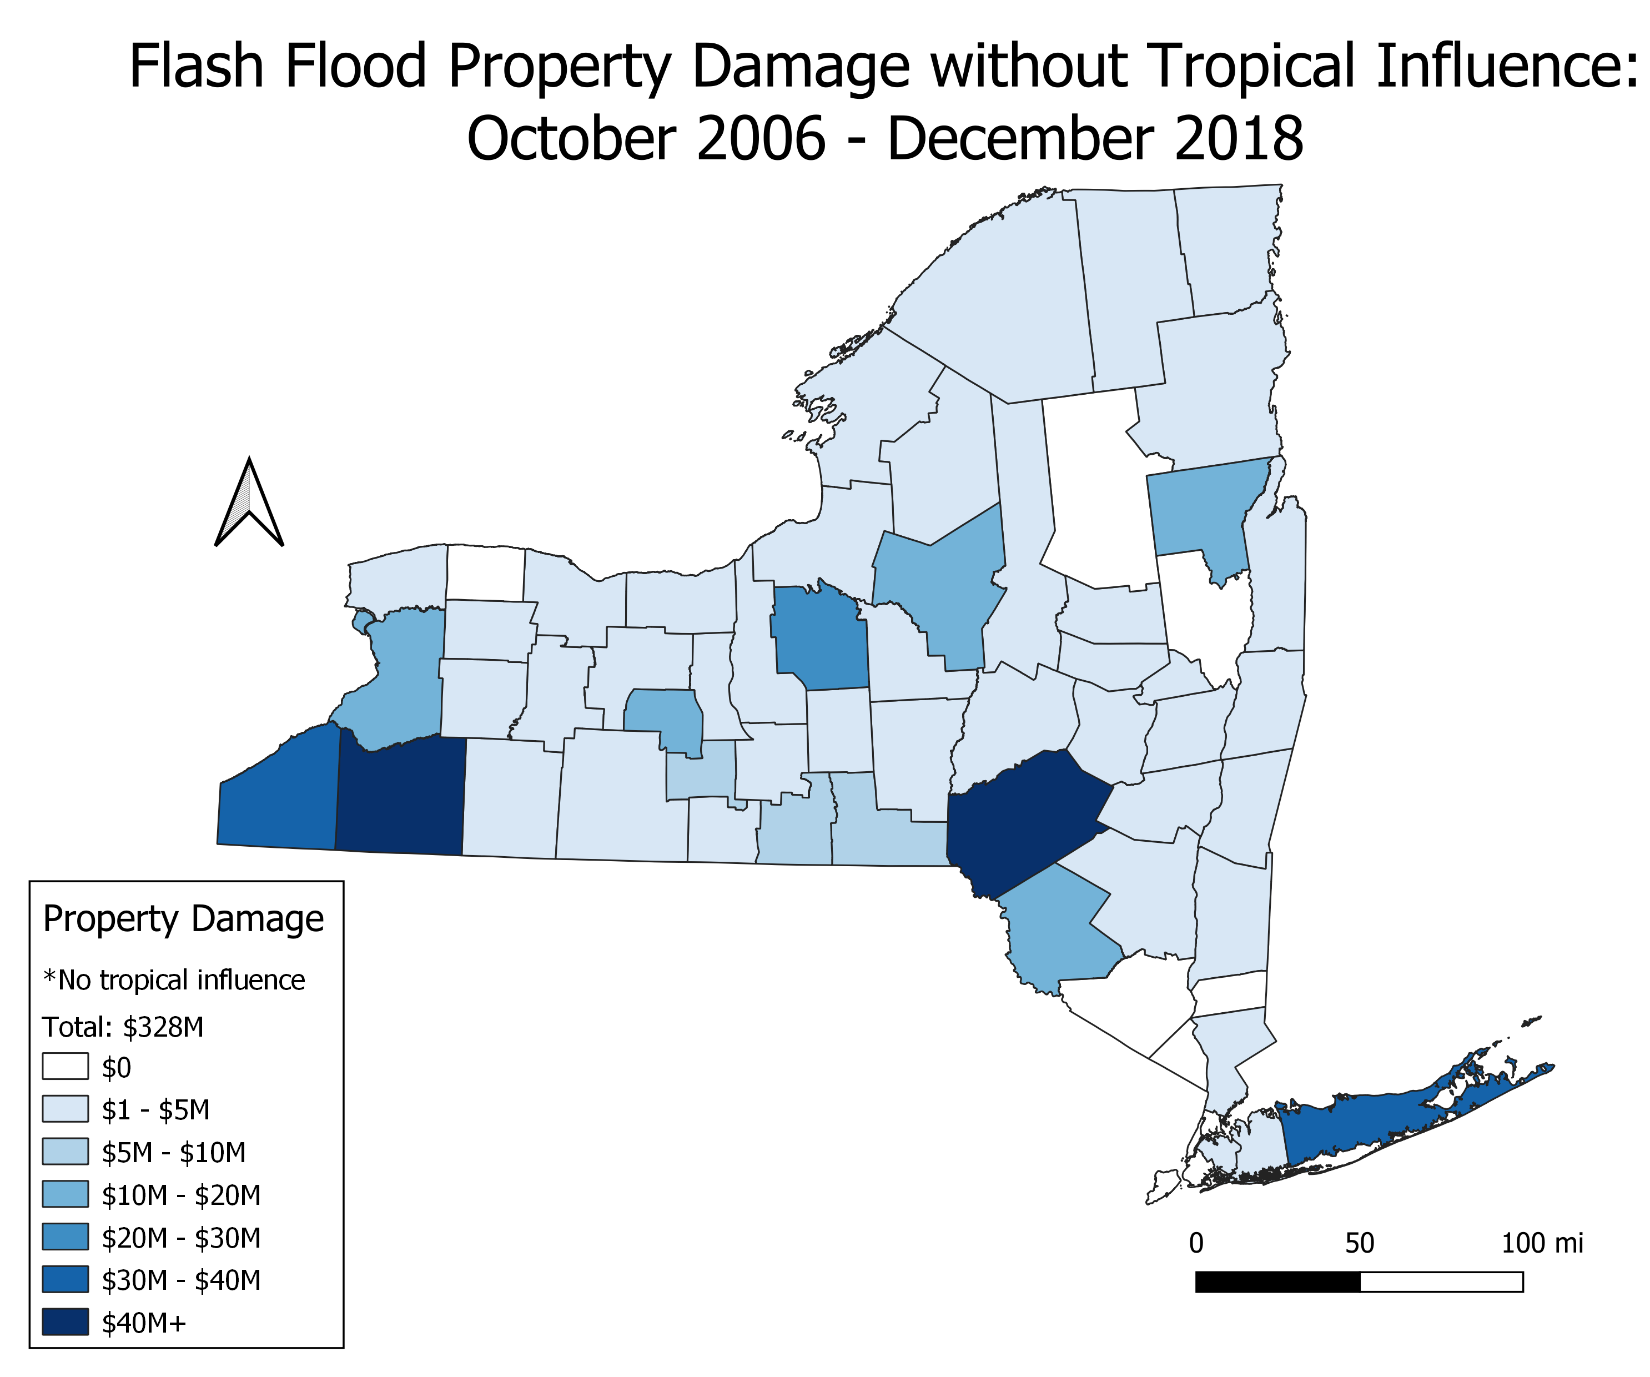
Motivation
$328 million in property damage
Need to understand flash flooding better in order to protect life and property across New York State
Could we relate soil moisture?
QGIS: NCEI Data
Notes:
NCEI: National Center for Environmental Information
In past, I have stated that the NYSM is a helpful tool for the NWS to use for flash flooding potential, as it is more accurate than MRMS data.
By understanding soil moisture, can we determine if there is a relationship to flash flooding across NYS, to further assist the NWS?

Slide 5
Methodology
New York State Mesonet (NYSM) real-time data.
NYSM Precipitation Gauge
5 cm, 25 cm, 50 cm soil moisture probes
Soil moisture percentile (based on 2017-2019 data) rather than raw data
National Weather Service (NWS) Chat:
Every Flash Flood Warning issued in New York State (ALY, BGM, BTV, BUF, OKX) in 2018 and 2019
Viewed polygon and determined if a NYSM station was in the polygon.
Meteograms were created to view the data
Data was categorized into two event types:
Thunderstorm
Widespread
Notes:
Used the percentiles rather than the raw data because the percentiles illustrated the changes in soil moisture better than the raw data. The raw data had subtle changes even during heavy rain and were too localized. The percentiles were able to smooth over the region and showed greater changes before/after rain.
Recorded all NYSM sites in each polygon for further research.
Discarded any flash flood warning that did not contain a single NYSM site.

Slide 6
Methodology
Soil Moisture Percentile Calculation:
Based off NYSM 2017-2019 data for each individual station
The driest raw soil moisture recorded at a given station = 0%
The wettest raw soil moisture recorded at a given station = 100%
This process was done at all the soil moisture sensor depths (5 cm, 25 cm, and 50 cm) as well as for the entire column (raw values at each level 5 cm + 25 cm + 50 cm)
Example (VOOR):
{0.07, 0.13, 0.21, …, 0.8}
Events: 2017-2019 | Event 1 (Driest) | Event 2 | Event 3 | Event 4 | Event 5 (Wettest)
Soil Moisture (Raw Data m^3/m^3) | 0.07 | .21 | 0.38 | 0.63 | 0.8
Soil Moisture Percentile | 0 | 25 | 50 | 75 | 100
Notes:
These 5 sample events do not have correlation with each other (Event 1 did not come after event 2 and so on)

Slide 7
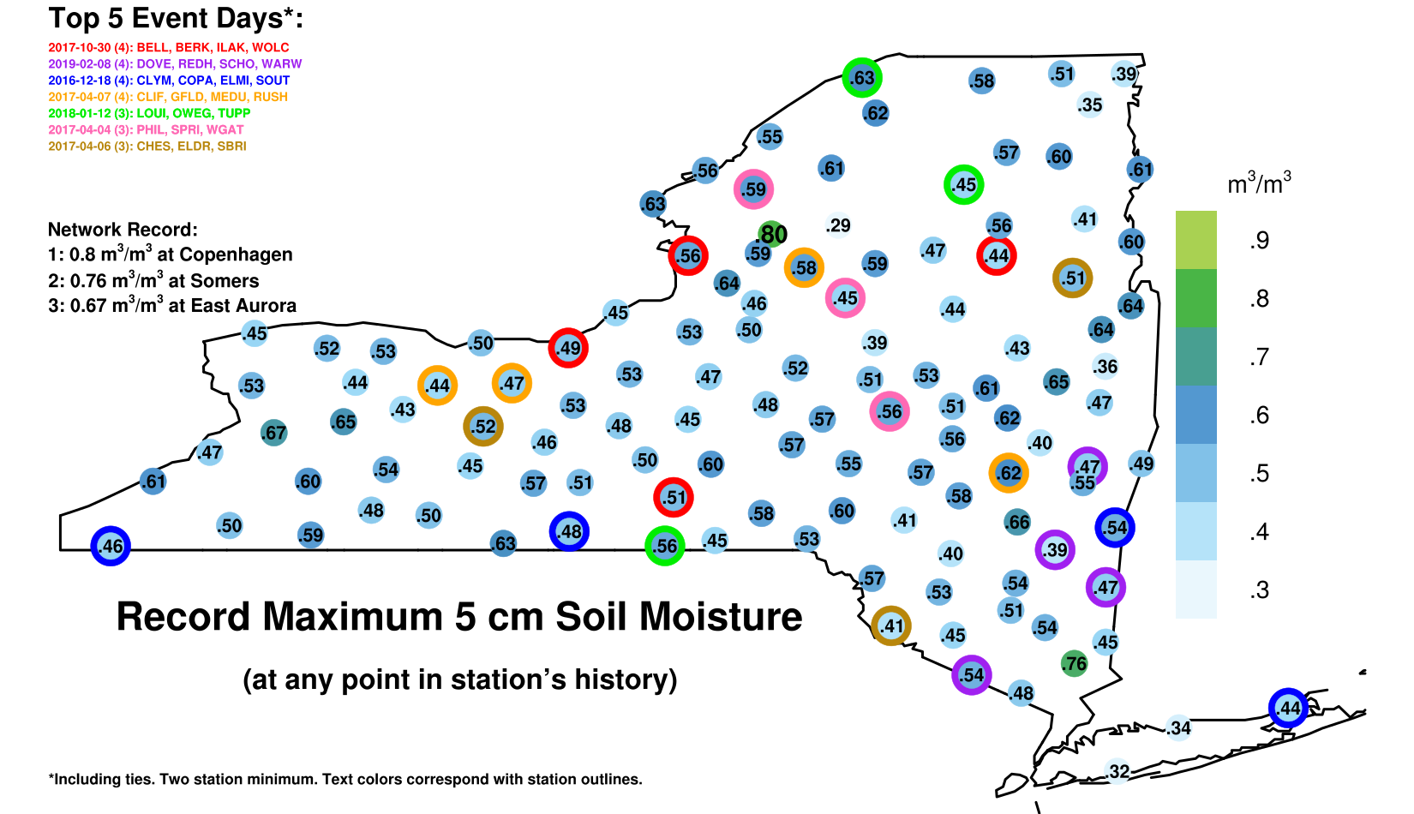
Maximum 5 cm Soil Moisture (Raw Data)
Notes:
Copenhagen: 0.8
Crogan: 0.29
Harrisburg: 0.59
Glenfield: 0.58
0.27 at CROG is a lot different than 0.27 at COPE

Slide 8
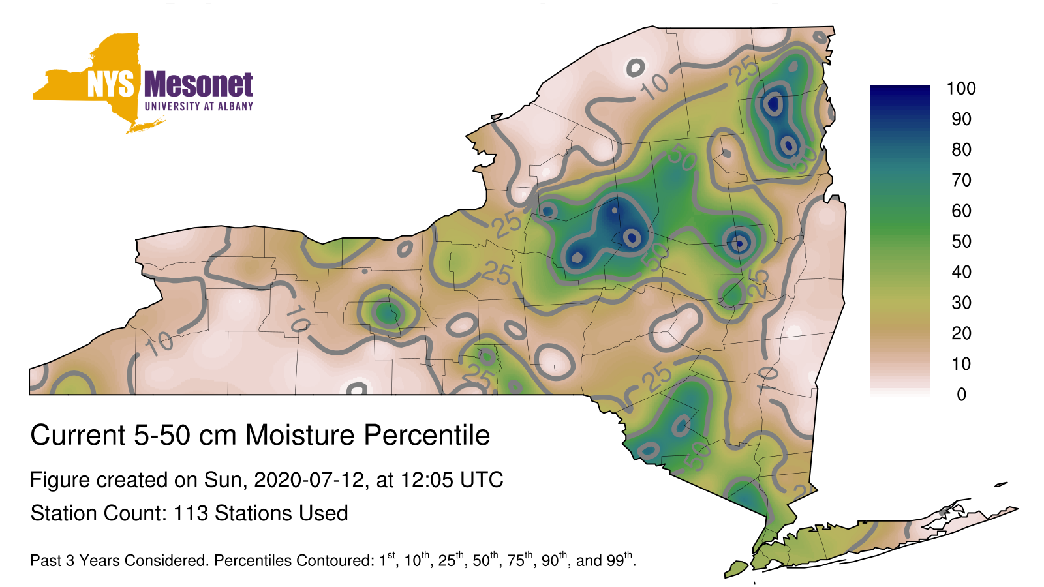
Methodology: Percentile
Notes:
This is looking at the column soil moisture percentile. Here we can compare each station using a single variable on the same type of scaling. It is much smoother and tells us more about the soil moisture than the individual raw data does

Slide 9
Thunderstorm Example
Notes:
How I categorized thunderstorm event

Slide 10
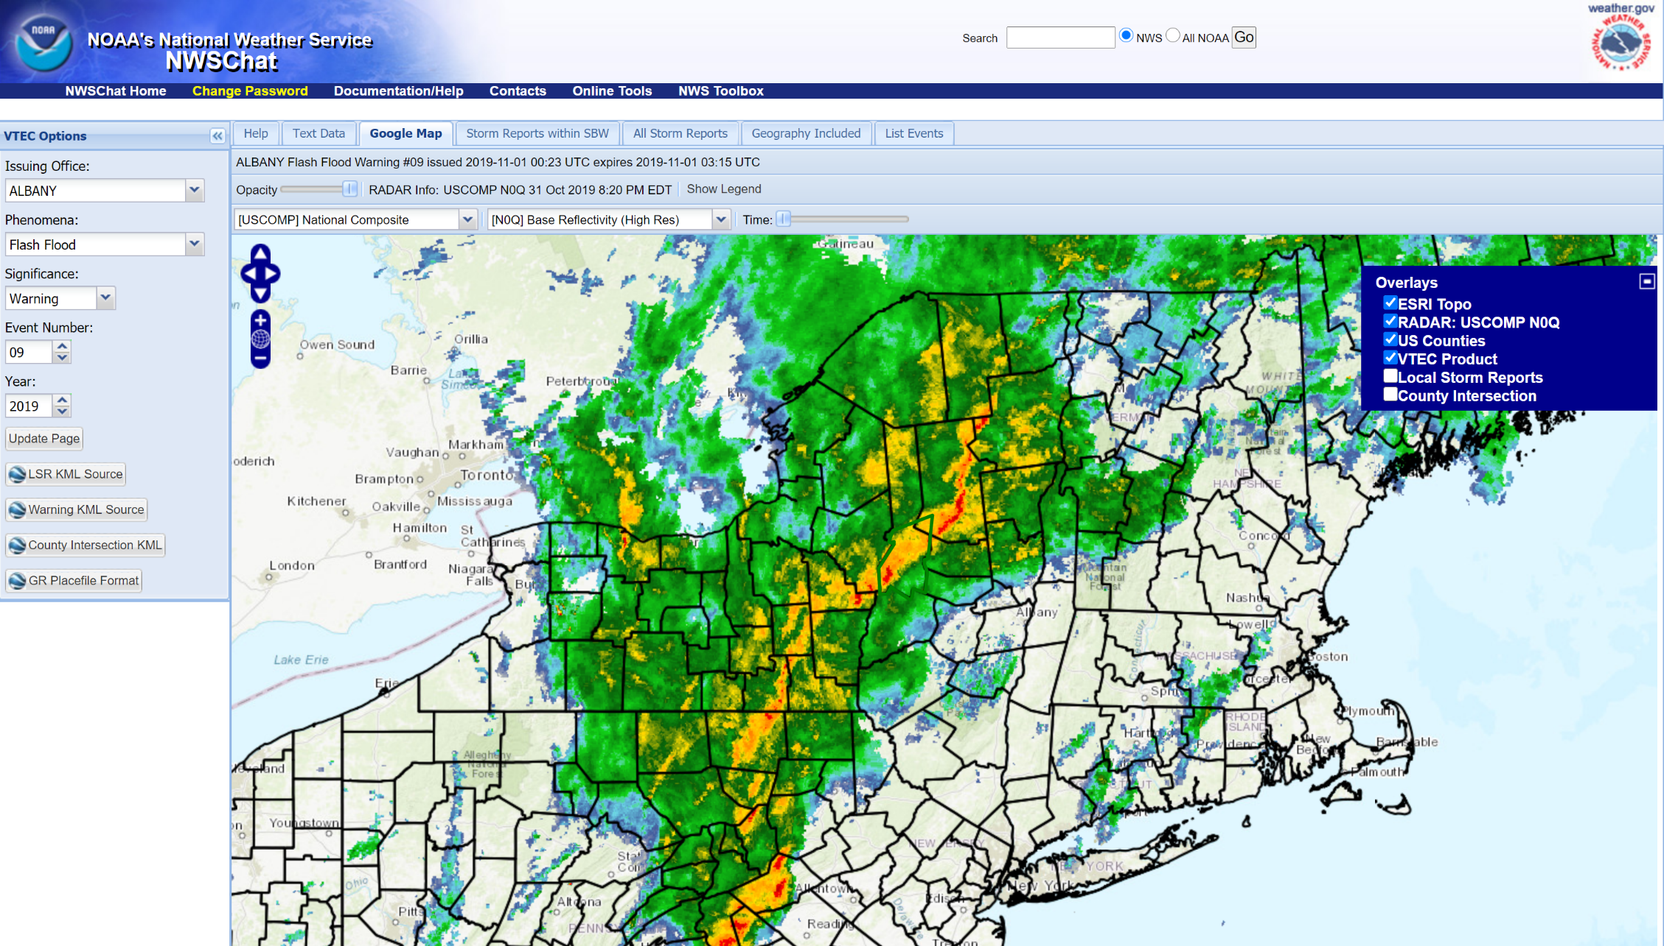
Widespread Example
Notes:
How I categorized widespread event

Slide 11
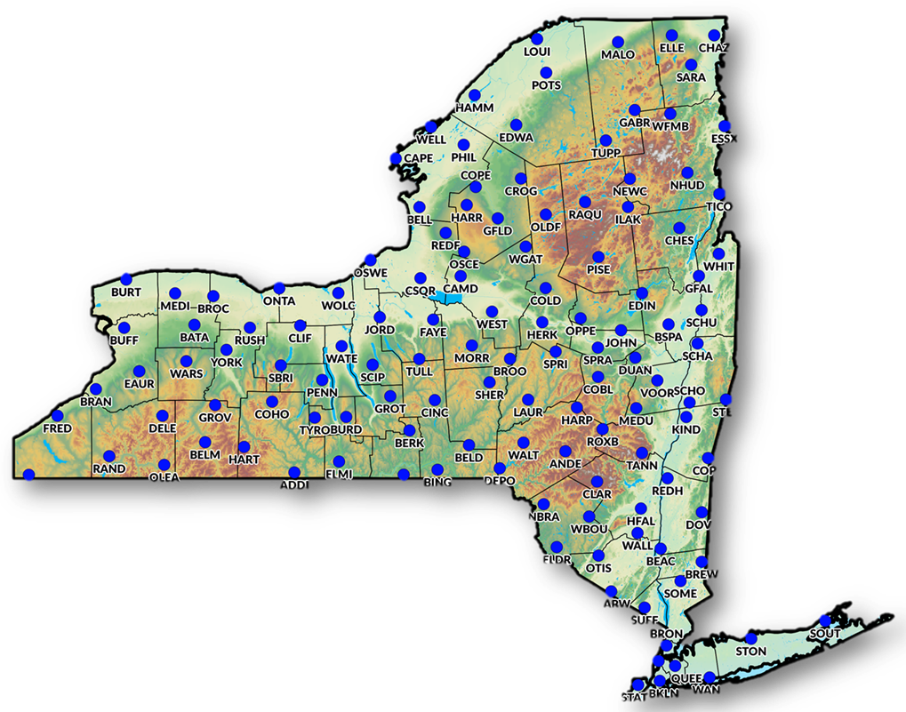
NYSM Standard Network
Using the polygon from the Flash Flood Warning, would locate corresponding NYSM Sites

Slide 12
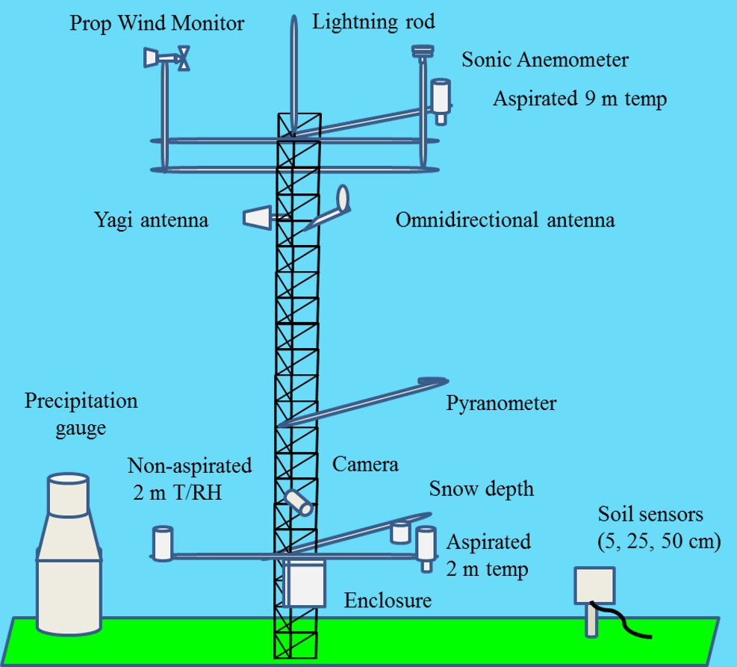
NYSM Tower
Observations every 5 minutes​
Precipitation​
Soil Moisture​
Temperature (2/9 m) ​
Humidity ​
Wind Speed ​
Wind Direction​
Surface Pressure​
Soil Temperature​
Solar Radiation​
Snow depth​
Photos​
nysmesonet.org

Slide 13
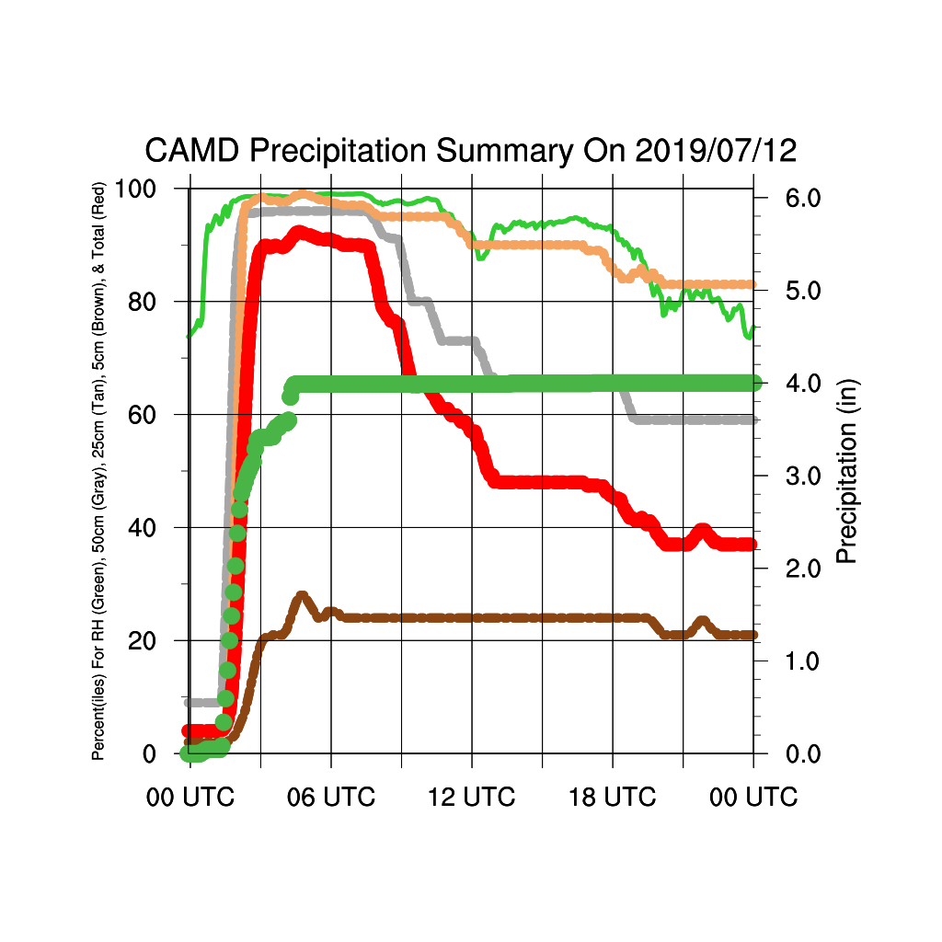
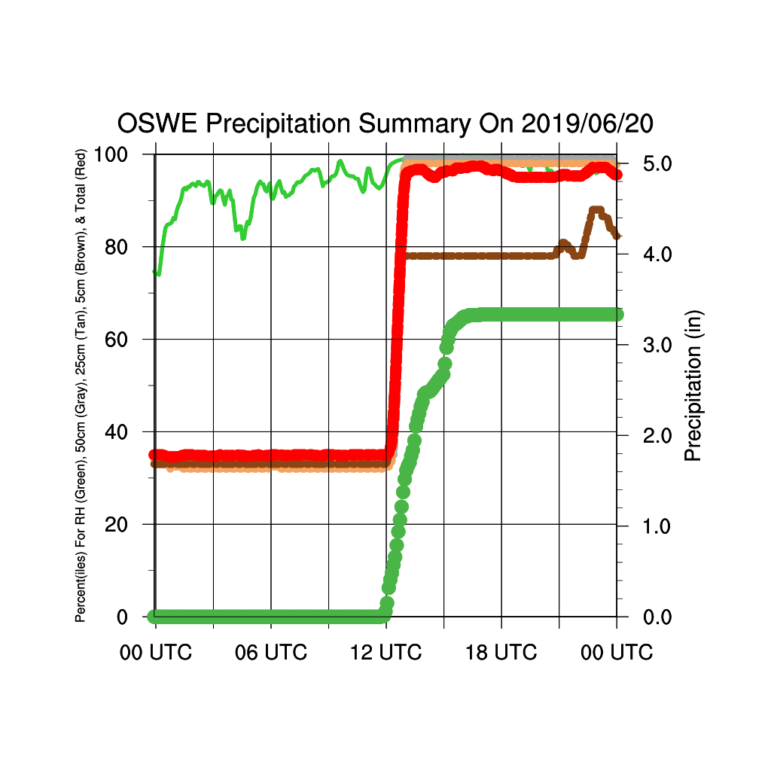
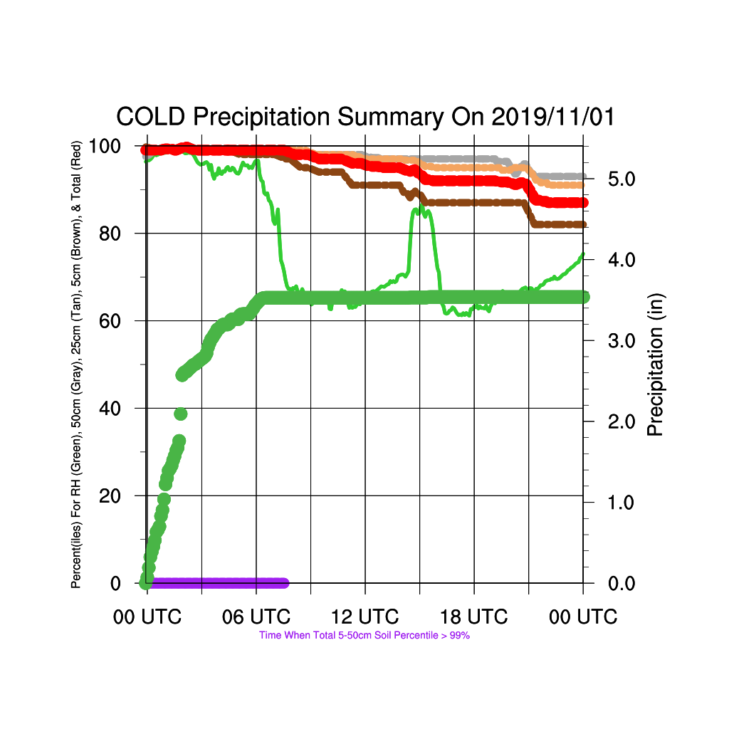
Good Meteograms
Notes:
Brown: 5 cm
Tan: 25 cm
Grey: 50 cm
Red: Column
Green: Rainfall
Small green: relative humidity
Purple: When column reached 100th percentile
Explain how I used each meteogram and why they are good

Slide 14
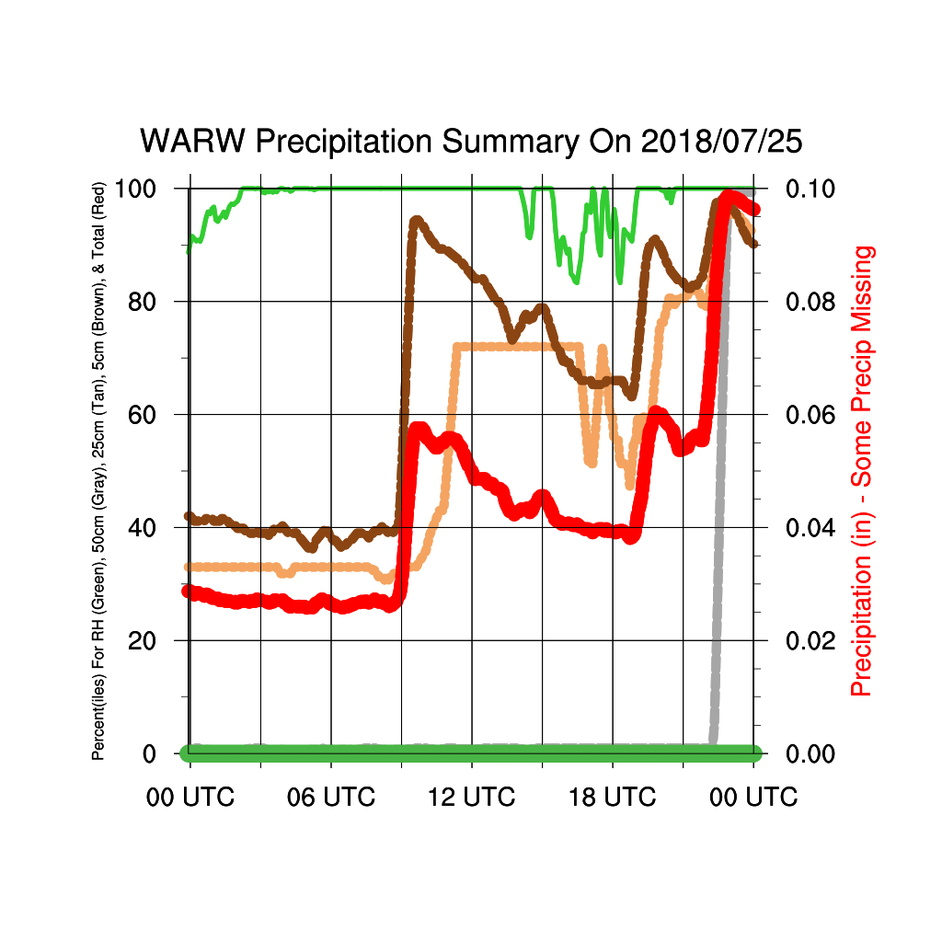
Bad Meteograms
Plus any NYSM New York City Site (BKLN, BRON, MANH, STAT, QUEE)
Notes:
Left: Precipitation missing/did not record
Right: About 3 inches of rain fell, however the percentiles remained constant (not realistic!)
NYC sites are on rooftops, thus, do not have soil moisture sensors. Can’t record soil moisture!

Slide 15
Climatology
Originally 220 events in 2018-2019
Removed all New York City sites, bad meteograms, missing precipitation, and any Flash Flood Warning that did not have a NYSM Site
New total 123 events
71 thunderstorm events (60 NWS Warnings)
52 widespread events (36 NWS Warnings)
Notes:
An event is a NYSM site that contained a flash flood warning. So one flash flood warning could yield i.e 3 nysm sites. 3 events.
There are more thunderstorm events than widespread events, can soil moisture tell us why?

Slide 16
Climatology: Seasonal
Notes:
This is not the total number of warnings, but it is the amount of days in the month where at least 1 flash flood warning was issued.
There can be multiple warnings in the same day
Thunderstorm Peak in July/August
Widespread peak in August/September

Slide 17
Climatology: Diurnal, Thunderstorm Events
Notes:
Most of the peak soil moisture occurred between 19 and 0 UTC with some lingering to about3UTC.
This is likely in due to the fact that convection typically develops in the afternoon hours, increasing the likelihood of heavy rainfall during this time period

Slide 18
Climatology: Diurnal, Widespread Events
Notes:
No real pattern between the widespread events

Slide 19
Results
Peak Soil Moisture Percentile
Main variables to look at:
Total Rainfall
Average Rainfall Rate
Duration
Starting Soil Moisture
Peak Soil Moisture
Time to Peak Soil Moisture
Soil Moisture Percentile Before Rain
Rain End
Rain Start
NWS Flash Flood Warning
Notes:
Explain meteogram
Explain each variable and if/how I calculated each

Slide 20
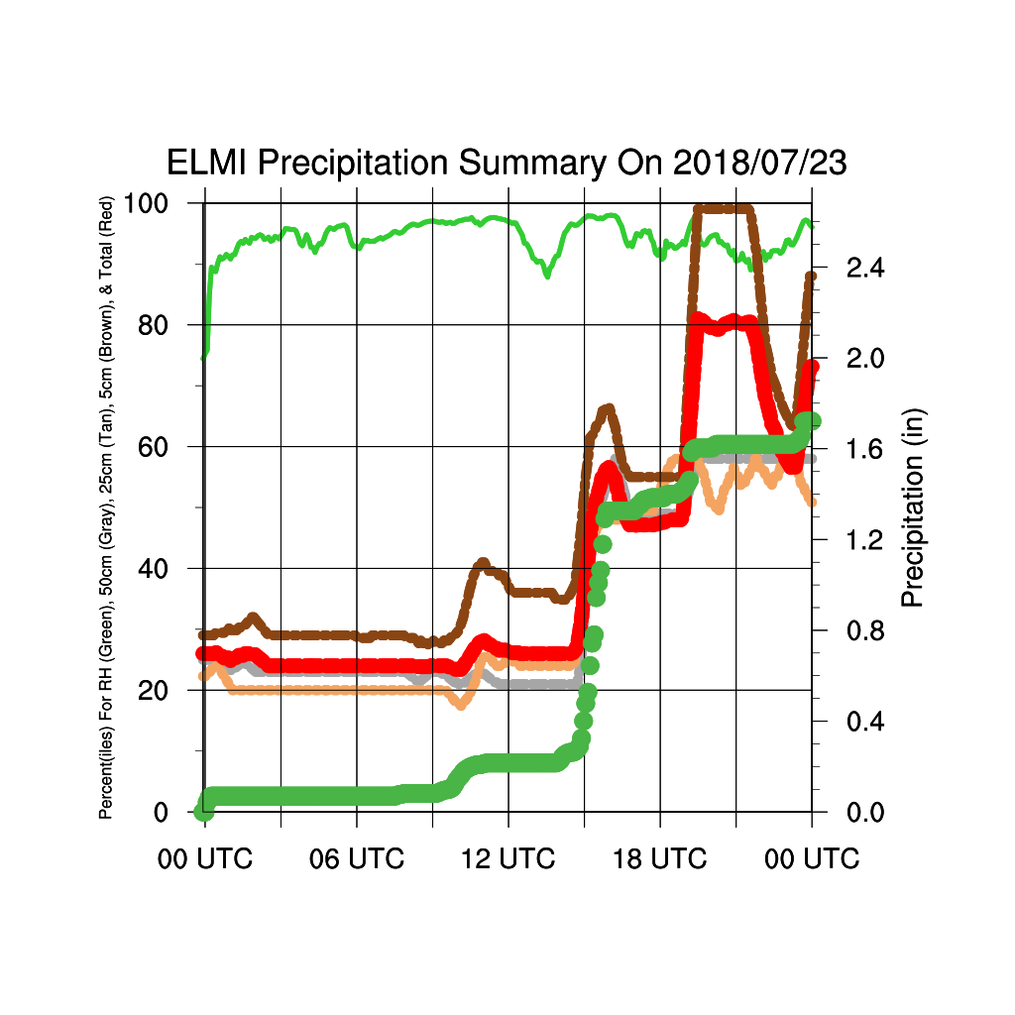
Results
Example of a complex meteogram
Rain start 15:00 UTC with 0.3 in
5 cm Percentile: 38% Column Percentile: 25%
5 cm Peak: 99% Column Peak: 81%
End Rainfall: 1.6” Total Rainfall: 1.3”
Peak Soil Moisture Percentile
Soil Moisture Percentile Before Rain
Rain End
Rain Start at 0.3 in
NWS Flash Flood Warning
Notes:
Complex meteogram with multiple peaks and storms
NWS Waring not until 20z

Slide 21
Total Rainfall
Notes:
Widespread more rainfall than thunderstorm events

Slide 22
Average Rainfall Rate
Notes:
To calculate the rate, I took the amount of total rainfall by the duration of the event. I do feel that the widespread events average rain rates are negatively skewed, as the widespread events lasted longer than the thunderstorm events.
However, for both the thunderstorm events and the widespread events, most of the values were below 1 in/hr. So for the widespread events, I would only expect the average rainfall rate to increase slightly, which would not alter the results. Thus, we kept the variable as is.
It is seen that the average rain rate is greater for thunderstorms than widespread events.

Slide 23
Duration
Notes:
Widespread events had a much greater duration than thunderstorm events (initial rainfall to end rainfall)
Most Events were less than
Thunderstorm: 2 hours
Widespread: 6 hours

Slide 24
Time to Peak Soil Moisture Percentile After Initial Rainfall
Notes:
Time it took for the soil moisture to reach its peak.
Most of the events:
Thunderstorm: 1 hour or less
Widespread: 4 hours or less
There was one case in the thunderstorm events where the peak occurred an hour prior to the rainfall. This is because it rained all day, but the flash flood warning was not issued until the end of the day.

Slide 25
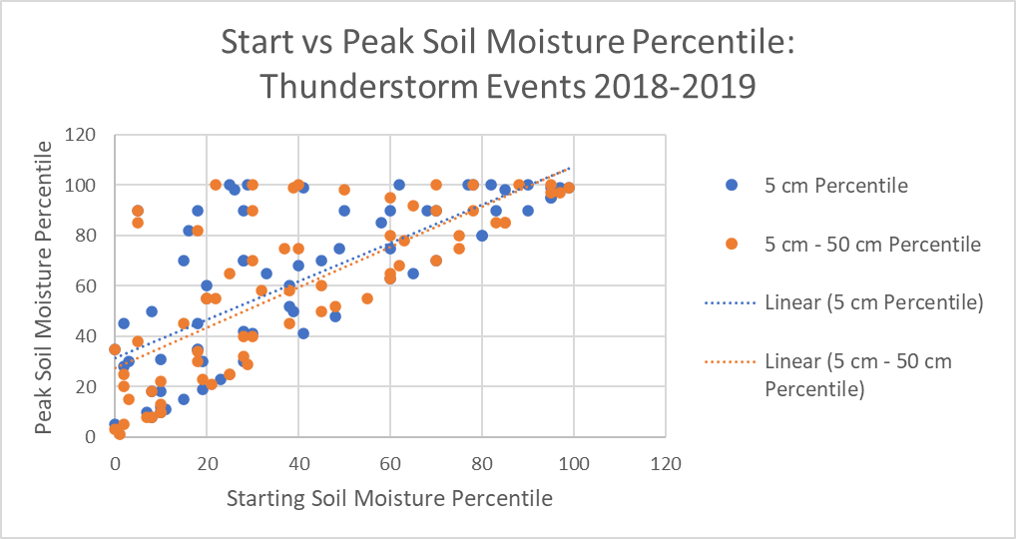
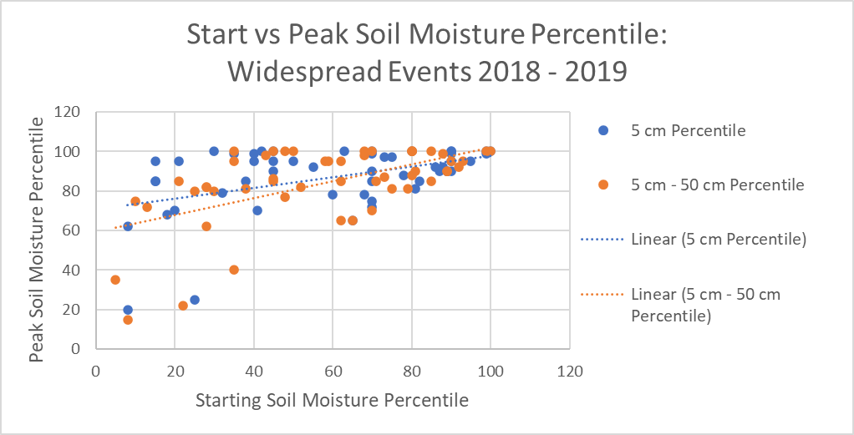
Start vs Peak Soil Moisture Percentile
Notes:
Looking at the starting vs peak soil moisture percentile, it is nice to see there is a direct relationship between then and that the soil moisture does not decrease when there is rainfall.
However, we do see that in the thunderstorm events, the starting and peak soil moisture percentile is more scattered. In the widespread events, most of the starting percentiles are greater than about 40% and there are more peaks with higher soil moisture values.

Slide 26
Peak Soil Moisture Percentiles (Column)
Widespread events have higher starting soil moisture percentile and higher peaks
100th percentile was reached more often in the widespread events
Notes:
Here is a better visual of the starting percentiles vs the peak percentiles. For the thunderstorm events, they are more scattered than the widespread events.
The widespread events typically have a starting value of about 40% and the peaks reach above the 80%.

Slide 27
Peak Soil Moisture Percentile vs Average Rainfall Rate
Even low rainfall rates result in high peak soil moisture percentiles
Average rainfall rates have more of an effect on thunderstorm events than widespread events
Notes:
For both thunderstorm and widespread events, we see that even low rainfall rates resulted in higher peak soil moisture percentiles.
Thunderstorms: 50th percentile and increase with rate.
Widespread: 80th percentile and increase with rate.
Trendline:
Thunderstorm events: Average rainfall rate increases, peak soil moisture increases
Widespread events: Peaks tend to always be high, regardless of the average rainfall rate

Slide 28
Peak Soil Moisture Percentile vs Total Rainfall
Notes:
We do see a direct relationship between rainfall and peak soil percentile, (which is nice to see as it goes with our intuition).
Just like in the average rainfall rate plots, most of the peaks in the widespread events are above the 80th percentile, while the thunderstorm peaks are more scattered.
However, for the thunderstorm events, it takes less rainfall (just over 1 inch) for the soil moisture to reach the 100th percentile for both the column and 5cm, than it does for the widespread events (about 1.7 inch). This could explain why there are more flash flood warnings issued for thunderstorm events than widespread events.

Slide 29
Soil Moisture Change vs Total Rainfall
Notes:
We separated the events that reached the 100th percentile against those that did not.
Thunderstorm:20% increase in peak soil moisture percentile per inch of rain.
Widespread events, there is less of a change per inch of rainfall.
Thus, an inch of rainfall has more of an effect on the soil moisture percentile for thunderstorms, than it does for widespread events.
More events where the soil moisture percentile has a greater change in the widespread events than in the thunderstorm events, regardless of rainfall.
Thunderstorm: Mainly less than 30% change. Heavier rate = more runoff
Widespread: Split.
Reason: (Big change) Longer duration so the soil has more time to soak in the water and change more
(Small change) Higher starting values so the soil is more saturated so isn’t effected much by the rainfall

Slide 30
Average Rainfall Rate vs Peak Soil Moisture Time
Outliers
Thunderstorm (3.54 in/hr, 0.5 hr)
Widespread (0.05 in/hr, 19 hr)
Thunderstorm events reach their peak soil moisture percentile quicker than widespread events due to higher average rainfall rate
Orange indicates peak after rainfall ended
Notes:
The orange dots represents the cases where the peak occurred after the rainfall ended. All the other events, the peak occurred while it was raining.
Here we see that since the average rainfall rate is greater in the thunderstorm events, the peak soil moisture time occurs quicker than widespread events. We also see that as the average rainfall rate increases, soil moisture reaches its peak percentile quicker.

Slide 31
Total Rainfall vs Peak Soil Moisture Time
Orange indicates peak after rainfall ended
Even with lower rainfall amounts, thunderstorm events reach their peak quicker than widespread events.
Likely due to the higher average rainfall rates
Notes:
For the thunderstorm events, it took mainly an hour or less regardless of the amount of rainfall for the soil moisture to reach its peak.
For the widespread events, it took mainly 4 hours or less for the soil moisture to reach its peak. I assume that this is because of the rainfall rate.

Slide 32
5 cm Soil Type
5 different types
Clay
Loam
Loamy Sand
Sandy Loam
Silt Loam
Not enough data
Notes:
Explain chart colors
Only used 5 cm
Soil Types: Samples sent to Cornell and they analyzed the types
Hard to compare types due to lack of sample size of each type
Although Loamy Sand had the smallest sample size, it did have the highest average peak in both the thunderstorm and widespread events.
NOT ENOUGH DATA

Slide 33
Conclusions
The soil moisture does not have to reach the 100th percentile for flash flooding to occur
Widespread events have higher soil moisture peak percentiles than thunderstorm events
Widespread events have a greater change in soil moisture percentile than thunderstorm events and typically start off at the 40th percentile or greater.
It takes less rainfall (about 1”) for the soil moisture to reach the 100th percentile for thunderstorm events, (1.7” for widespread events)
Thunderstorms reach their peak soil moisture quicker than widespread events
Need more data to make valid conclusions on soil type
Notes:
I would like to take a future look into rainfall rate and soil moisture, to see if there is a better relationship between them.
Future work:
Use the soil type file from June, and look at other variables to each soil type such as saturation %, water capacity, etc
Hopefully obtain more data on soil type to make conclusions.
They may have a large impact

Slide 34
Future Work
View which Flash Flood Warnings were verified and compare non-verified events to verified events
Calculate and use the instantaneous rainfall rate rather than the average rainfall rate
Take an in depth look at soil type
Look at other atmospheric variables and their relationship on soil moisture (i.e. Precipitable Water)
Notes:
Compare seasons, foliage, topography, etc.

Slide 35
Extra Plots

Slide 36
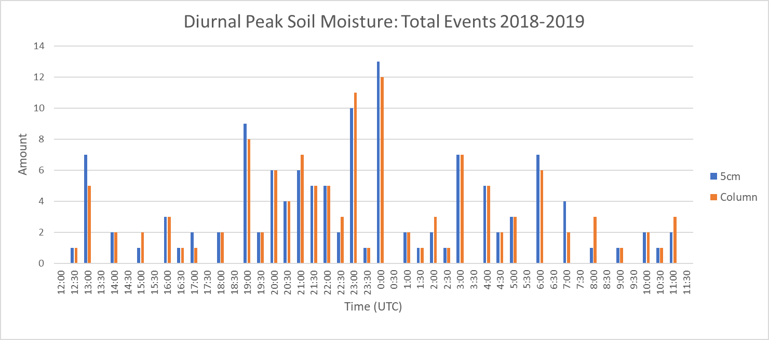
Extra Plots

Slide 37
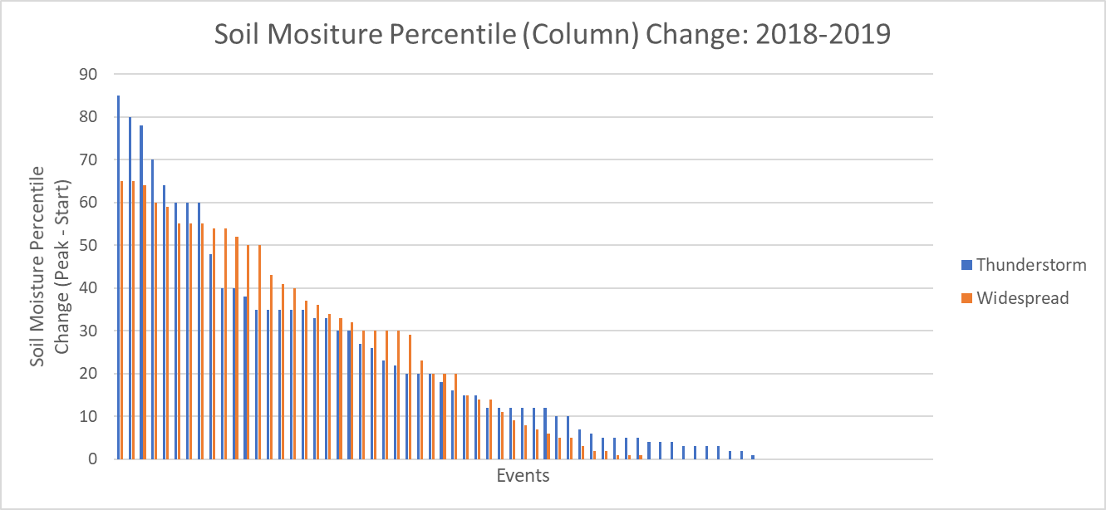
Extra Plots
Notes:
Thunderstorm Average Change: 19.7%
Widespread Average Change: 26%

Slide 38
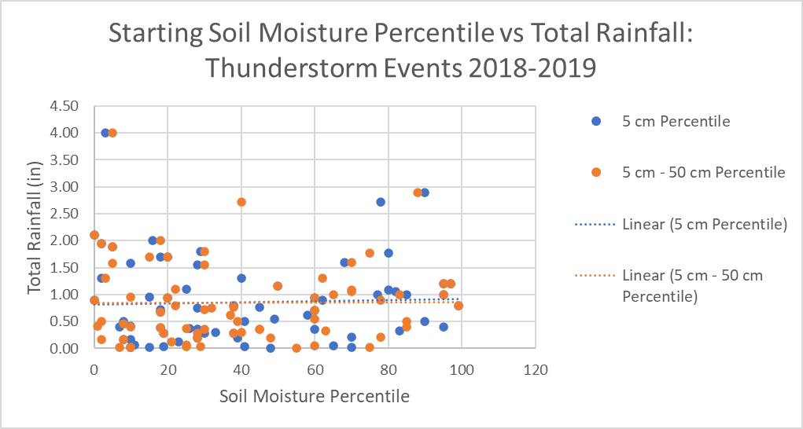
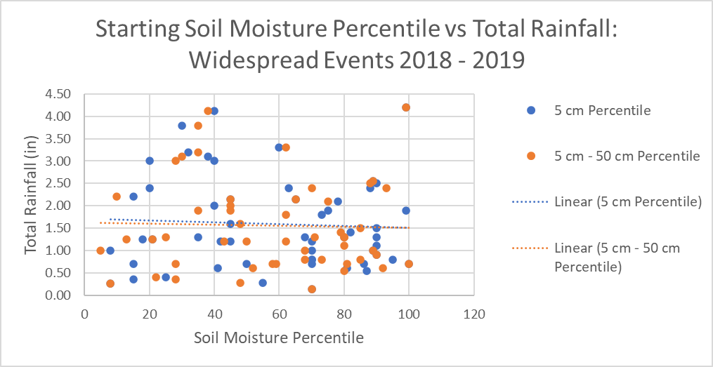
Extra Plots

Slide 39
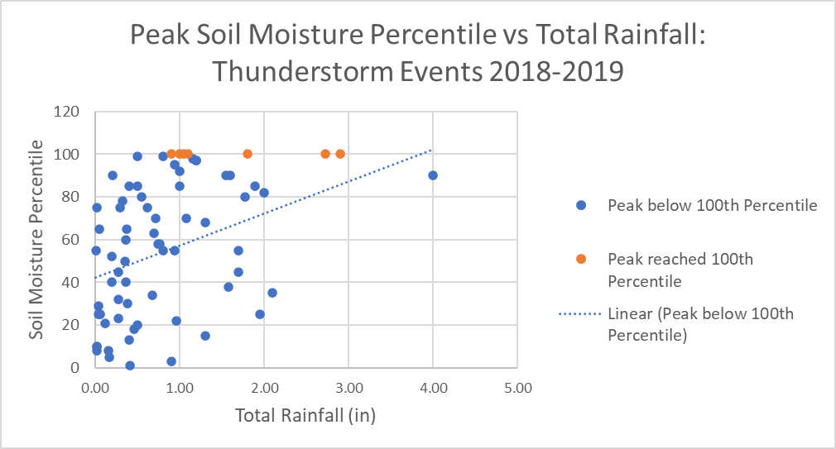
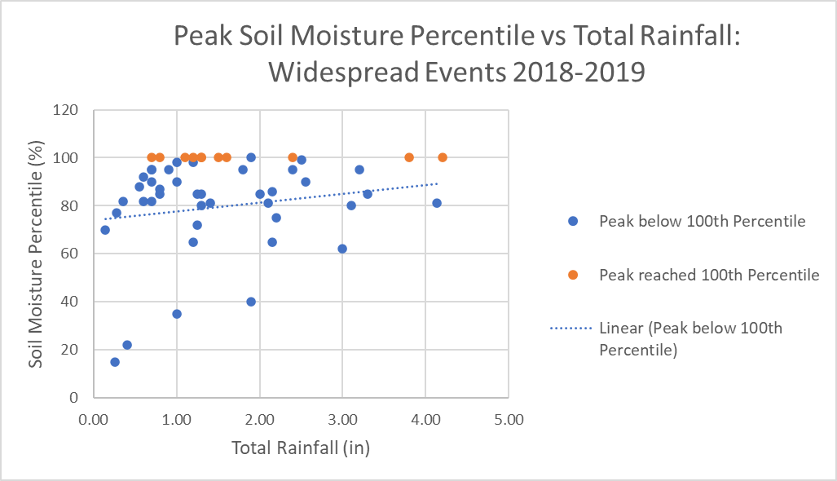
Extra Plots

Slide 40
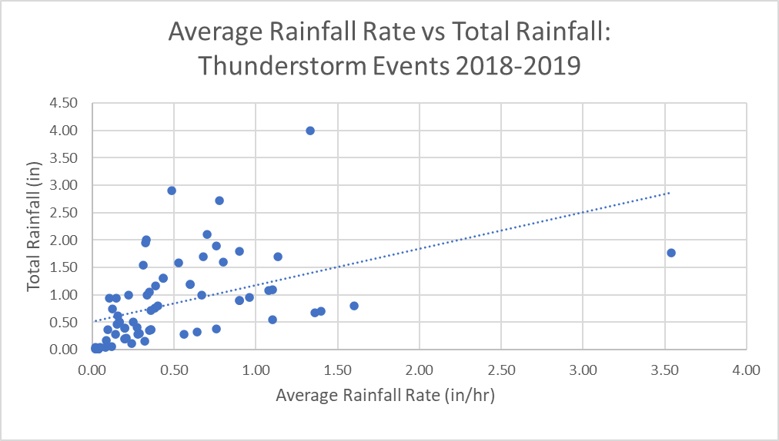
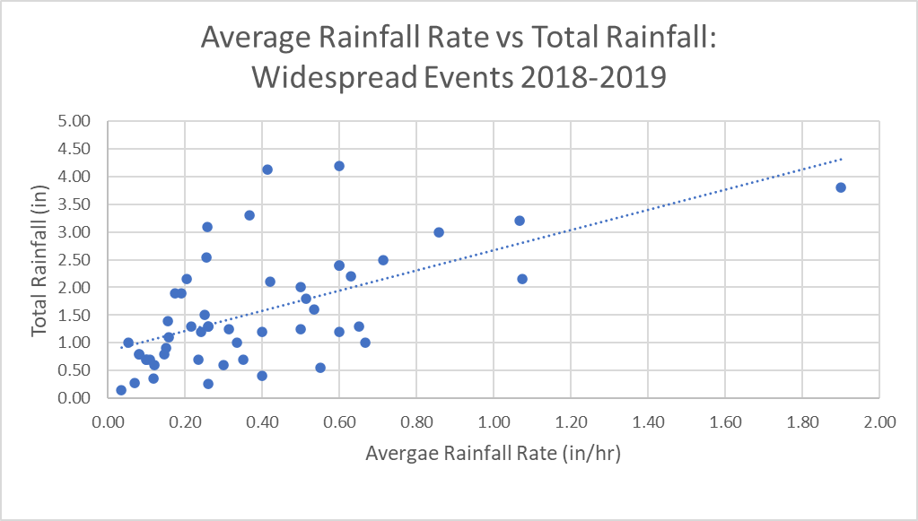
Extra Plots

Slide 41
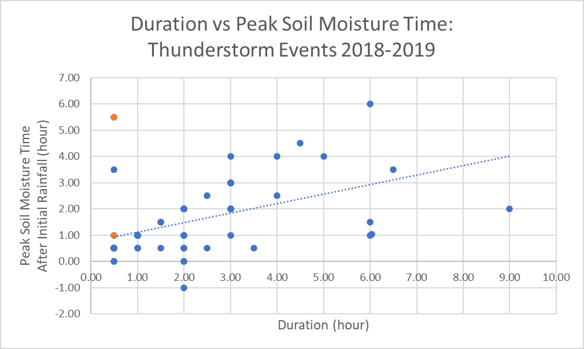
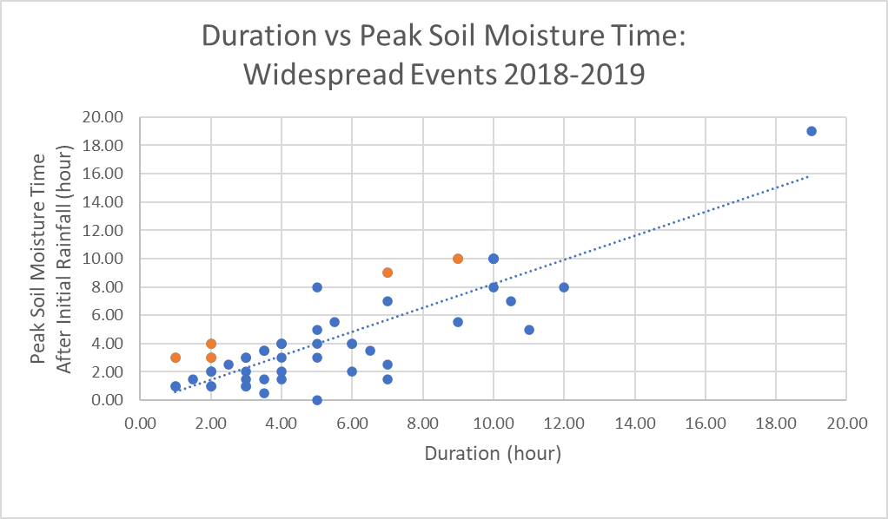
Extra Plots
Orange indicates peak after rainfall ended

Slide 42
Extra Plots

Slide 43
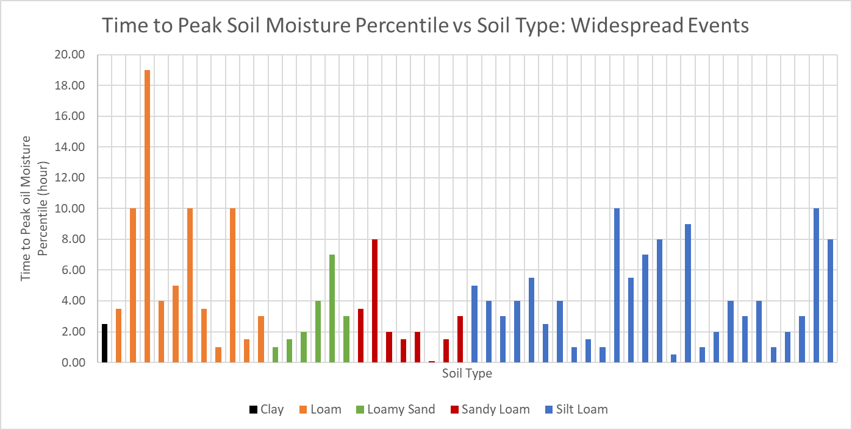
Extra Plots

Slide 44
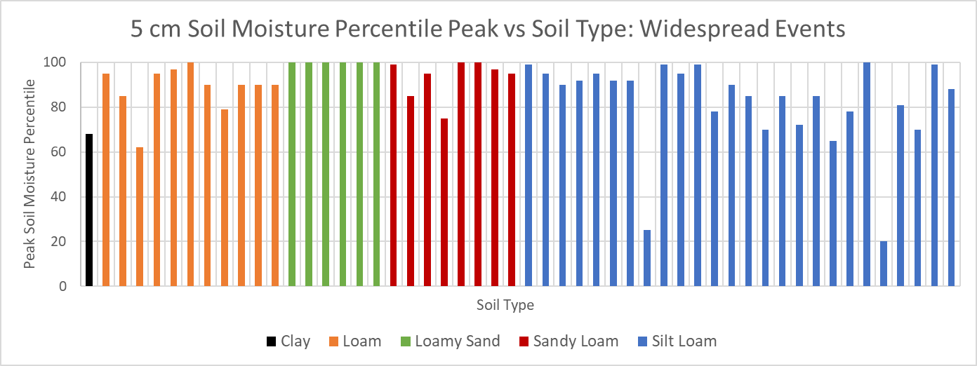
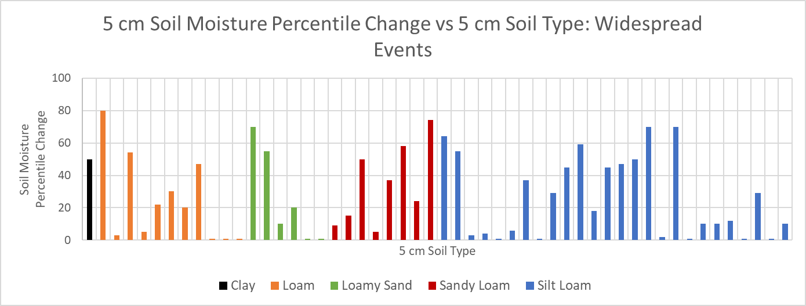
Extra Plots

