Slide 1
Isaias Retrospective
Created By Nick Bassill (for questions, please ask nbassill@albany.edu)
Presented By The UAlbany Weather Enterprise

Slide 2
Storm Highlights (from the NYS Mesonet)

Slide 5
The Forecast

Slide 6
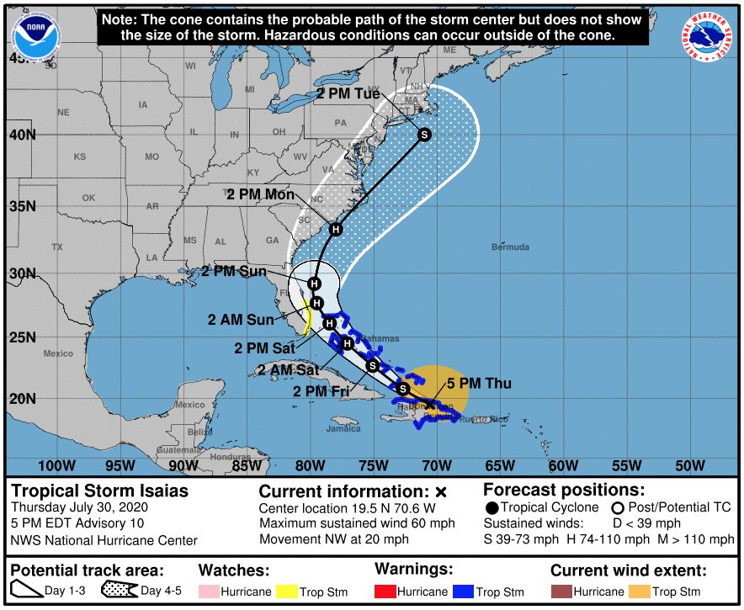
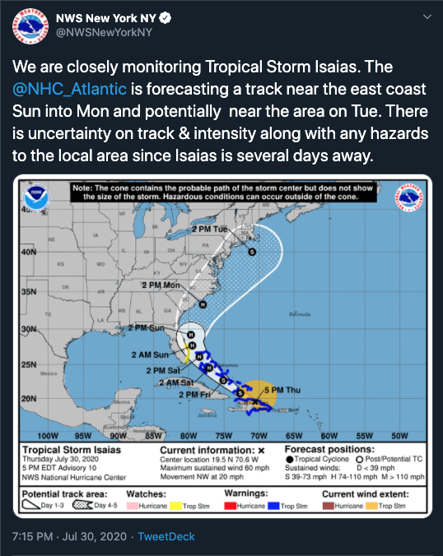
Thursday 5 PM: First Forecast With NY In The “Cone”

Slide 7
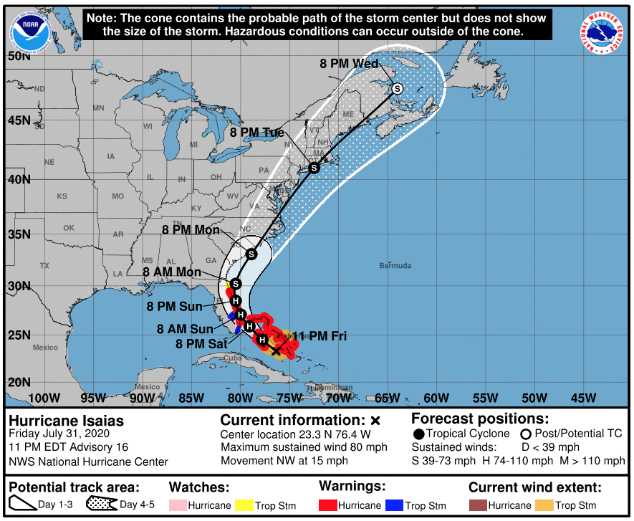
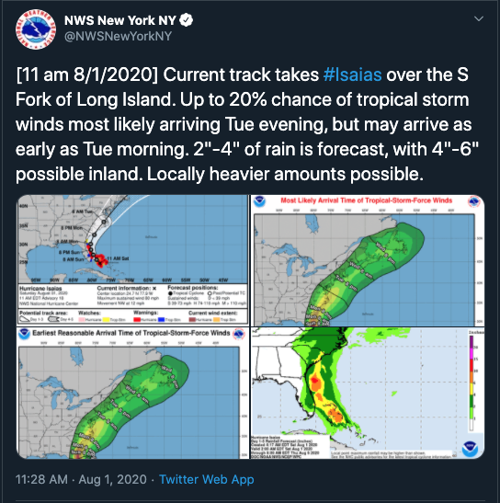
Friday 11 PM: First Forecast With A Track Crossing NY
(Next Morning)

Slide 8
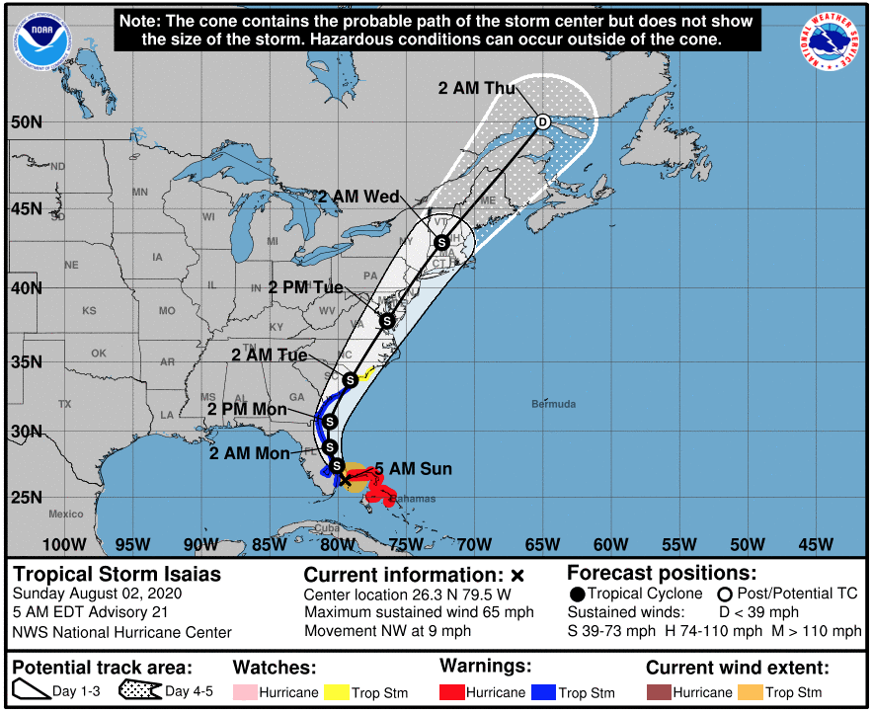
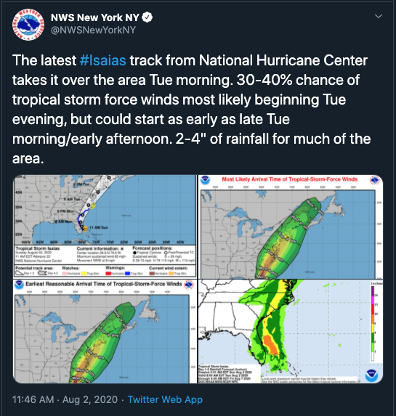
Sunday 5 AM: First Forecast With A Track West Of NYC
(6 Hours Later)

Slide 9
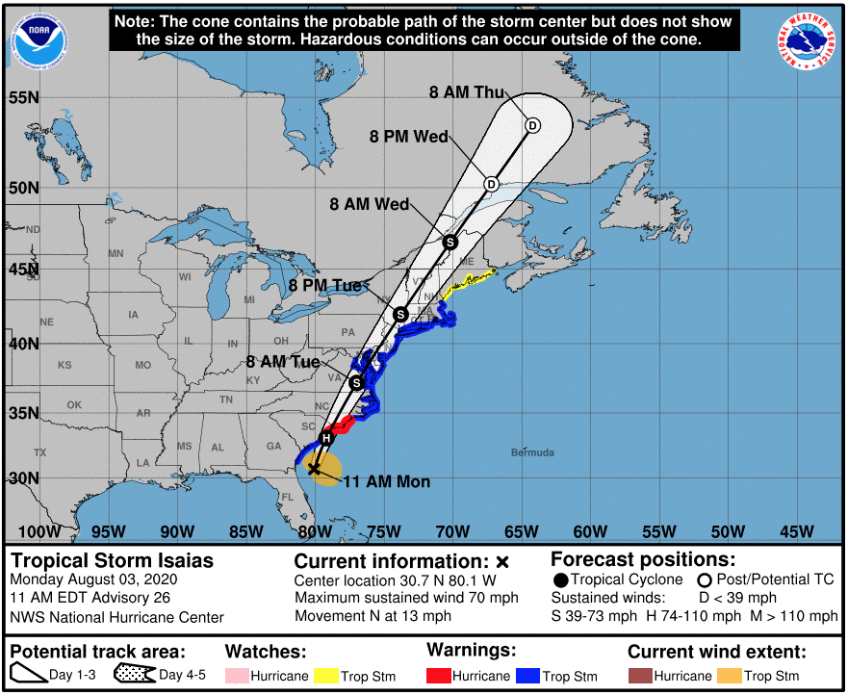
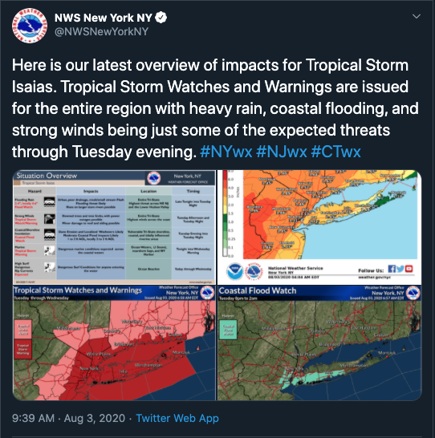
Monday 11 AM: First Forecast With Accurate Path
(2 Hours Earlier)

Slide 10
Monday 11 AM: First Forecast With Accurate Path
(2 Hours Earlier)

Slide 11
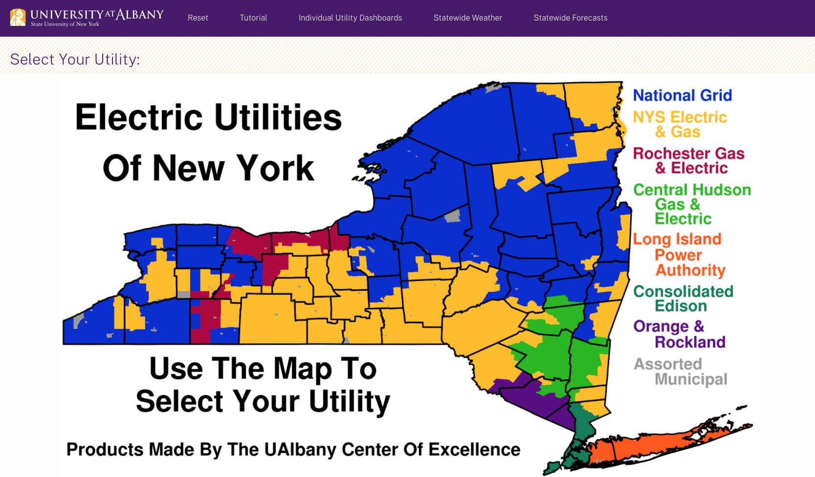
UAlbany Utility Dashboard Forecast

Slide 12
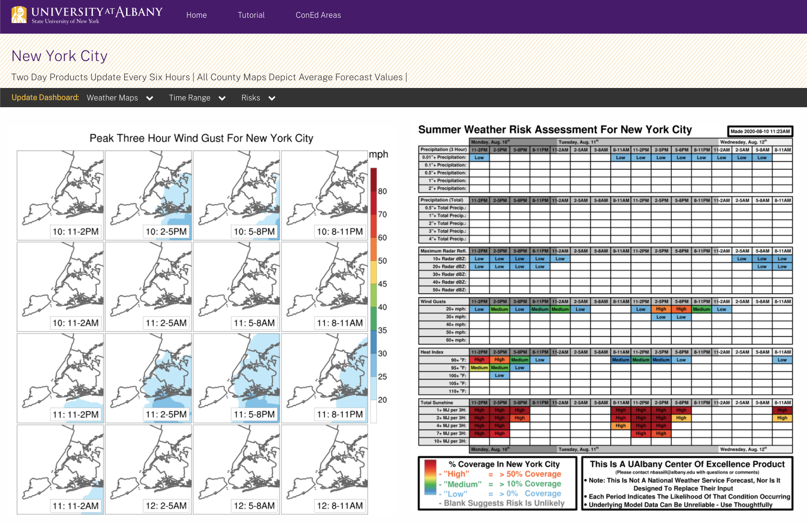
(2 Day Outlook From Monday Morning)
60+ mph winds possible between 11AM-8PM

Slide 13
(NYC 2 Day Outlook From Monday Morning)
60+ mph winds possible between 11AM-8PM

Slide 14
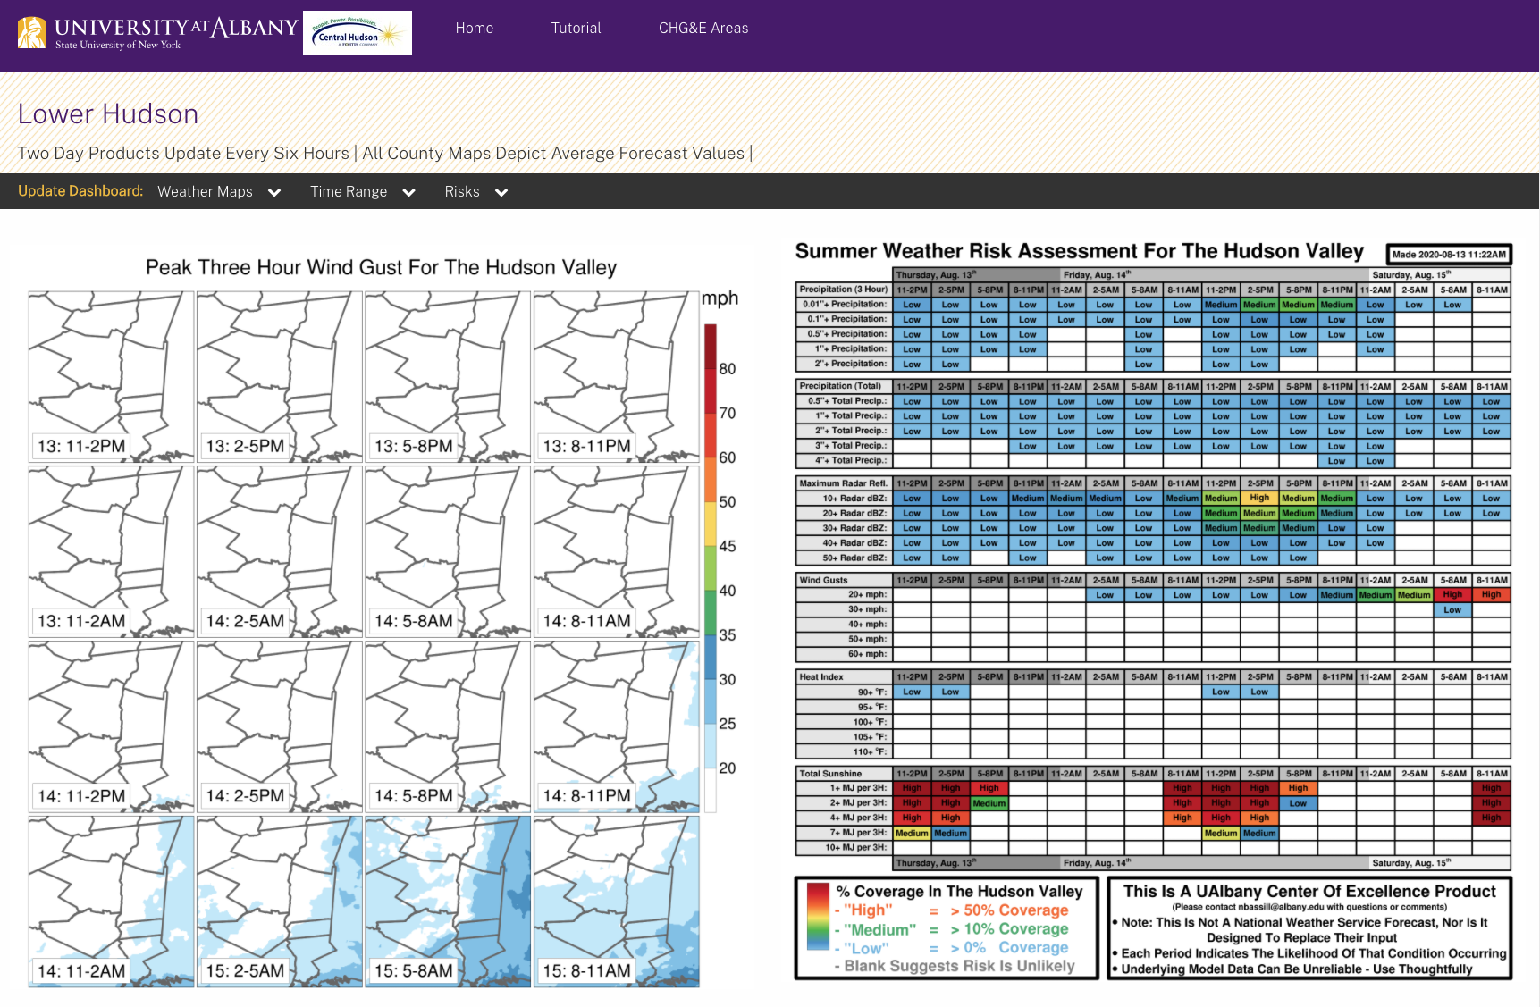
(Hudson Valley 2 Day Outlook From Monday Morning)
60+ mph winds possible between 2PM-8PM

Slide 15
(Hudson Valley 2 Day Outlook From Monday Morning)
4+ inches of rain possible by 8PM

Slide 16
What Happened (By The NYS Mesonet)

Slide 17
(Path of Isaias)

Slide 18
Biggest Gusts *Right* Of Track
(Path of Isaias)

Slide 19
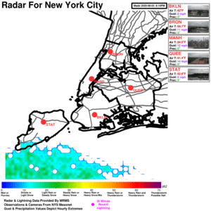
Why Was There So Much Damage In NYC? Data From Queens NYS Mesonet Site 1) A Combination of strong peak gusts (70+ mph) 2) Long duration of 40+ mph gusts (~5 hours) 3) 40+ mph gusts from every direction between East → South → West (full 175º range) 4) Very rare to see southeast winds this strong
8PM Monday- 8PM Tue. Data
⎕ 10:30 AM-3:30 PM

Slide 20
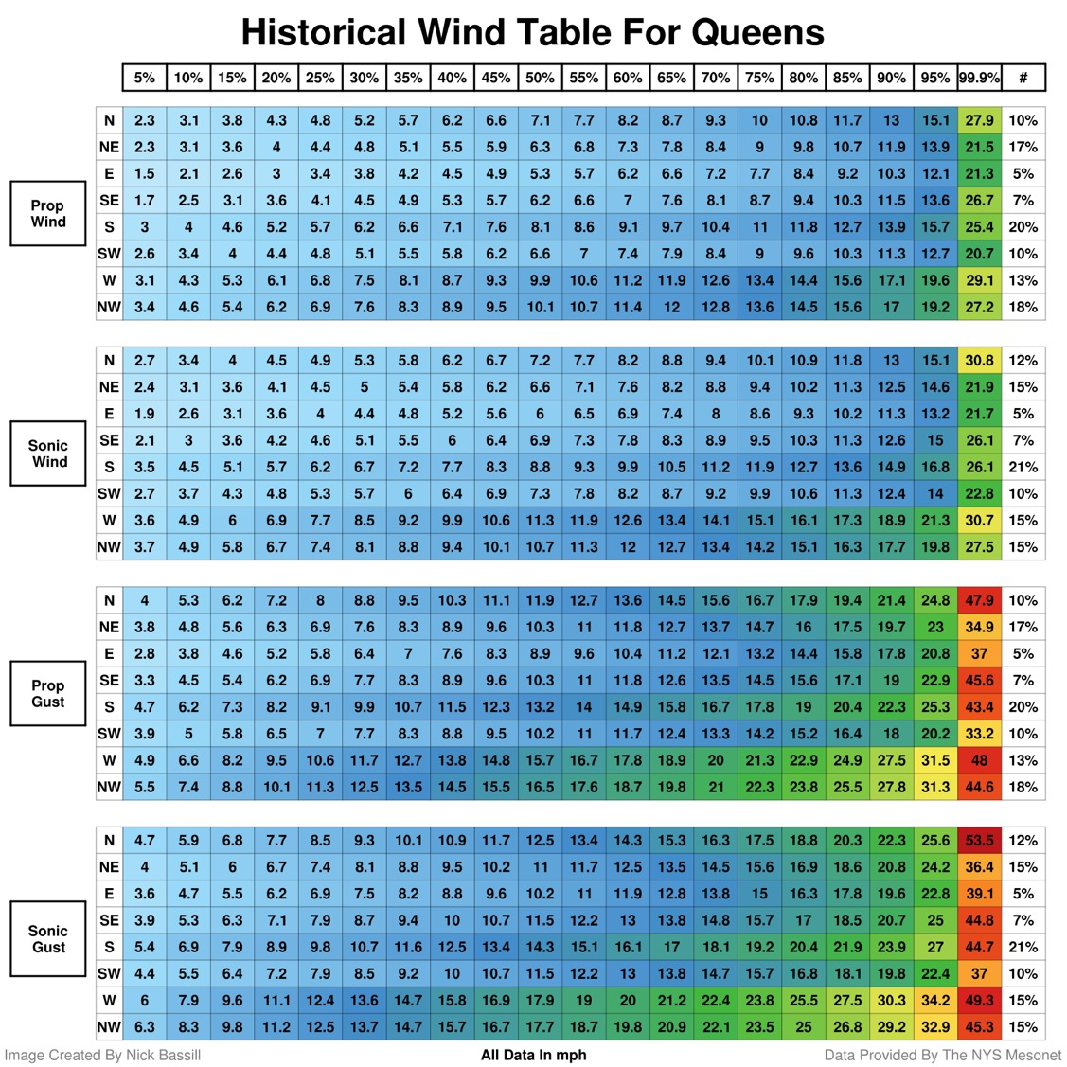
How Rare Are 40-70 mph Southeast Wind Gusts At Queens? 1) Historically, winds only come from the east or southeast a total of 12% of the time 2) In the 7% of the time the winds come from the southeast, only one in a thousand gusts is 44.8 mph or higher 3) In Isaias, numerous gusts of 40-70 mph were reported from the southeast

Slide 21
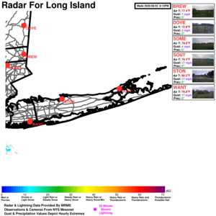
Nassau County Analysis Data From Wantagh NYS Mesonet Site 1) Peak gusts near 70 mph 2) Long duration of 40+ mph gusts (~6 hours) 3) 40+ mph gusts from every direction between ESE → South → SW (full 130º range) 4) Very rare to see southeast winds this strong
8PM Monday- 8PM Tue. Data
⎕ 11:00 AM-5:00 PM

Slide 22
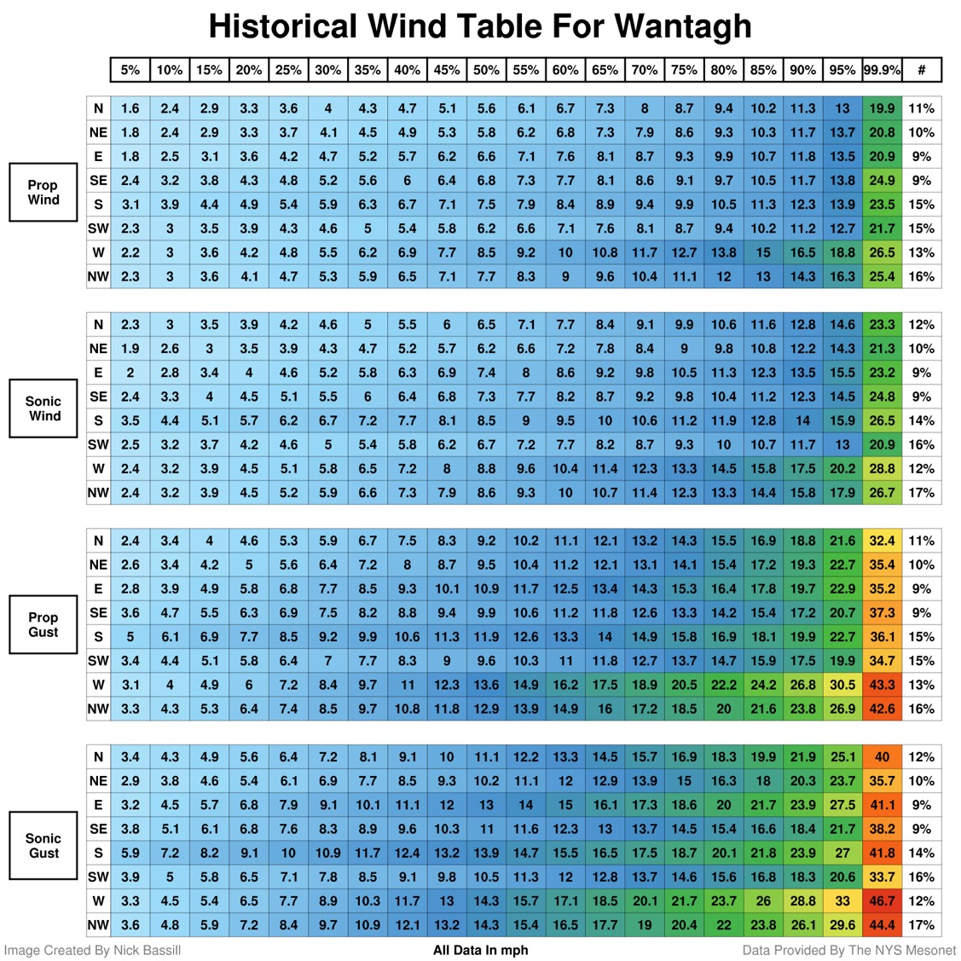
How Rare Are 40-70 mph Southeast Wind Gusts At Wantagh? 1) Historically, winds only come from the east or southeast a total of 18% of the time 2) In the 9% of the time the winds come from the east, only one in a thousand gusts is 38.2 mph or higher 3) In Isaias, numerous gusts between 40-70 mph were reported from the southeast

Slide 23
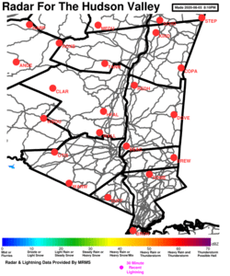
Westchester County Analysis Data From Somers NYS Mesonet Site 1) Peak gusts near 57 mph from the southeast 2) Lengthy period of 35+ mph gusts (~8 hours, with a gap in the middle) 3) 35+ mph gusts from every direction between East → South → SW (full 130º range)
8PM Monday- 8PM Tue. Data
⎕ 11:30 AM-8:00 PM

Slide 24
How Rare Are 57 mph Southeast Wind Gusts At Somers? 1) Historically, winds only come from the southeast a total of 11% of the time 2) In this 11%, only one in a thousand gusts is 31.8 mph or higher 3) In Isaias, 57 mph gusts were reported from the southeast

Slide 25
Putnam County Analysis Data From Brewster NYS Mesonet Site 1) Peak gusts near 45 mph from the south-southeast 2) Lengthy period of 30+ mph gusts (~8 hours, with a gap in the middle) 3) 30+ mph gusts from every direction between Southeast → South → West (full 130º range) 4) Given area topography, it’s likely stronger wind gusts occurred nearby that may not be reflected here
8PM Monday- 8PM Tue. Data
⎕ 11:00 AM-7:00 PM

Slide 26
How Rare Are 45 mph Southeast Wind Gusts At Brewster? 1) Historically, winds only come from the east or southeast a total of 13% of the time 2) In the 8% winds come from the southeast, only one in a thousand gusts is 23.4 mph or higher 3) In Isaias, 45 mph gusts were reported from the southeast 4) Given nearby topography, it’s quite likely stronger gusts were observed at other locations in or near Putnam

Slide 27
Rockland County Analysis Data From Suffern NYS Mesonet Site 1) Peak gusts near 52 mph 2) Brief duration of 40+ mph gusts on either side of Isaias 3) 40+ mph gusts from both southeast and west 4) 1.6” of rainfall on the day before strongest gusts
8PM Monday- 8PM Tue. Data
⎕ 12:30 PM-6:00 PM

Slide 28
How Rare Are 40 mph Southeast Wind Gusts At Suffern? 1) Historically, winds only come from the southeast a total of 7% of the time 2) In this 7%, only one in a thousand gusts is 23 mph or higher 3) In Isaias, 44 mph gusts were reported from the southeast 4) Wind gusts from the west are more common (and can be stronger), but 50+ mph gusts are still quite rare

Slide 29
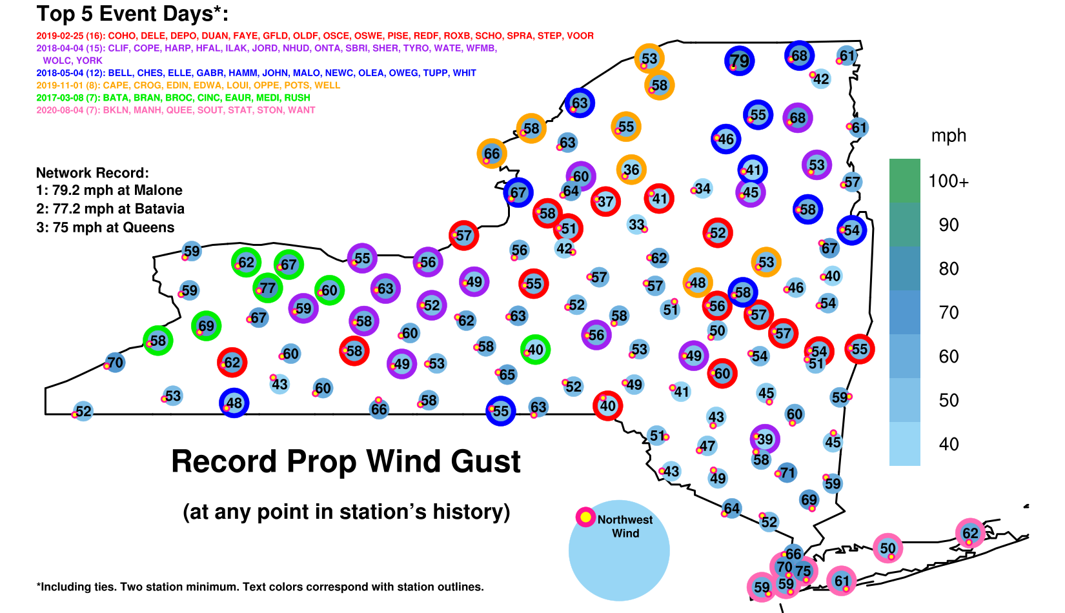
Sites In Pink Set All-time Wind Gust Records From Isaias

Slide 30
Heavy Rain *Left* Of Track
(Path of Isaias)

Slide 31
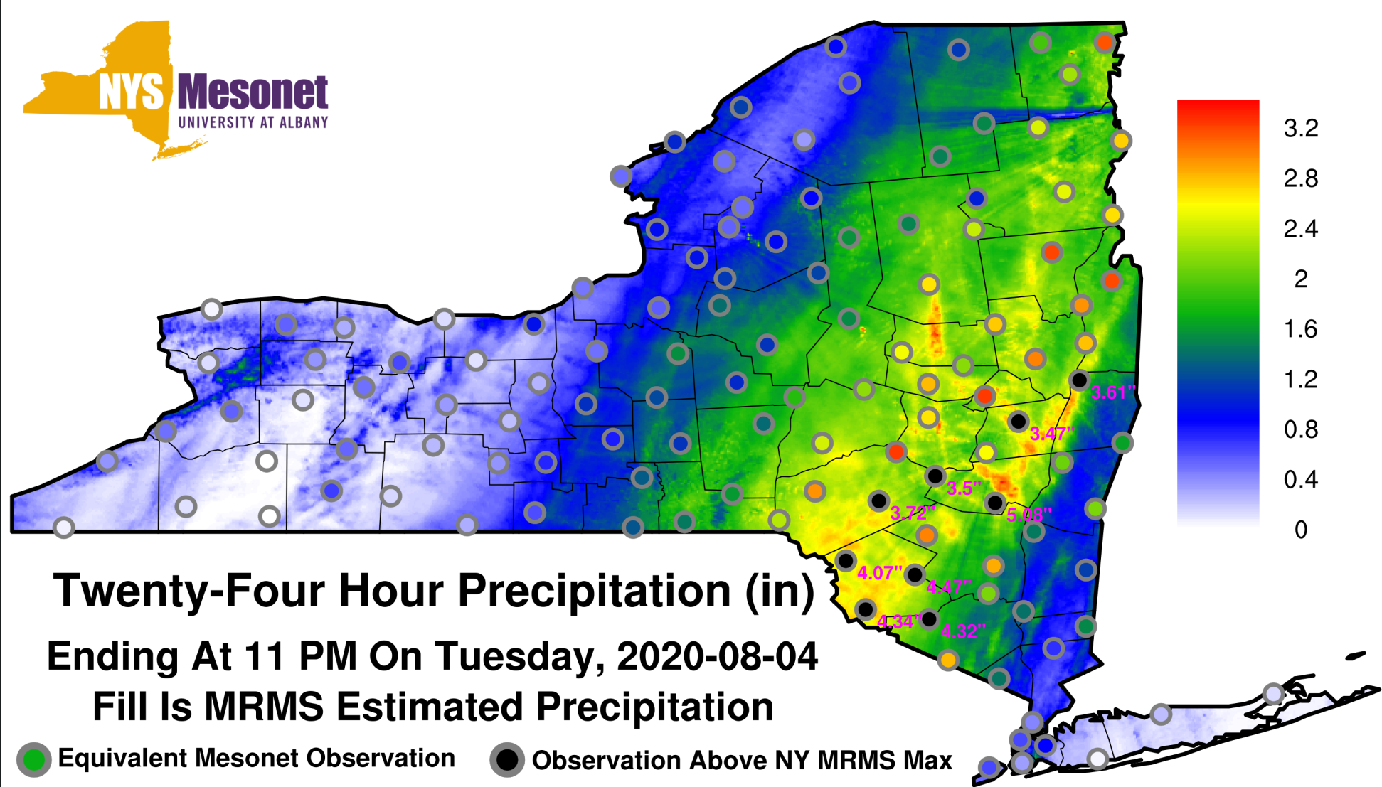
NYSM Data Tells You What Radar Can’t

Slide 32
UAlbany Engagement on Isaias
Currently working on outage models, or have proposals to do so, for four downstate utilities
Discussed possible impacts and likely track of Isaias with multiple utilities in the lead-up to the storm
After the storm, evaluated what went right/wrong with the forecast (akin to this presentation)
NYS Mesonet data was instrumental in evaluating what was occurring during the storm

Slide 33
Next Steps
(a) DPS-led Dashboard: Establish Mesonet data feed – Jerry
(b) DPS-led Review of Isaias: We can provide assistance - Nick/Jerry
(c) Exploiting UAlbany-Utility Dashboard and related Expertise:
* Regroup with Utilities to debrief on Isaias (users and leadership)
* Get Weather information into the hands of those that need it
* Discuss research interests shared by all utilities
* Discuss funding opportunity (NSF)

