Slide 1
Isaias Retrospective
Created By Nick Bassill (for questions, please ask nbassill@albany.edu)
Presented By The UAlbany Weather Enterprise

Slide 2
The Forecast

Slide 3
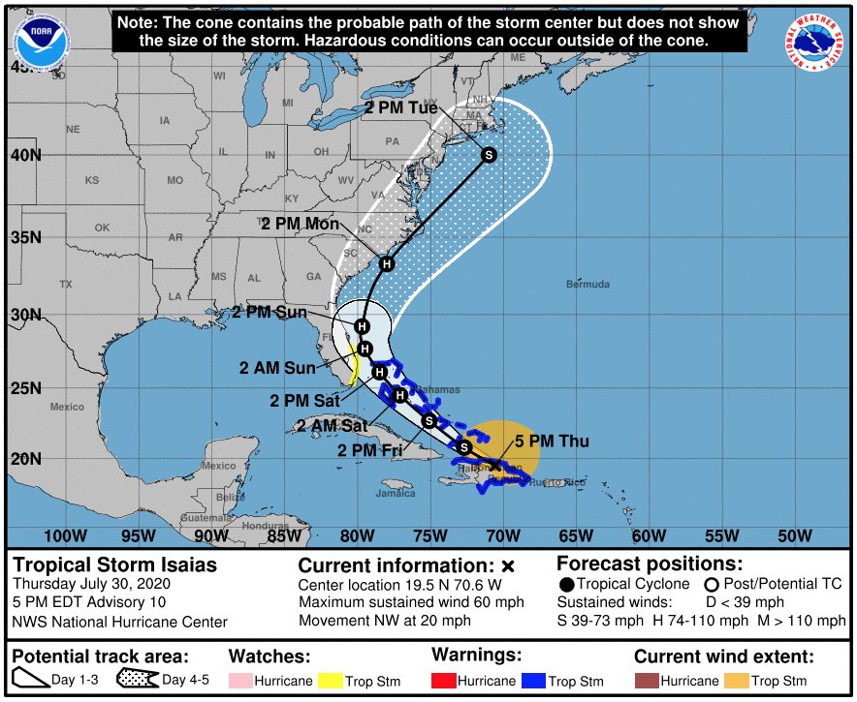
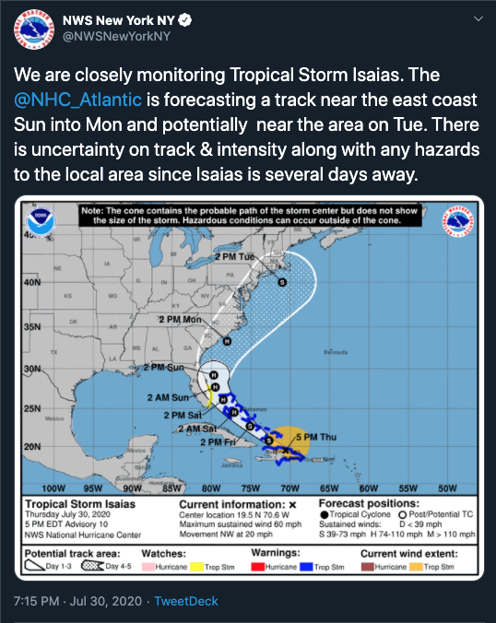
Thursday 5 PM: First Forecast With NY In The “Cone”

Slide 4
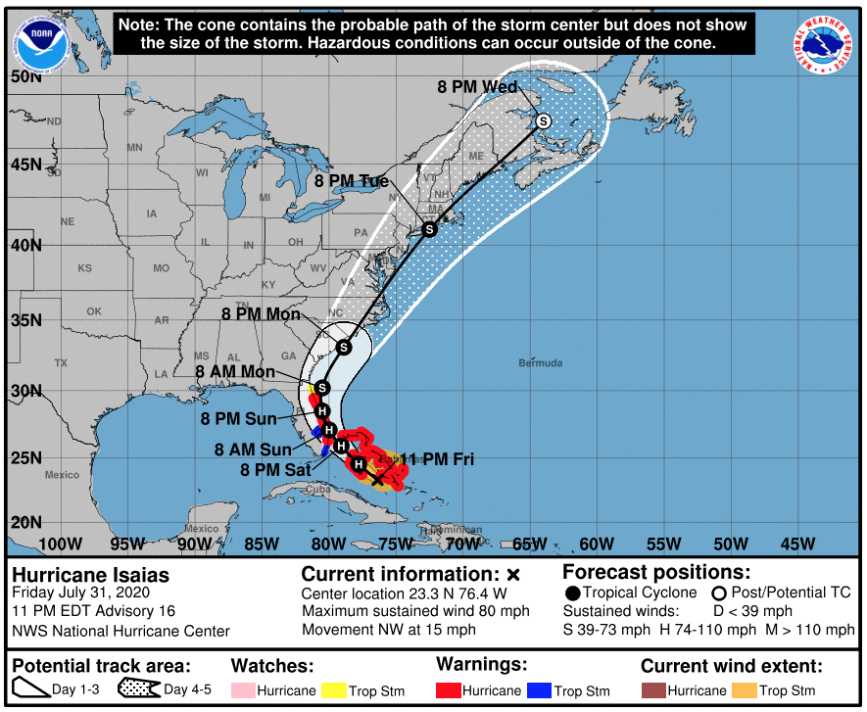
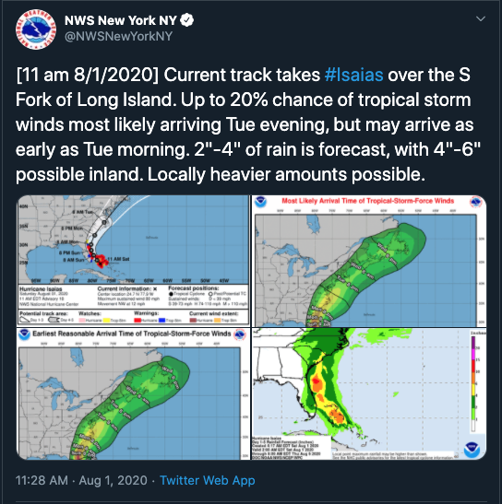
Friday 11 PM: First Forecast With A Track Crossing NY
(Next Morning)

Slide 5
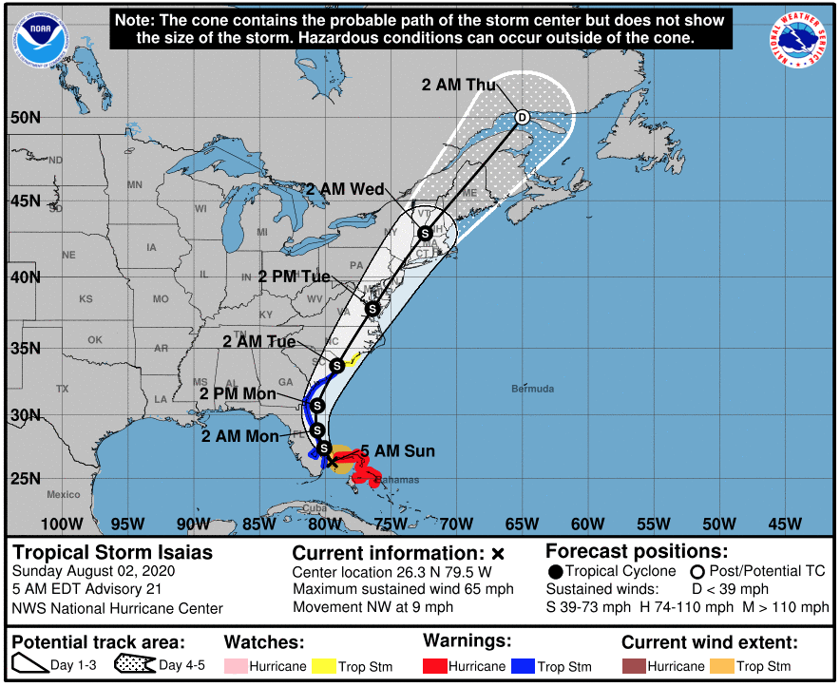
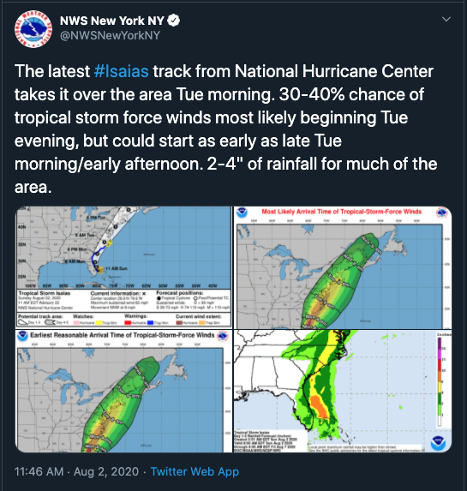
Sunday 5 AM: First Forecast With A Track West Of NYC
(6 Hours Later)

Slide 6
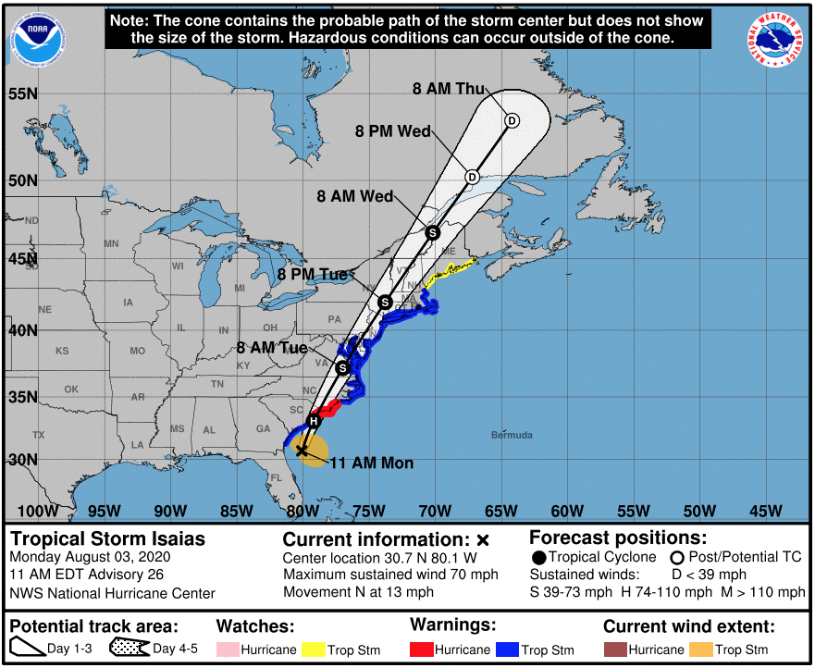
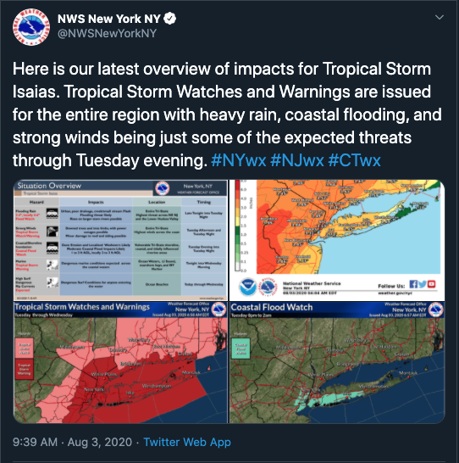
Monday 11 AM: First Forecast With Accurate Path
(2 Hours Earlier)

Slide 7
Monday 11 AM: First Forecast With Accurate Path
(2 Hours Earlier)

Slide 8
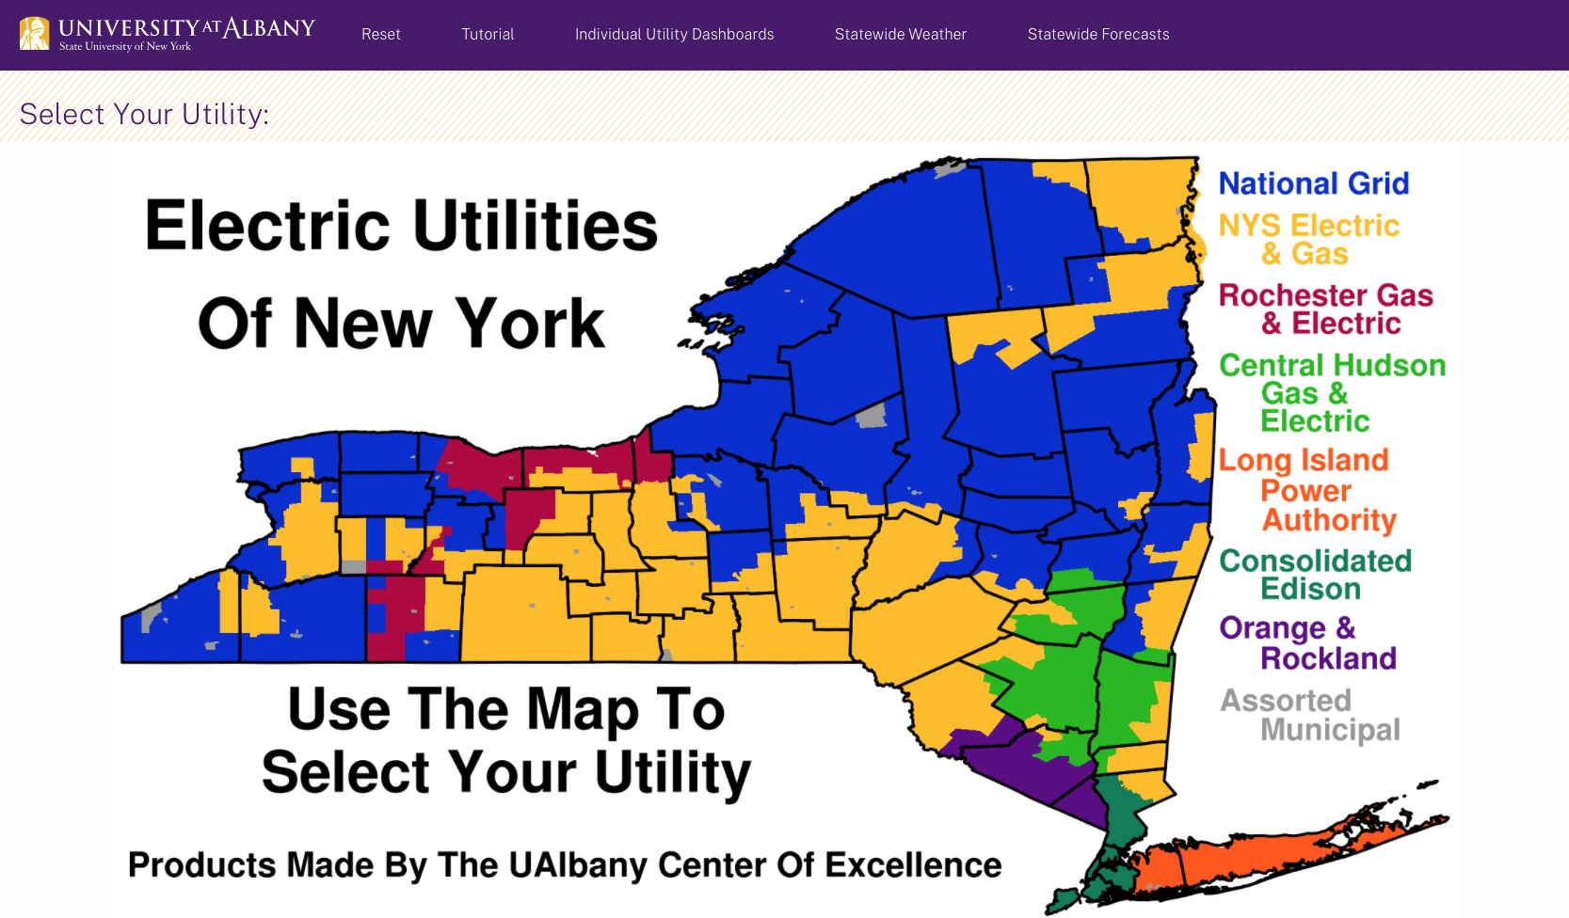
UAlbany Utility Dashboard Forecast

Slide 9
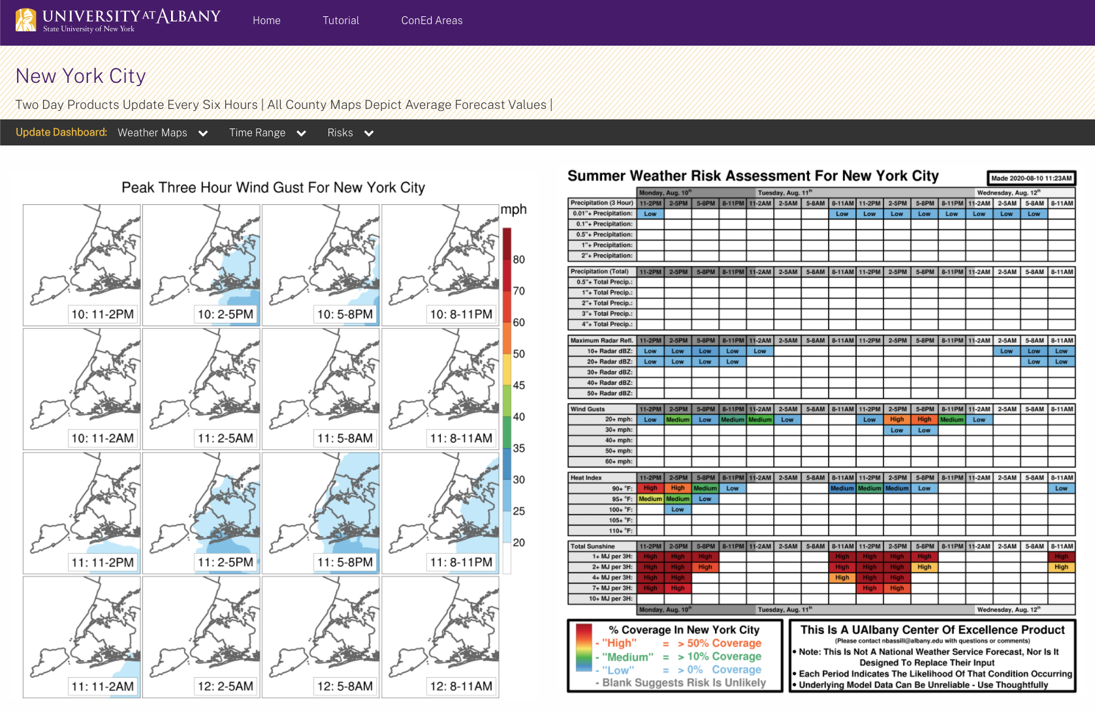
(2 Day Outlook From Monday Morning)
60+ mph winds possible between 11AM-8PM

Slide 10
(2 Day Outlook From Monday Morning)
60+ mph winds possible between 11AM-8PM

Slide 11
What Happened (By The NYS Mesonet)

Slide 12
(Path of Isaias)

Slide 13
Biggest Gusts *Right* Of Track
(Path of Isaias)

Slide 14
Why Was There So Much Damage In NYC? 1) A Combination of strong peak gusts (70+ mph) 2) Long duration of 40+ mph gusts (5 hours) 3) 40+ mph gusts from every direction between East → South → West 4) Very rare to see southeast winds this strong
⎕ 10:30 AM-3:30 PM

Slide 15
Heavy Rain *Left* Of Track
(Path of Isaias)

Slide 16
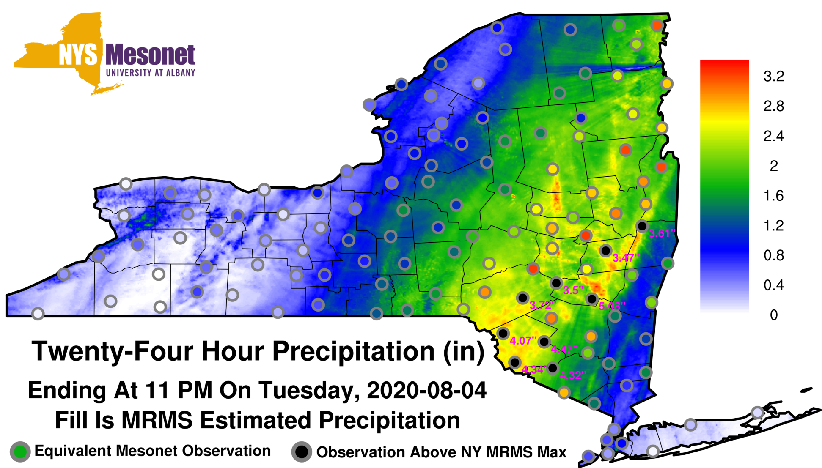
NYSM Data Tells You What Radar Can’t

Slide 17
UAlbany Engagement on Isaias
Currently working on outage models, or have proposals to do so, for four downstate utilities
Discussed possible impacts and likely track of Isaias with multiple utilities in the lead-up to the storm
After the storm, evaluated what went right/wrong with the forecast (akin to this presentation)
NYS Mesonet data was instrumental in evaluating what was occurring during the storm

Slide 18
Next Steps
(a) DPS-led Dashboard: Establish Mesonet data feed – Jerry
(b) DPS-led Review of Isaias: We can provide assistance - Nick/Jerry
(c) Exploiting UAlbany-Utility Dashboard and related Expertise:
* Regroup with Utilities to debrief on Isaias (users and leadership)
* Get Weather information into the hands of those that need it
* Discuss research interests shared by all utilities
* Discuss funding opportunity (NSF)

